Slide 1
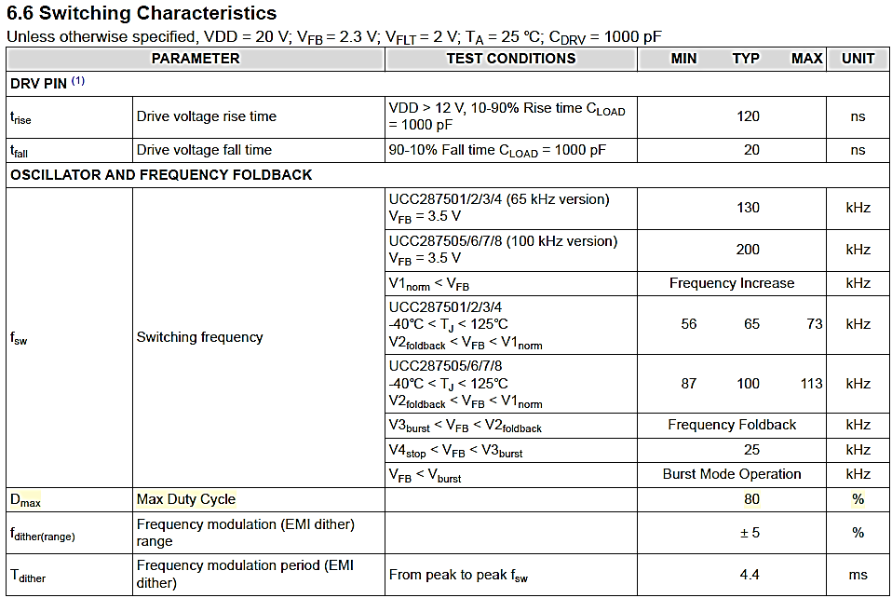
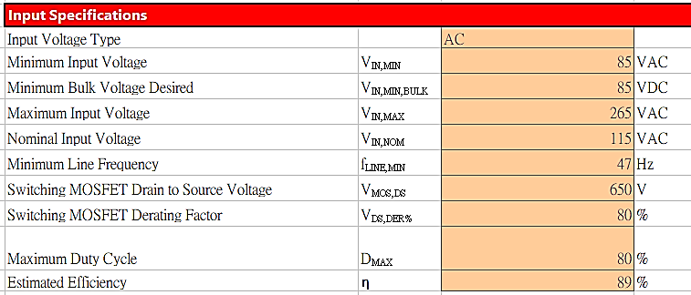
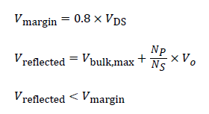
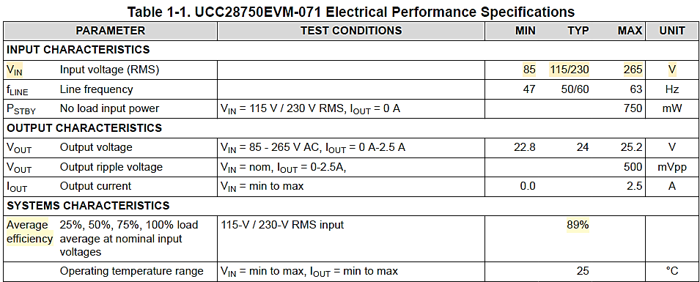
1、input specifications
IPP65R190C7 SPEC
UCC28750 SPEC
UCC28750 SPEC

Slide 2
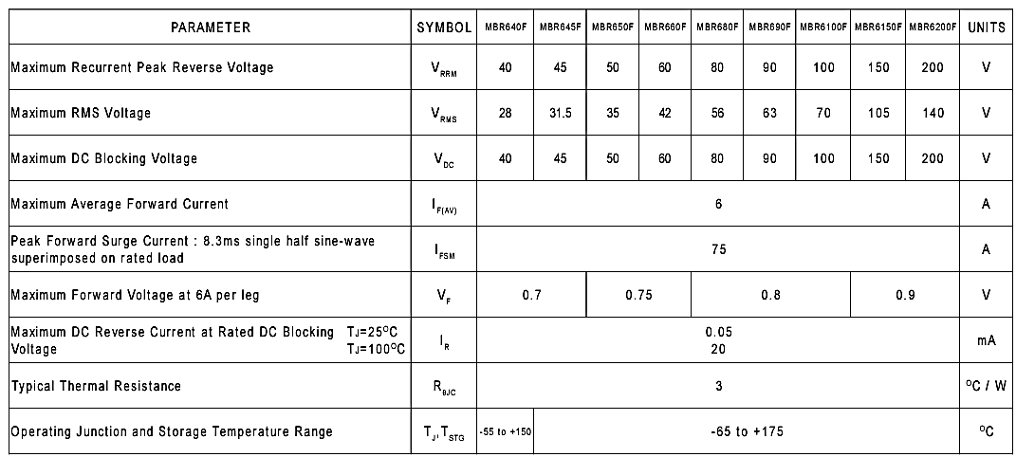
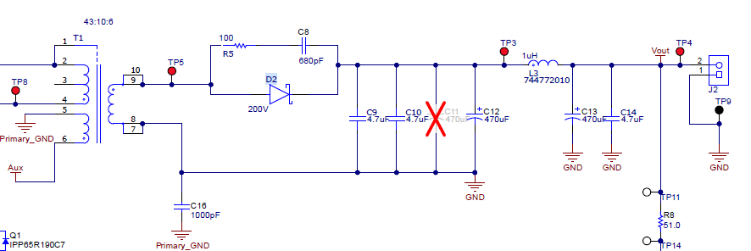
2、output specifications
Can't find relevant information, fill in 5% temporarily
MBR6200F_T0_00001 SPEC
Schematic of UCC28750EVM-071

Slide 3
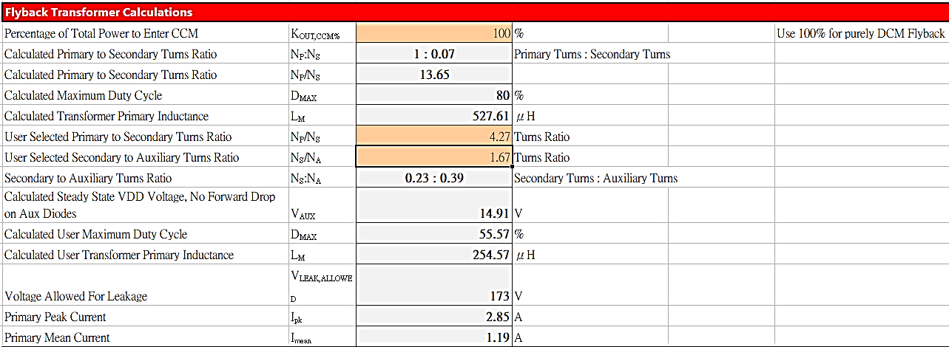
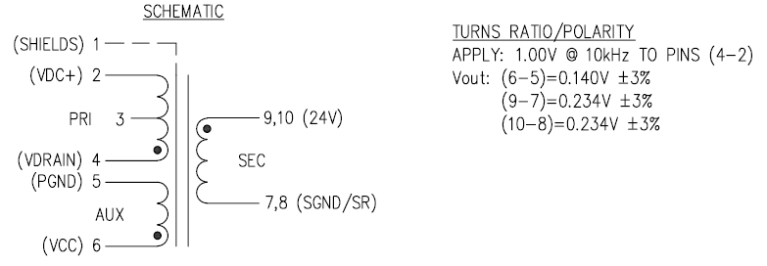
3、flyback transformer calculations
Can't find relevant information, fill in 100% temporarily
Transfomer RLTI-1450 SPEC

Slide 4
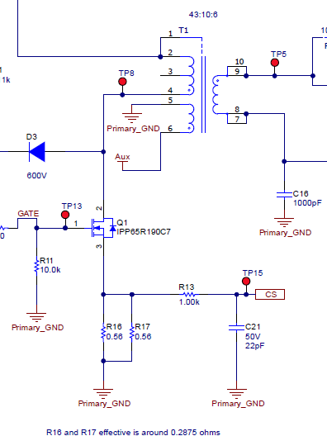
4、current sense resister calculations
Schematic of UCC28750EVM-071
Rslope
Rcs

Slide 5
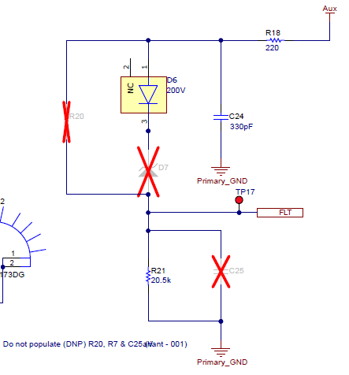
5、startup resistor calculator
Can't find relevant information, fill in 1 sec temporarily
Schematic of UCC28750EVM-071
X

Slide 6
6、overtemperature calculations
Schematic of UCC28750EVM-071
R21 is a normal resistor where EVK design ,not an NTC，
these 2 item are temporarily value.

Slide 7
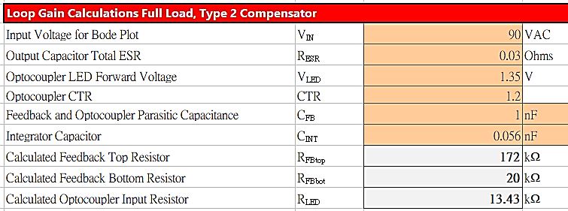
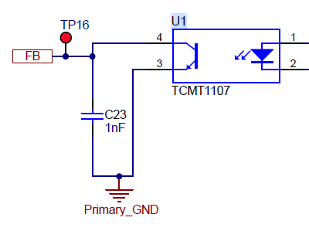
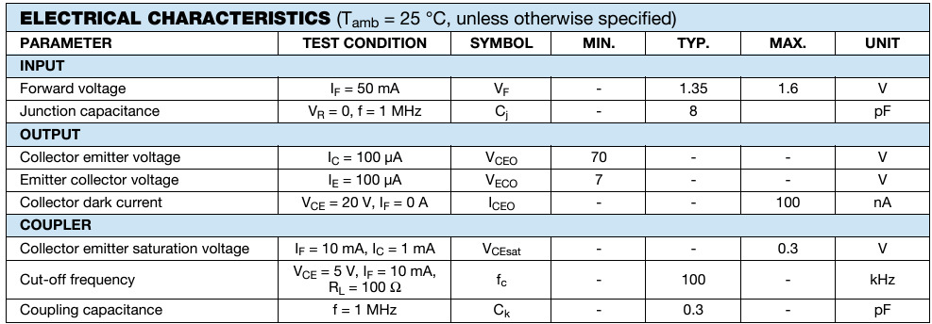
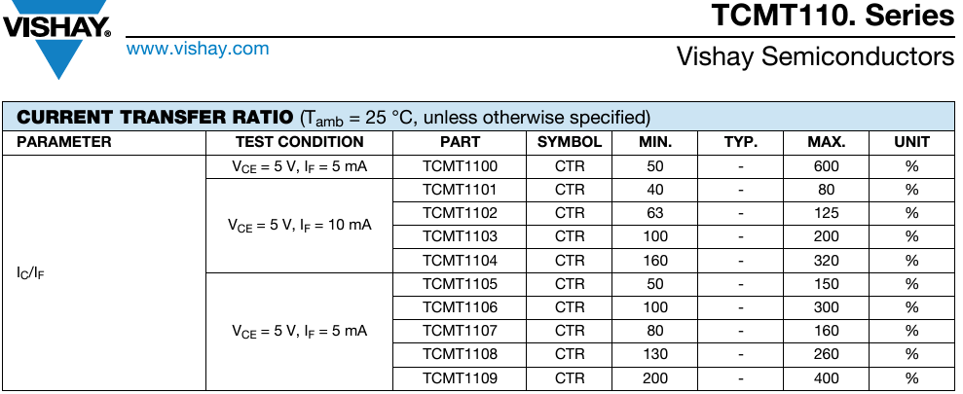
7、loop gain calculations full load, type 2 compensator
Can't find relevant information, fill in temporarily value
average
Can't find relevant information, fill in temporarily value
TCMT1107 SPEC
Schematic of UCC28750EVM-071
TCMT1107 SPEC

