Slide 1
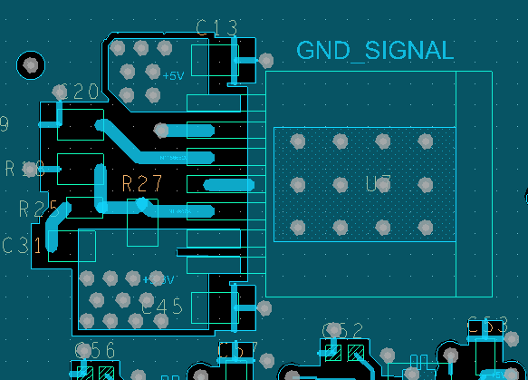
U7 5V->3.3V

Slide 2
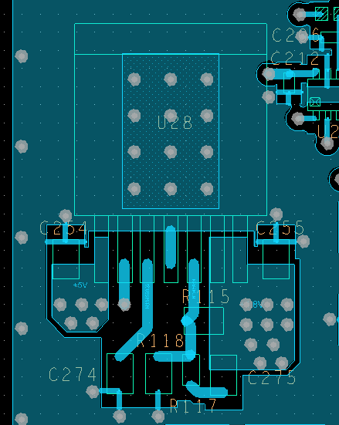
U28 5V->1.8V

