Slide 1
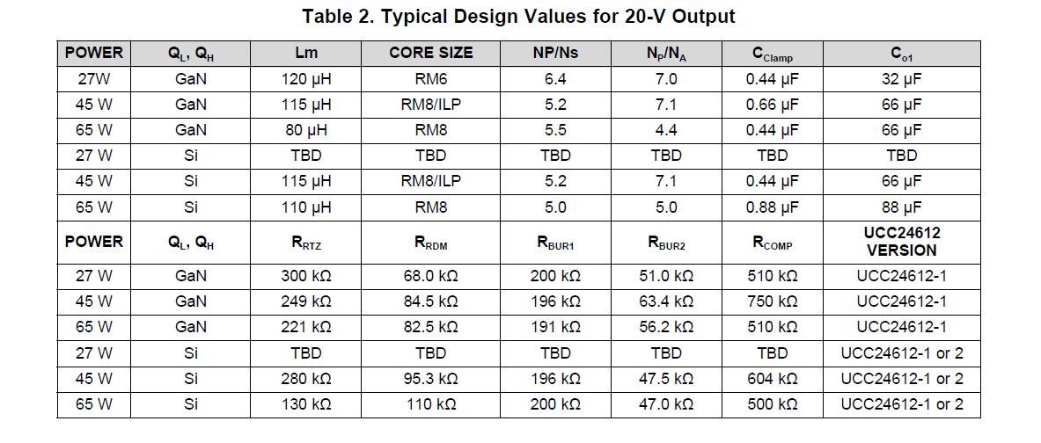

Slide 2
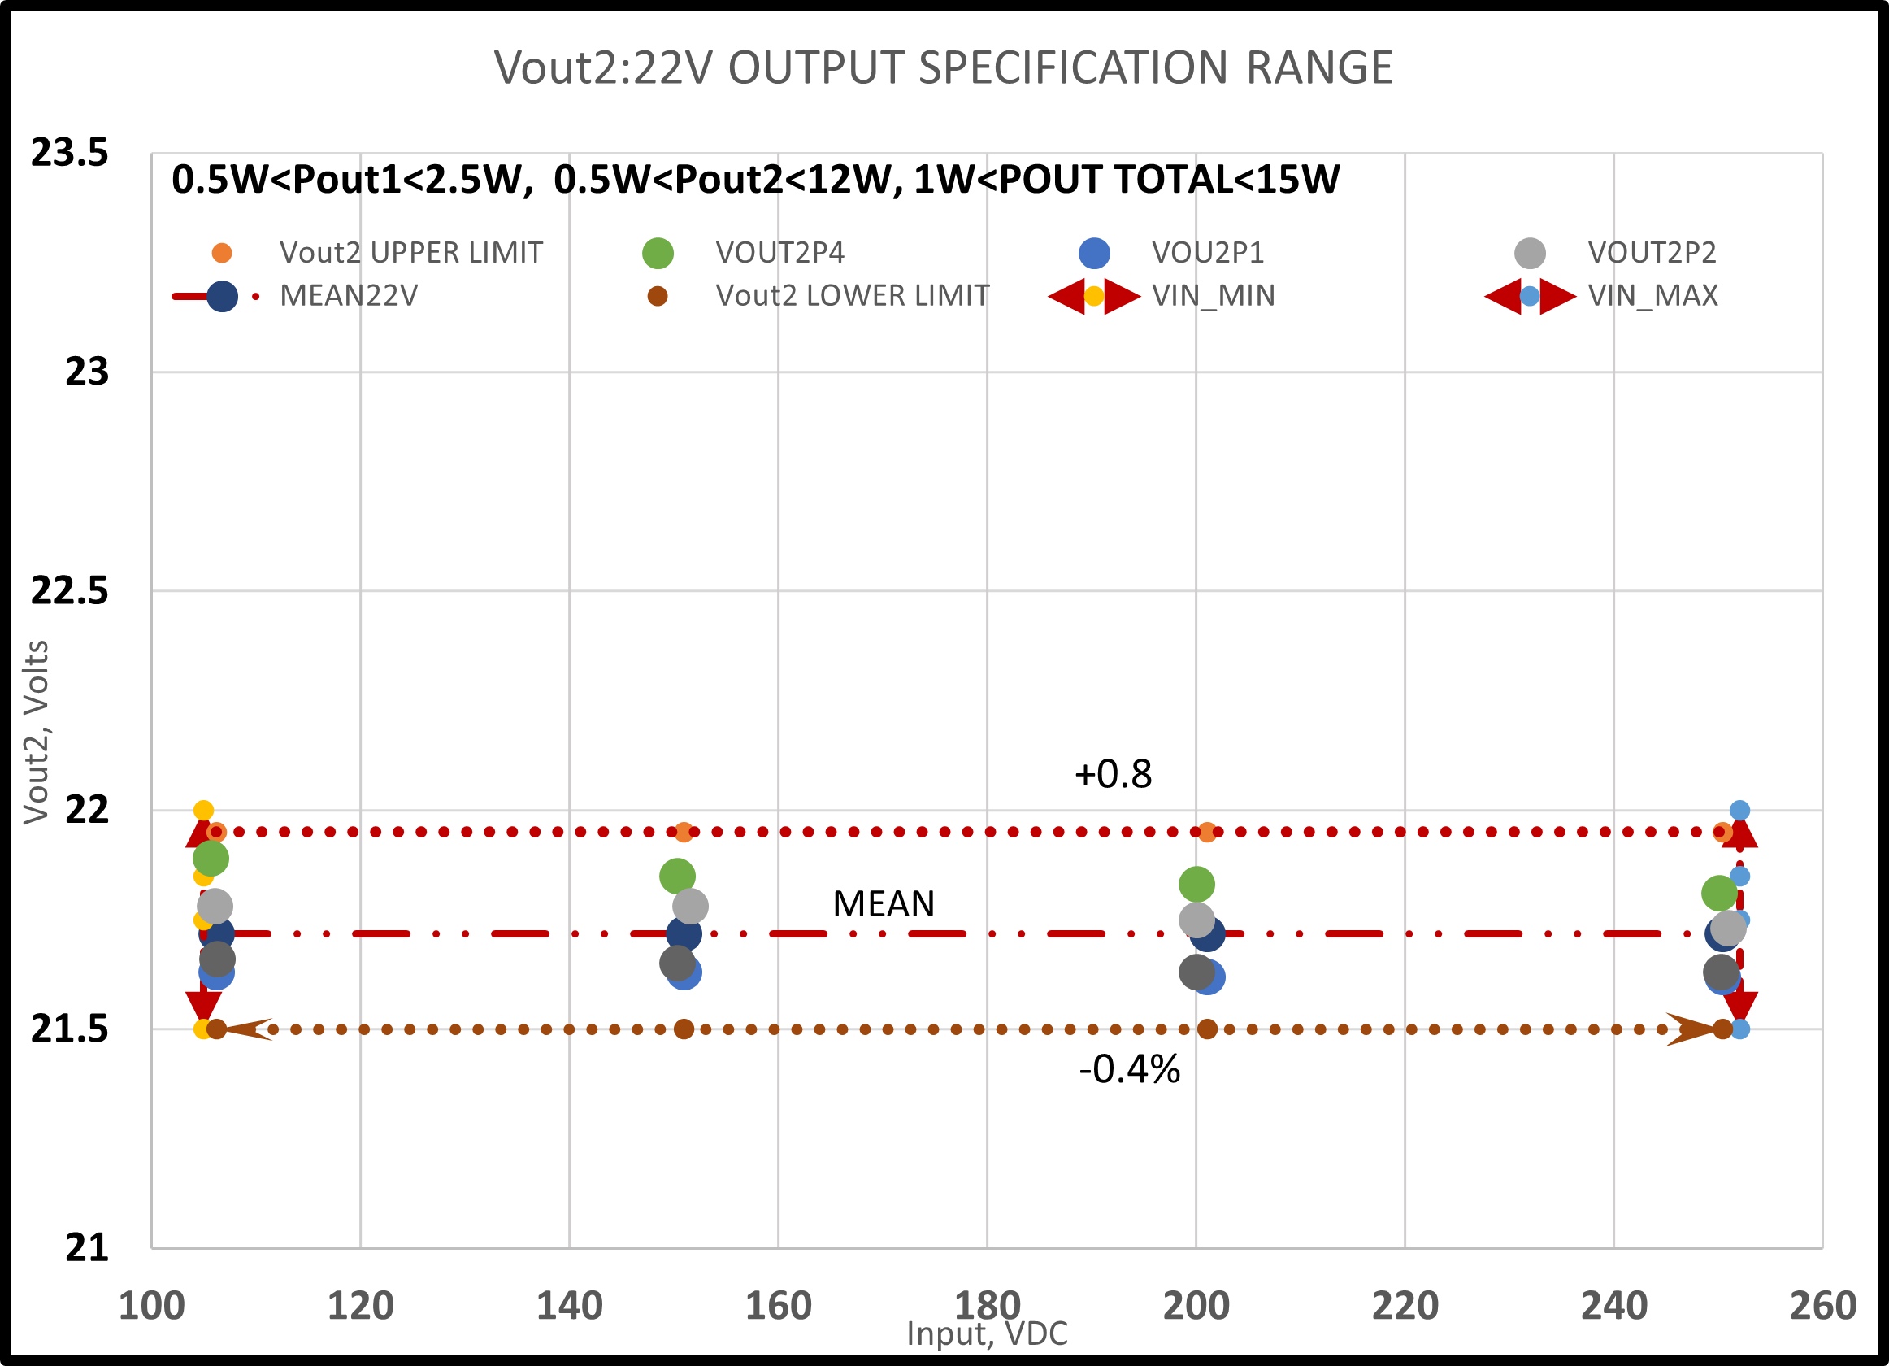
4-corner domain- example
load range
Vout range
Vin range
Example of “wide sense stability of a design once parameters are set and built from

