Slide 1
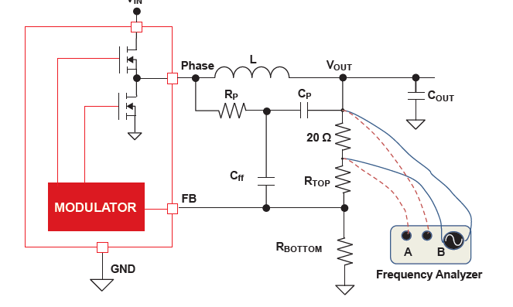
LOOP OUTPUT NODES TO NA
= SAME NODES WHERE INJECTION IS DONE.
CAP
Isolation transformer needs a DC decoupling cap
Most of the times, NA needs DC decoupling caps
SMPS

Slide 2
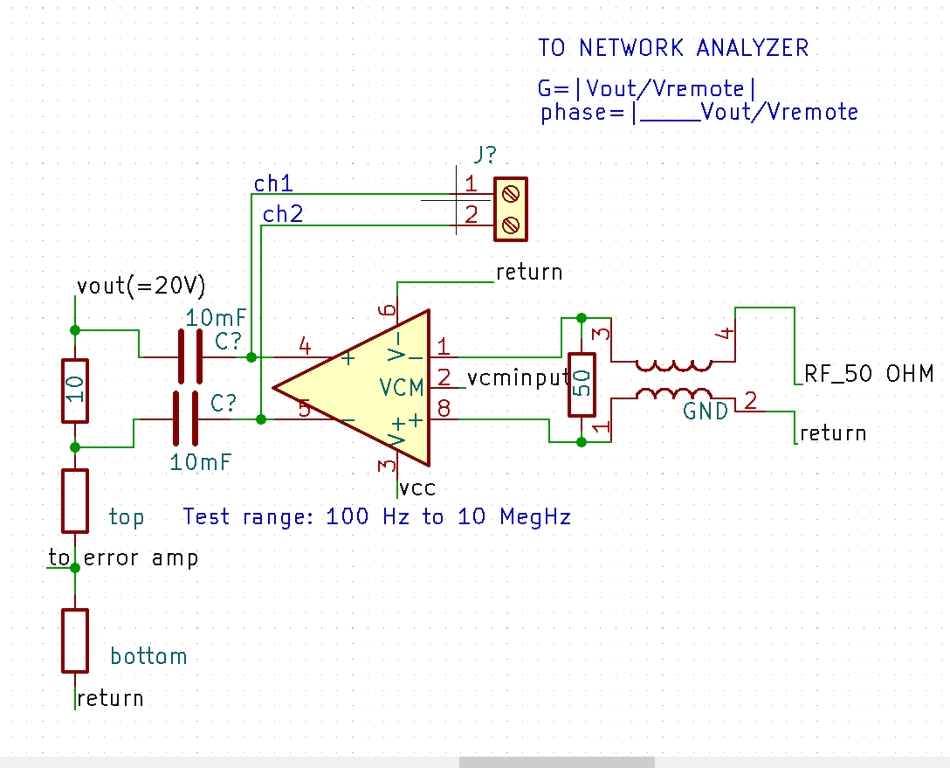
DC Decoupled: Direct driving loop measuring signal from Network Analyzer to injection nodes. High cap values.
Double use of decoupling caps in diff opamp case.
SMPS

