Slide 1
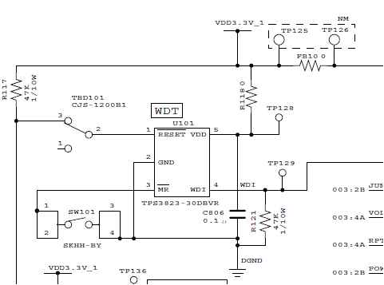
Schematic
SW
②
①
CPU
(WDI output)
Open
(TPS3823’s /RESET output
Is Floating)
CPU
(Reset input)
TPS3823-30 ( Null version)

Slide 2
Teset Result
Problem
Reset stay low.
Reset is not removed
Reset is removed
(OK)
Problem: Reset is not removed
①(Refer to schematic)
SW(TBD101 ) Pin1⇔Pin2
Pin1 :not pull up
No Problem
②(Refer to schematic)
SW(TBD101) Pin3⇔Pin2
Pin1: not pull up
Question:
We think /RESET of TPS3823 is Push-Pull output. So,we think Reset is removed if Vcc started up and proper WDI input…
Why /RESET terminal should be pull up?
Would you please let us the reason ?

