Slide 1
BQ76952: When the OCD1 threshold is reached, both the OTPB will reset and partial analog data will reset to default value
TI Forum
2024/04/08

Slide 2
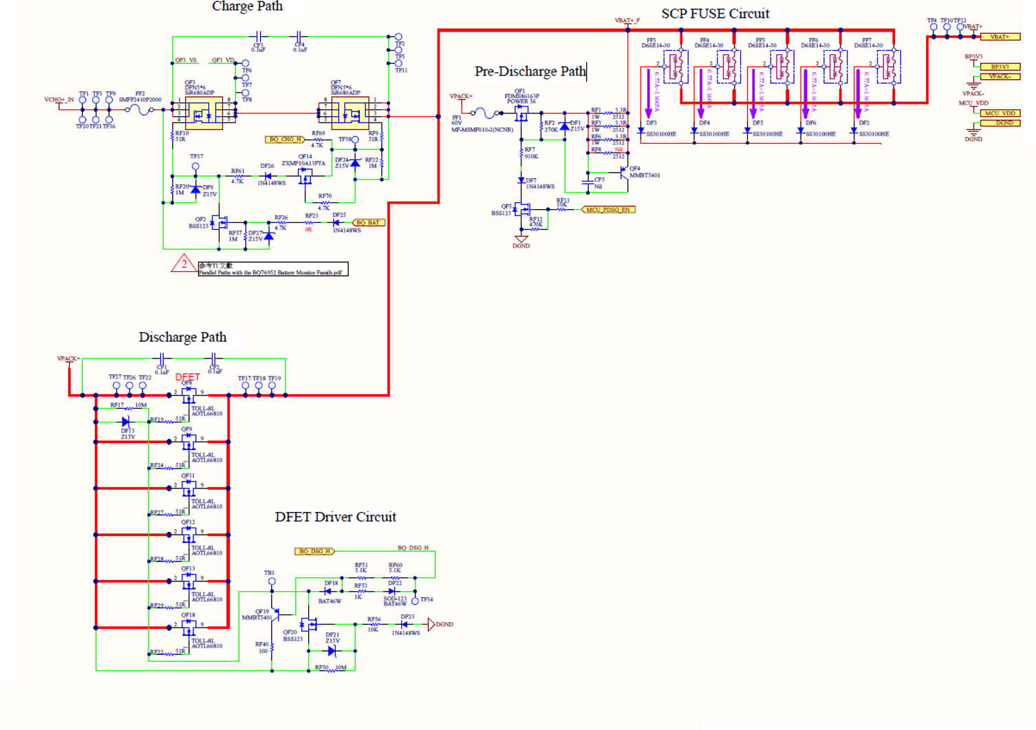
FET circuitry

Slide 3
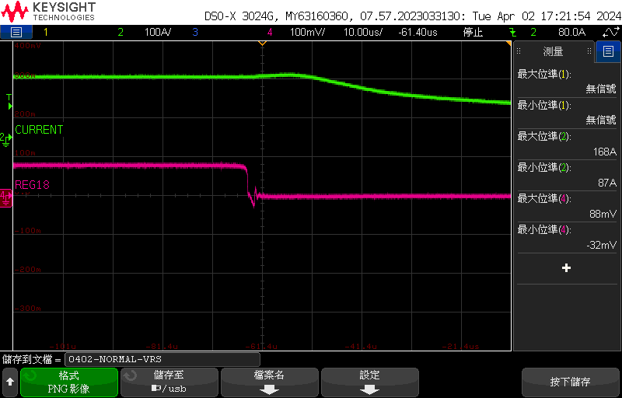
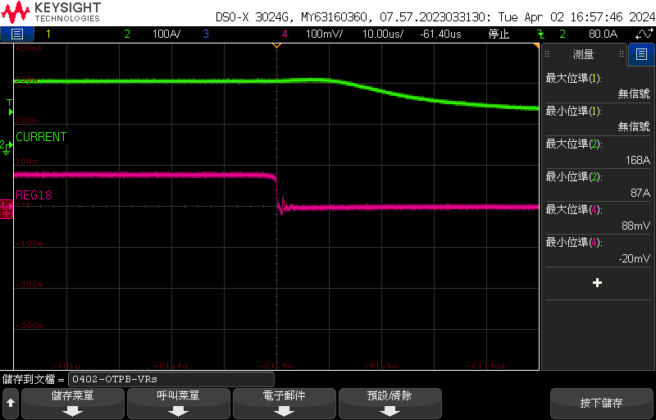
V.Rsense
Normal Pack : Trigger the OCD1 as expected.
OTPB Pack : The DUT that trigger OTPB flag.
Normal Pack
OTPB Pack
V.Rsense
V.Rsense
The timing at which the DFET is switched off
Green: Current(clamp meter)
Pink: Voltage across the Rsense
Green: Current(clamp meter)
Pink: Voltage across the Rsense

Slide 4
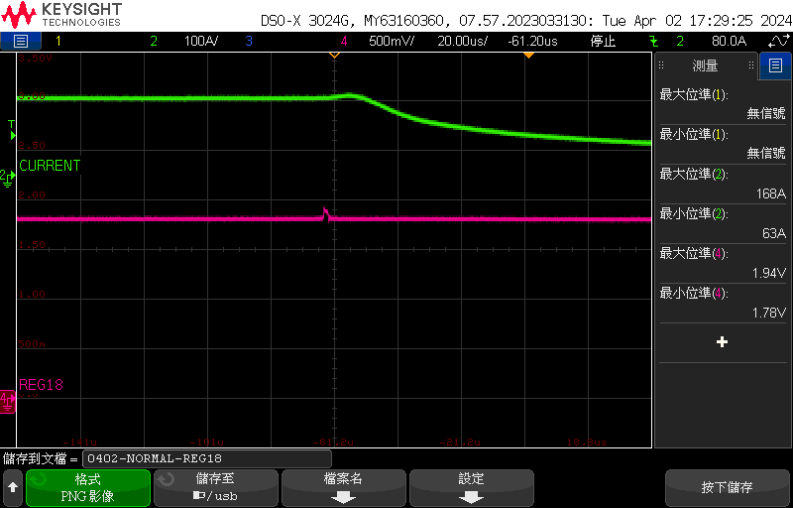
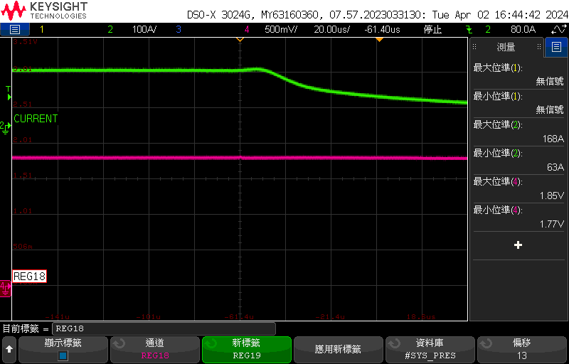
REG18
Normal Pack : Trigger the OCD1 as expected.
OTPB Pack : The DUT that trigger OTPB flag.
Normal Pack
OTPB Pack
Max. voltage of REG18 = 1.94v
Min. voltage of REG18 = 1.78v
REG18
REG18
Green: Current(clamp meter)
Pink: REG18
Green: Current(clamp meter)
Pink: REG18

Slide 5
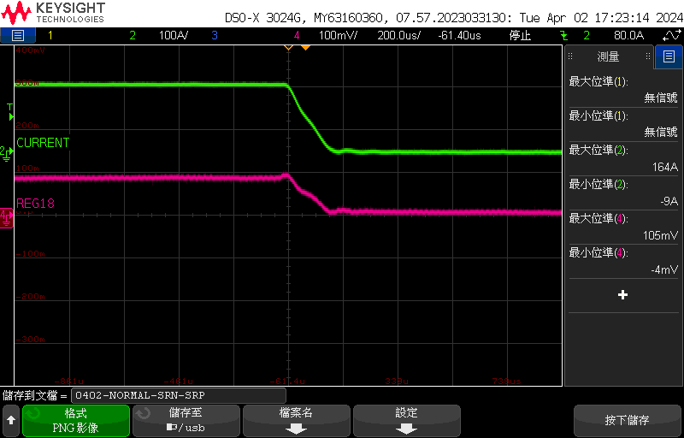
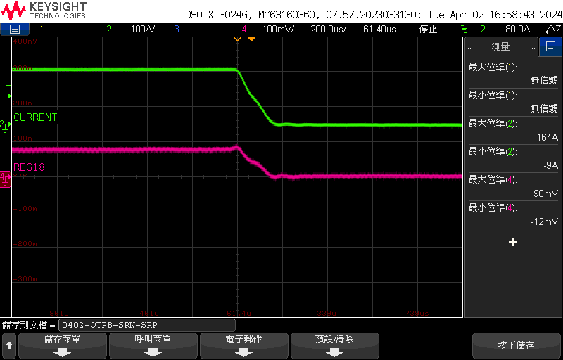
SRN-SRP
Normal Pack : Trigger the OCD1 as expected.
OTPB Pack : The DUT that trigger OTPB flag.
Normal Pack
OTPB Pack
SRN-SRP
SRN-SRP
Green: Current(clamp meter)
Pink: SRN - SRP
Green: Current(clamp meter)
Pink: SRN - SRP

Slide 6
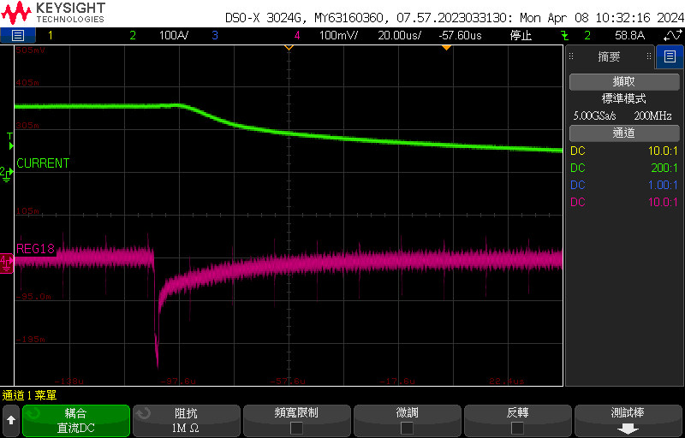
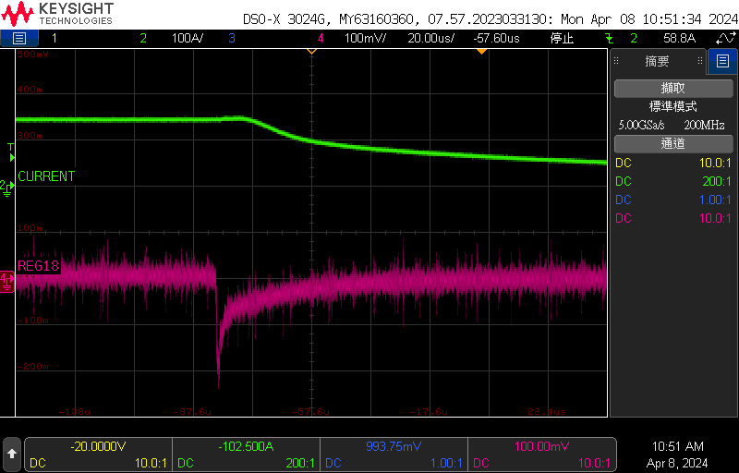
SRP - DGND
Normal Pack : Trigger the OCD1 as expected.
OTPB Pack : The DUT that trigger OTPB flag.
Normal Pack
OTPB Pack
SRP - DGND
SRP - DGND
Green: Current(clamp meter)
Pink: SRP - DGND
Green: Current(clamp meter)
Pink: SRP - DGND

Slide 7
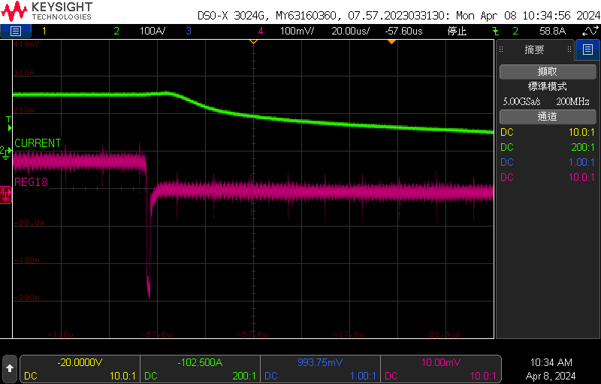
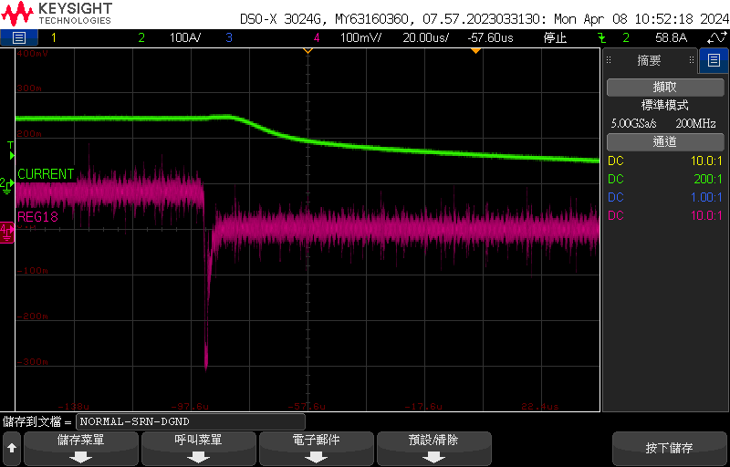
SRN - DGND
Normal Pack : Trigger the OCD1 as expected.
OTPB Pack : The DUT that trigger OTPB flag.
Normal Pack
OTPB Pack
SRN - DGND
SRN - DGND
Green: Current(clamp meter)
Pink: SRN - DGND
Green: Current(clamp meter)
Pink: SRB - DGND

