Slide 1
BQ76952: When the OCD1 threshold is reached, both the OTPB will reset and partial analog data will reset to default value
TI Forum
2024/04/11

Slide 2
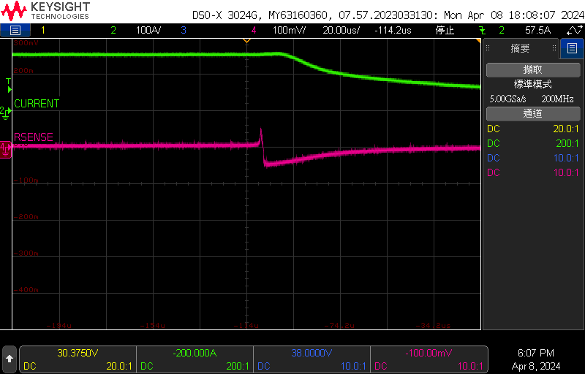
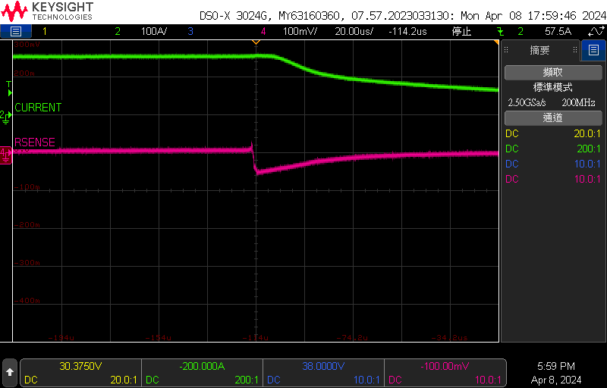
SRP - DGND
We connected DGND to VBAT- directly to minimize the ground path.
Normal Pack
Voltage division of signal <SRP-DGND>
OTPB Pack
time scale= 20us
SRP-DGND
SRP-DGND
~50mV
~50mV
Green: Current(clamp meter)
Pink: SRP – DGND
Green: Current(clamp meter)
Pink: SRP - DGND

Slide 3
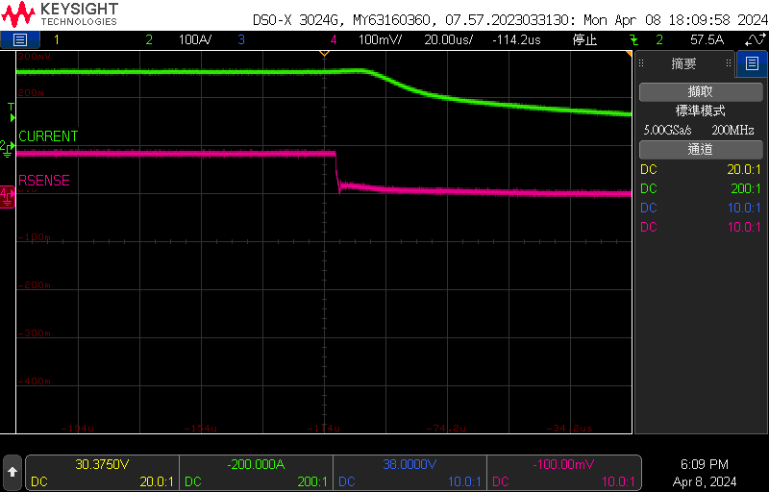

SRN - DGND
We connected DGND to VBAT- directly to minimize the ground path.
Normal Pack
OTPB Pack
SRN-DGND
~100mV
SRN-DGND
~100mV
Green: Current(clamp meter)
Pink: SRN - DGND
Green: Current(clamp meter)
Pink: SRN - DGND

Slide 4
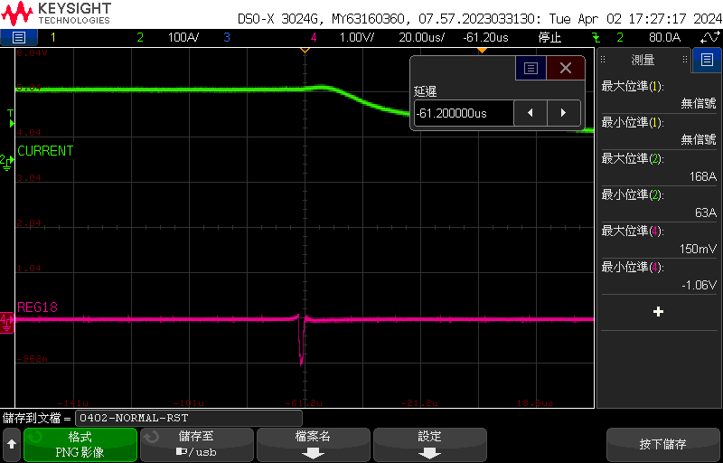
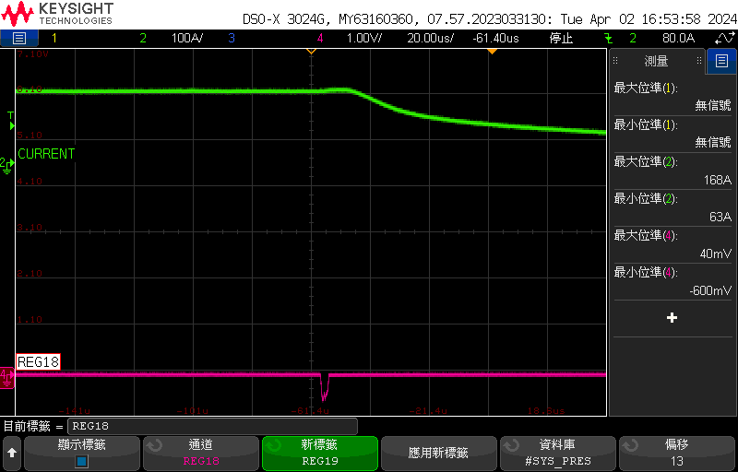
RST_SHUT
Keep DGND and VBAT- as original design
Normal Pack
OTPB Pack
Minimum voltage level of RST_SHUT = -1.06v
Minimum voltage level of RST_SHUT = -600mv
RST_SHUT
-1.06V
RST_SHUT
-600mV
Green: Current(clamp meter)
Pink: RST_SHUT
Green: Current(clamp meter)
Pink: RST_SHUT

