Slide 1
BQ76952: When the OCD1 threshold is reached, both the OTPB will reset and partial analog data will reset to default value.
2024/04/12
TI Forum

Slide 2
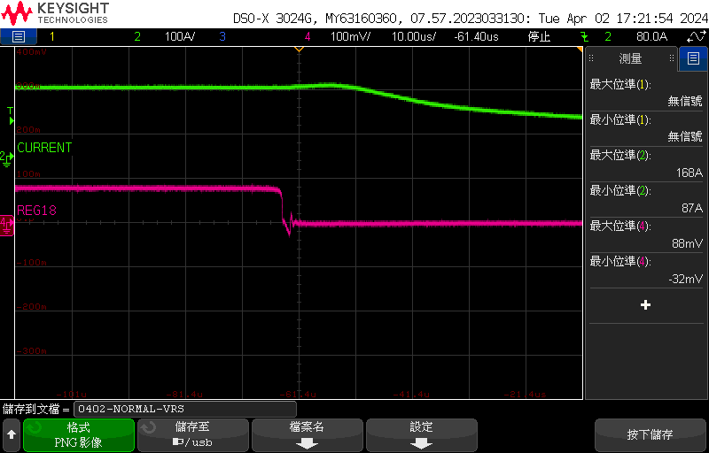
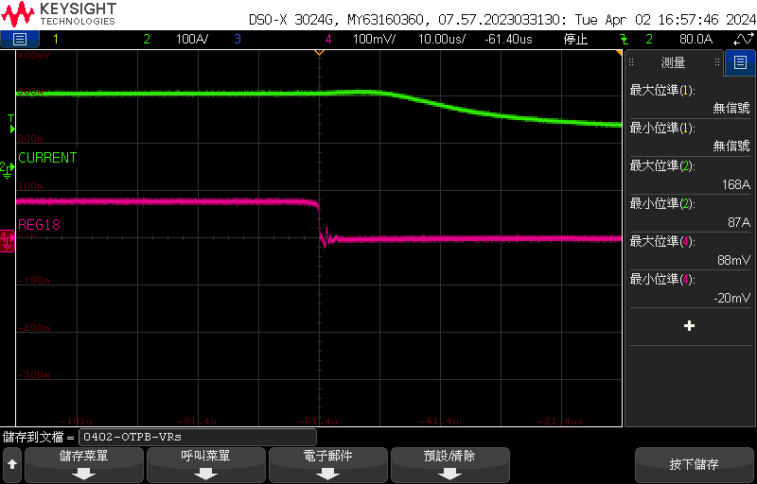
V.Rsense
Normal Pack : Trigger the OCD1 as expected.
OTPB Pack : The DUT that trigger OTPB flag.
Normal Pack
OTPB Pack
V.Rsense
V.Rsense
The timing at which the DFET is switched off
Green: Current(clamp meter)
Pink: Voltage across the Rsense
Green: Current(clamp meter)
Pink: Voltage across the Rsense

Slide 3
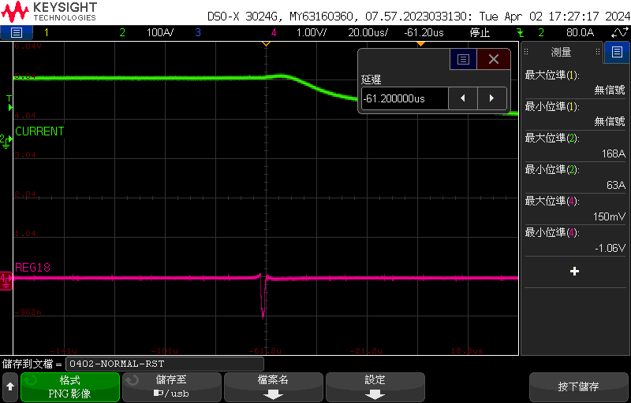
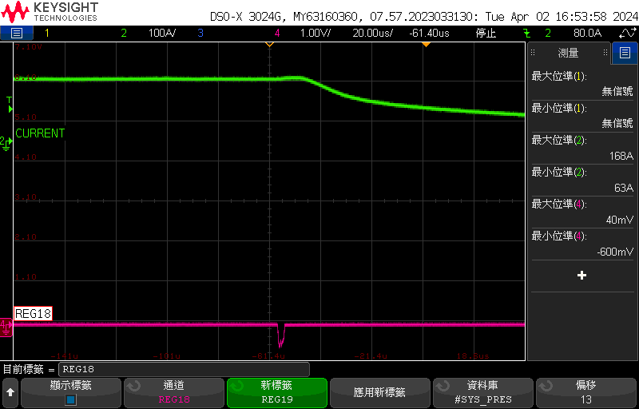
RST_SHUT
Keep DGND and VBAT- as original design
Normal Pack
OTPB Pack
Minimum voltage level of RST_SHUT = -1.06v
Minimum voltage level of RST_SHUT = -600mv
RST_SHUT
-1.06V
RST_SHUT
-600mV
Green: Current(clamp meter)
Pink: RST_SHUT
Green: Current(clamp meter)
Pink: RST_SHUT

Slide 4
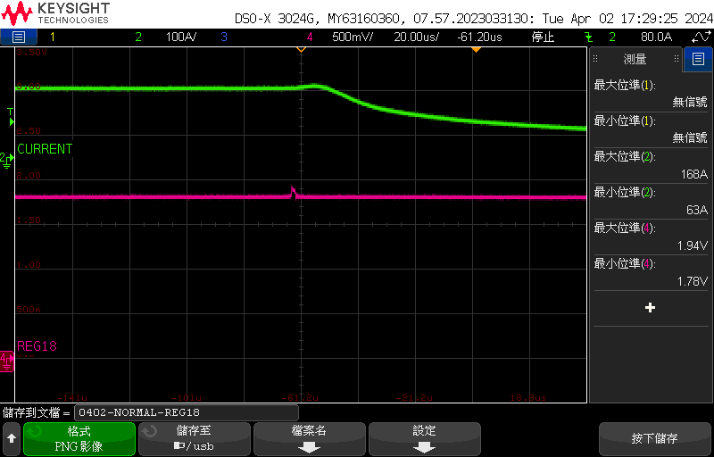
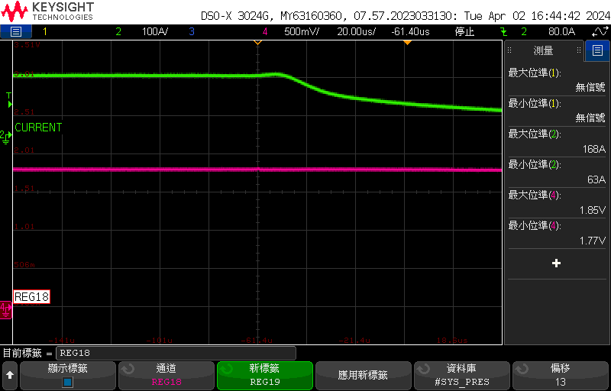
REG18
Normal Pack : Trigger the OCD1 as expected.
OTPB Pack : The DUT that trigger OTPB flag.
Normal Pack
Voltage division of signal <SRP-DGND>
OTPB Pack
time scale= 20us
Maximum voltage level of RST_SHUT = 1.94v
Maximum voltage level of RST_SHUT = 1.85v
Minimum voltage level of RST_SHUT = 1.78v
Minimum voltage level of RST_SHUT = 1.77v
Green: Current(clamp meter)
Pink: REEG18
Green: Current(clamp meter)
Pink: REG18

Slide 5
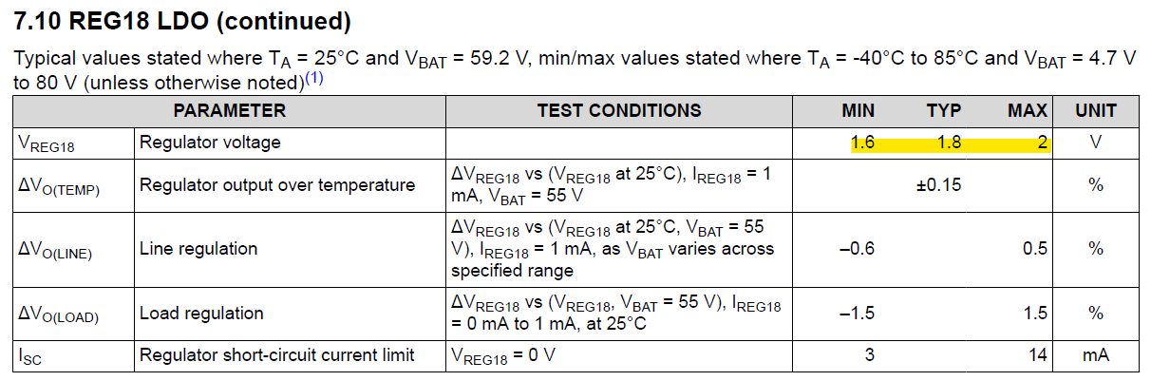
REG18

