Slide 1
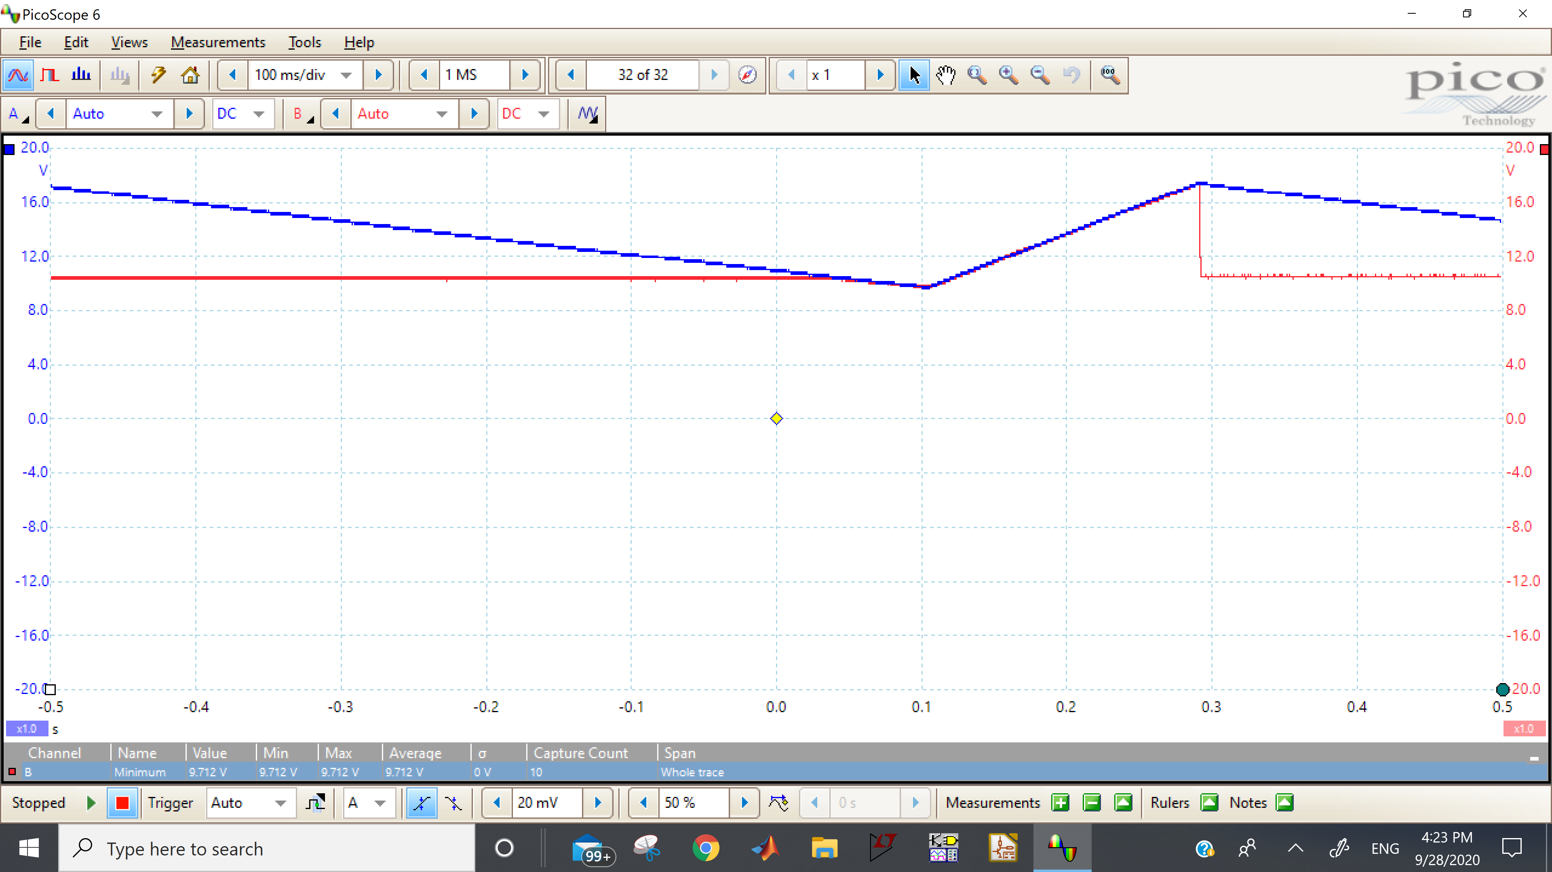
VDD MAX 17.56 WHILE EVAL IS 18.5
HVG<10V
Eval is 10.5

