Slide 1
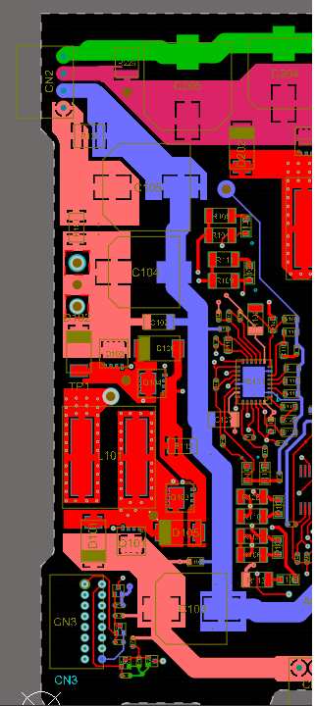
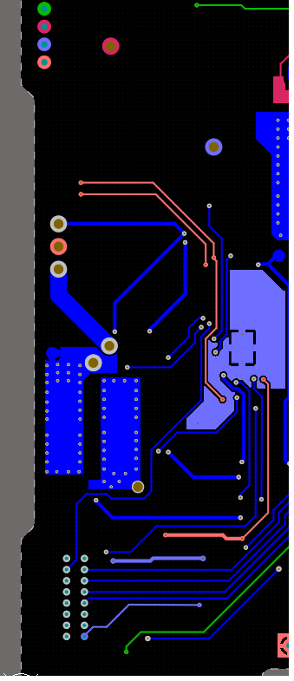
The Board Layout
The Board consists of
2 Layer.
The component
side
The bottom
side

Slide 2
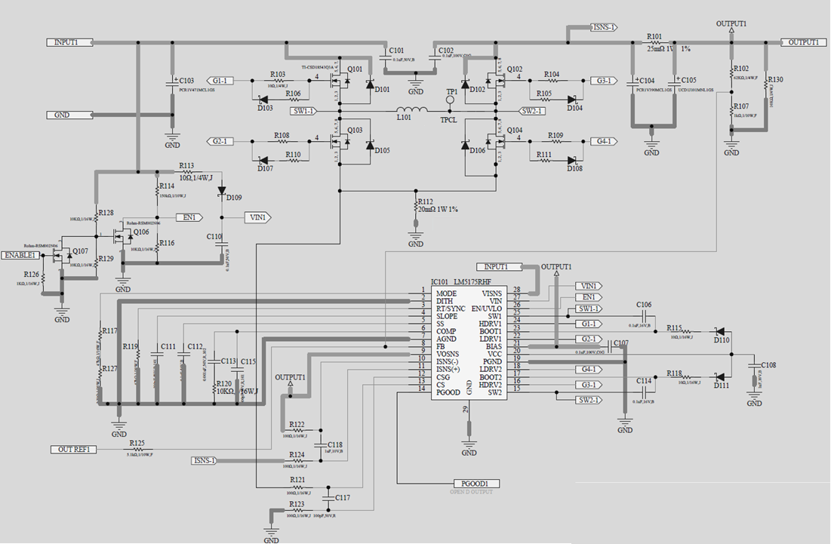
Q101-Q104:CSD18543Q3A
L101:74439369150 (Wurth)
Vin：12/24V
Vout：5V～24V（adjust with external DAC）
Iout：1.25V～2.5A

Slide 3
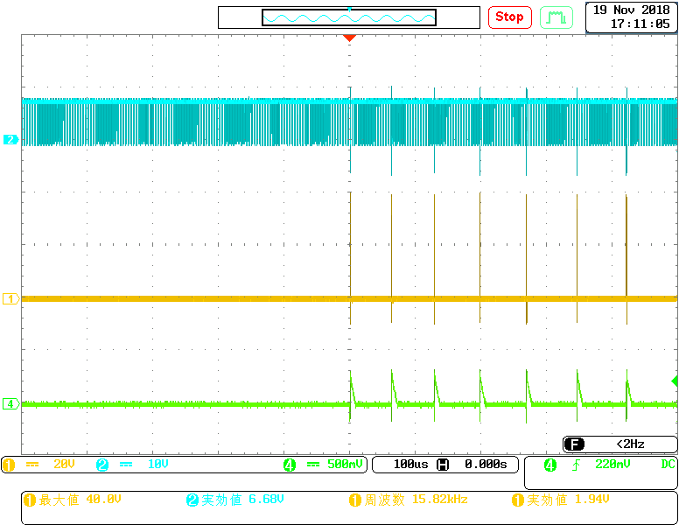
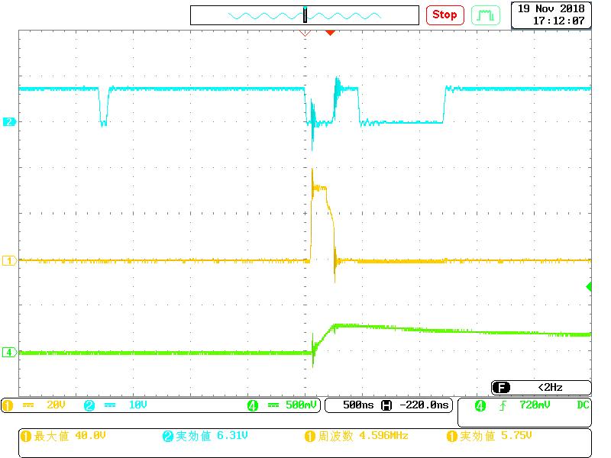
QL1 Gate
QH1 Gate
Inductance Current
At the soft start,
QH 1 (input side, HighSide FET) suddenly outputs and becomes intermittent operation
When connected with the load, gate driver of LM5175 was damaged.

