Slide 1
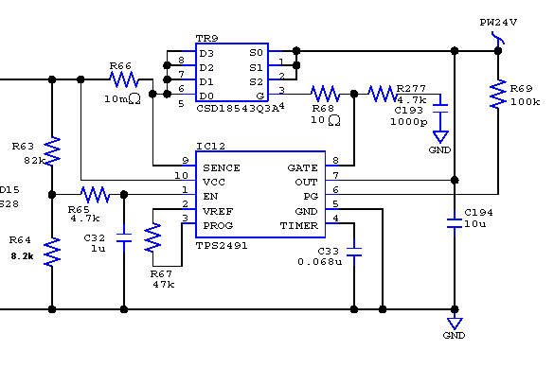
Question about PG pin of TPS2491
circuit and measure point
color of circle and waveform(next page) match.
RED：SENCE
YELLOW：EN
GREEN：PG
INPUT：24V
EN：When the power supply is about 14V, EN is off.

Slide 2
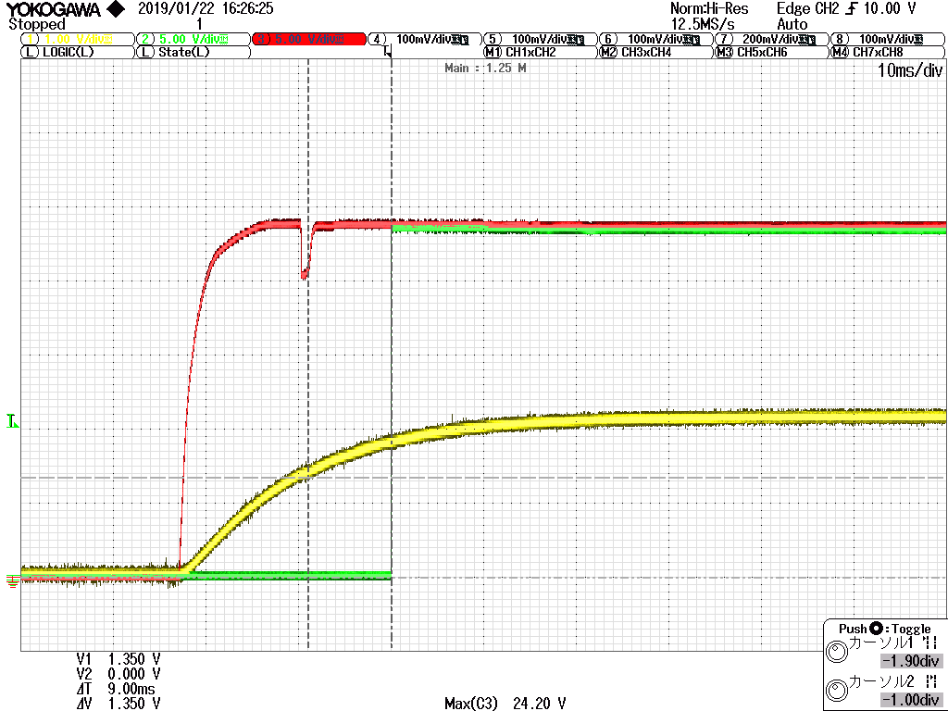
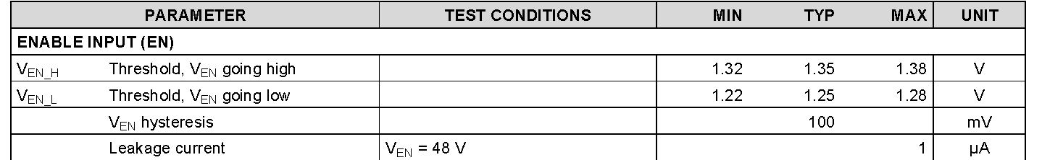
Question
①Is it possible to think the time between cursors(9ms) as a 9 ms delay specified in the data sheet?
②Does the rising edge of PG depend only on Vvcc?
Is the threshold voltage of EN related?
When I compared the datasheet and the waveform, it seemed to be rising with the threshold voltage of EN (blue circle)
Red：SENCE
Yellow：EN(blue circle1.35V)
Green：PG
9ms
①
②

Slide 3
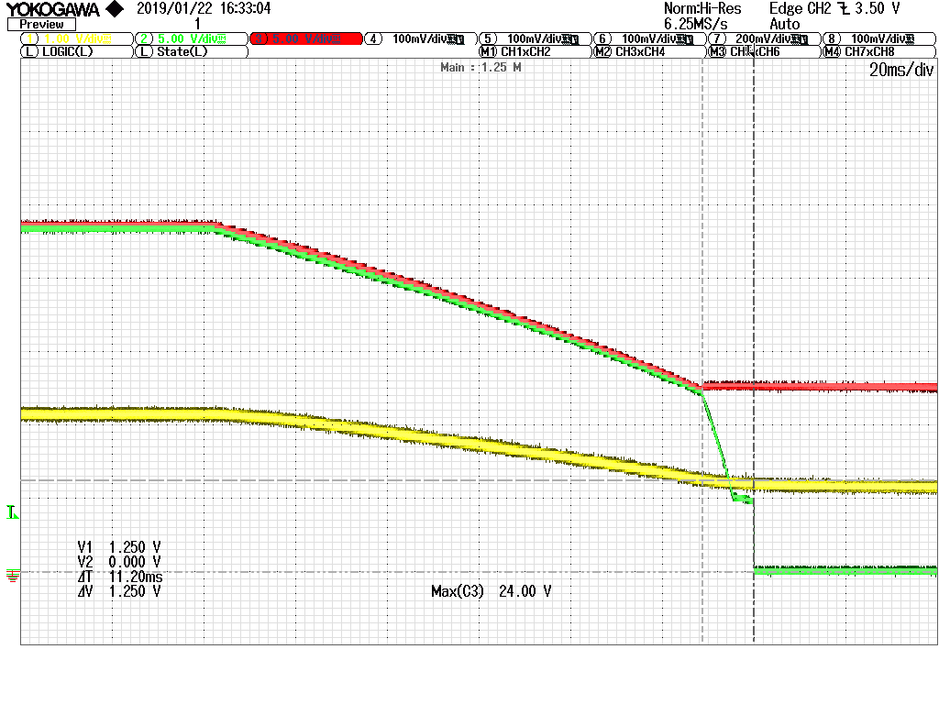
Question
③ Below is a falling waveform of PG
I design to PG Off wheb EN is off. Is there any problem about the waveform?
I think it is basically possible to be controlled by EN.
The time between the cursors is 11.2ms, is there any problem?
Red：SENCE
Yellow：EN(blue circle1.25V)
Green：PG
11.2ms
③

