Slide 1
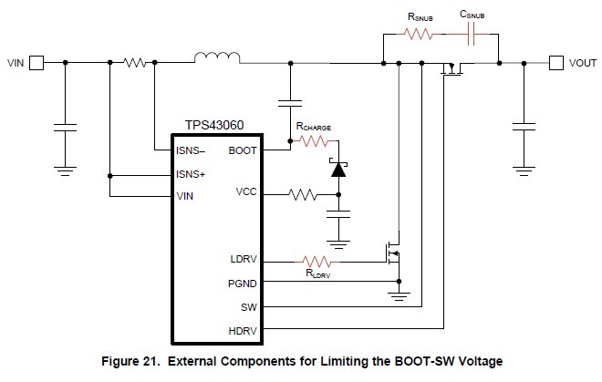
The TPS43060 requires an external bootstrap diode from VCC to BOOT to charge the bootstrap capacitor. It also requires a 2-Ω resistor connected in series with the VCC pin to limit the peak current drawn through the internal
circuitry when the external bootstrap diode is conducting.
According to the datasheet,
resistance of connecting Vcc pin is required 2ohm,
what is the range of resistance value.
For example, is it possible to use 2.2ohm?
What percent is required the resistance accuracy.

