Slide 1
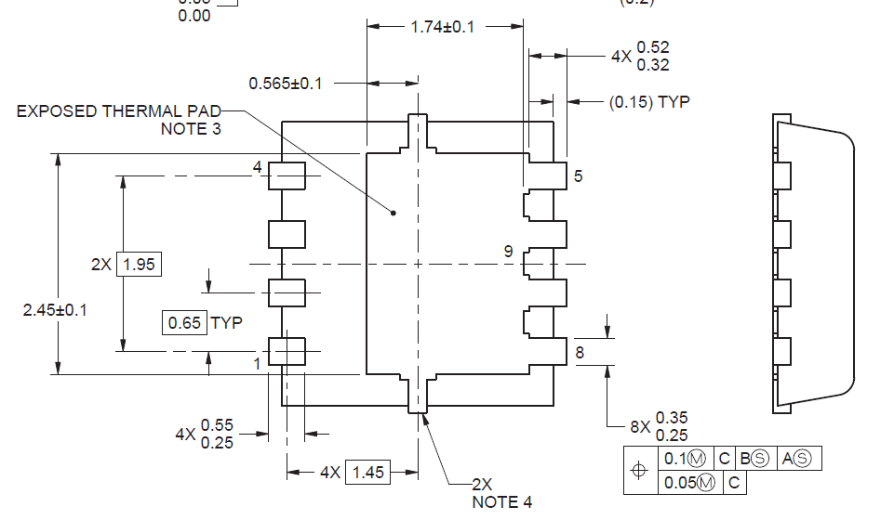
What is the distance of 1 & 2?
①
②

Slide 2
