Slide 1
Schematic and layout of tps6508641
Date: May 7th.

Slide 2
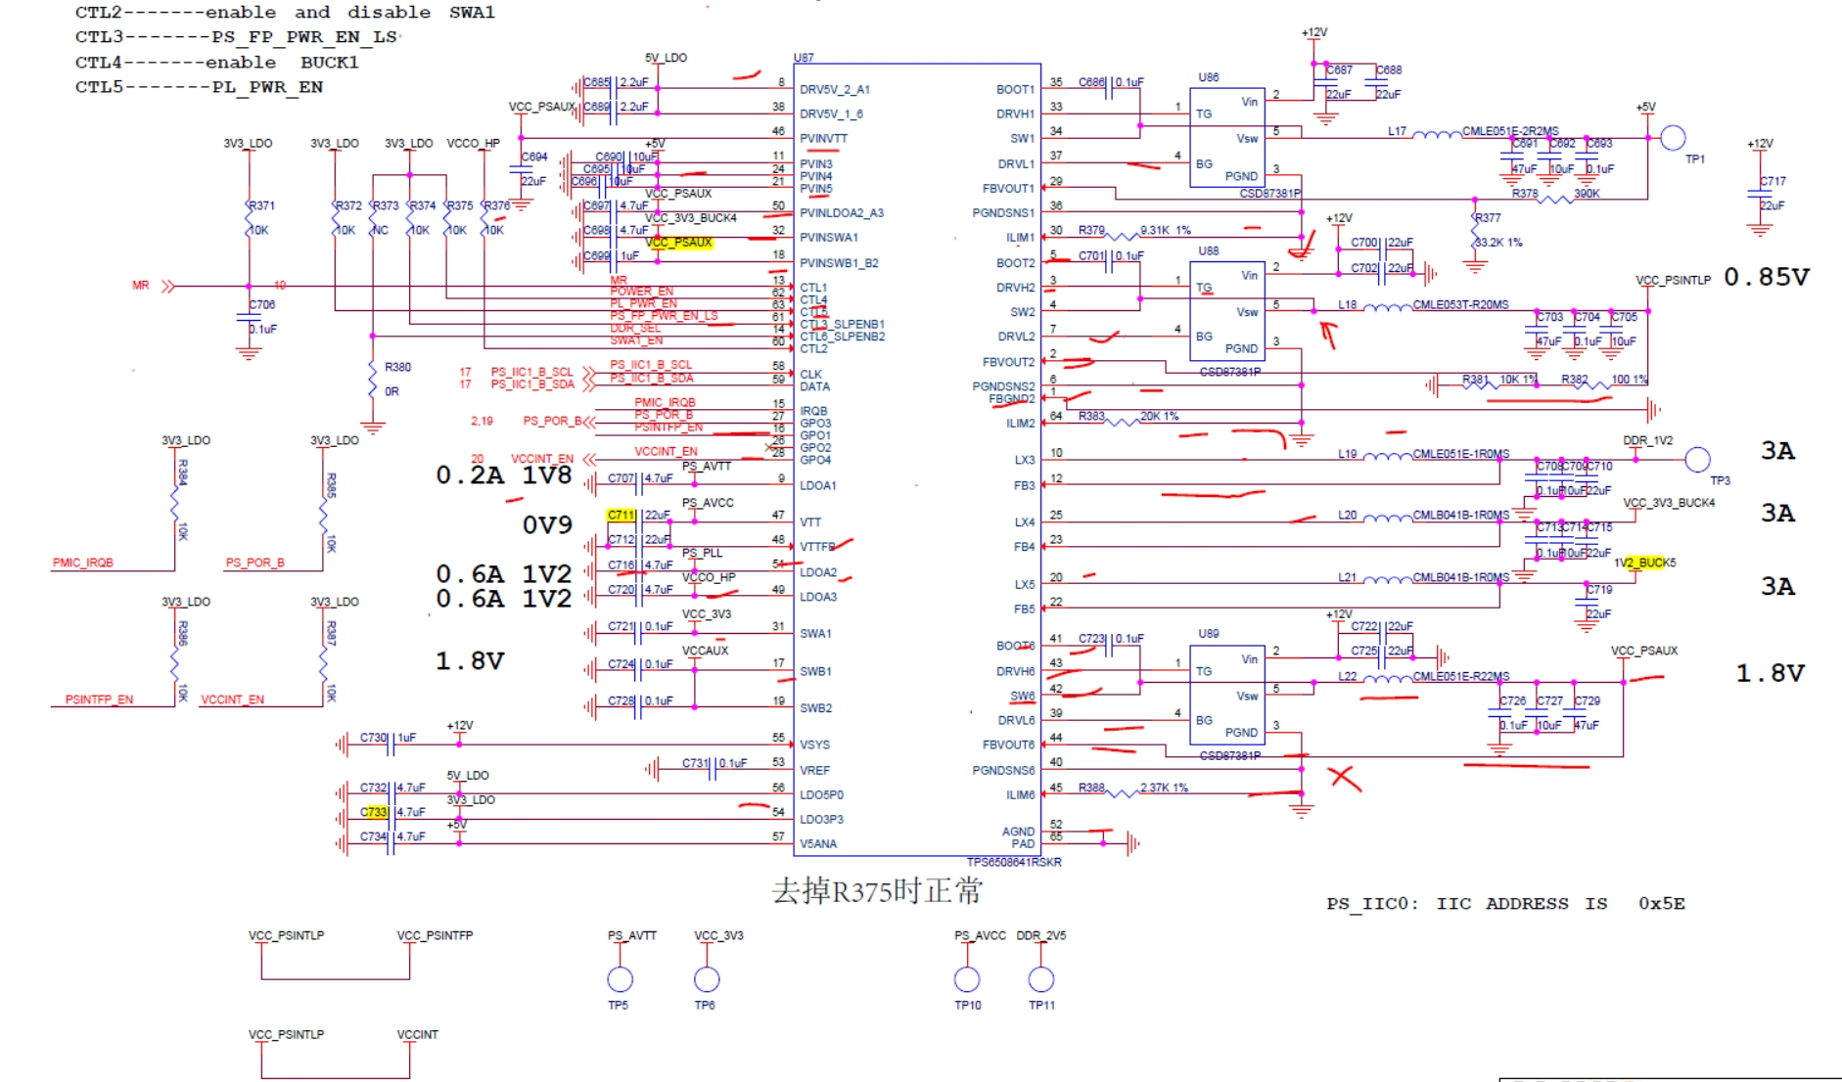
Schematic

Slide 3
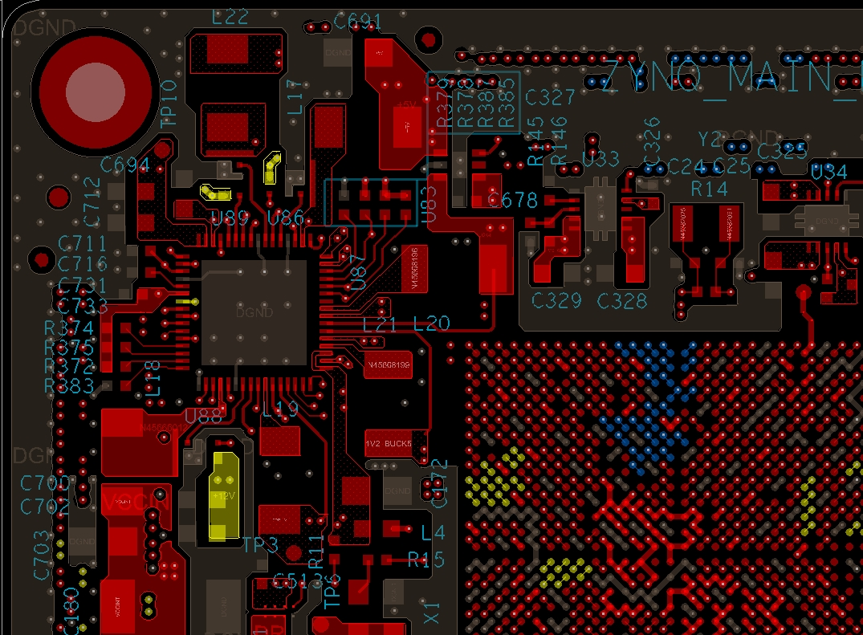
Layout: top layer (layer 1)

Slide 4
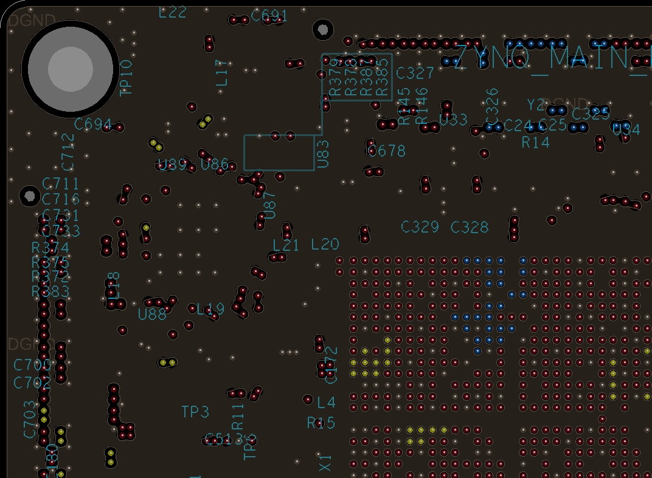
Layout: layer2

Slide 5
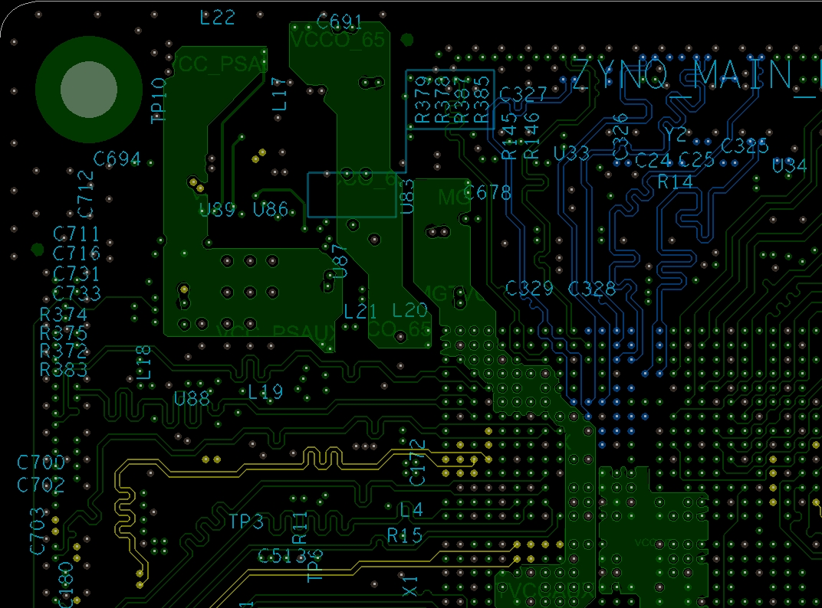
Layout: layer3

Slide 6
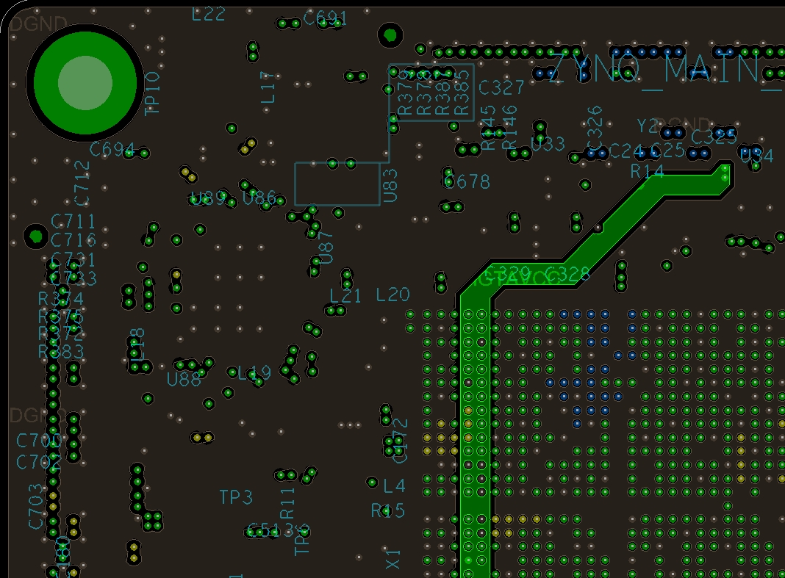
Layout: layer4

Slide 7
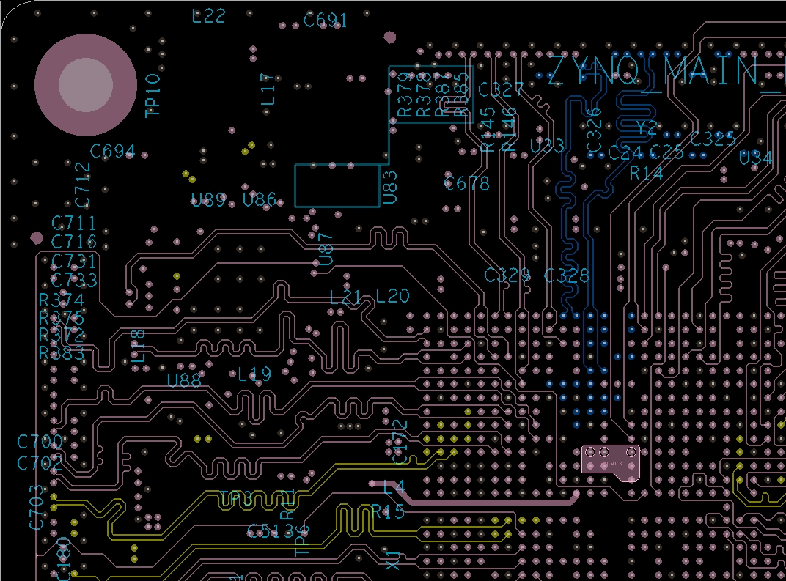
Layout: layer5

Slide 8
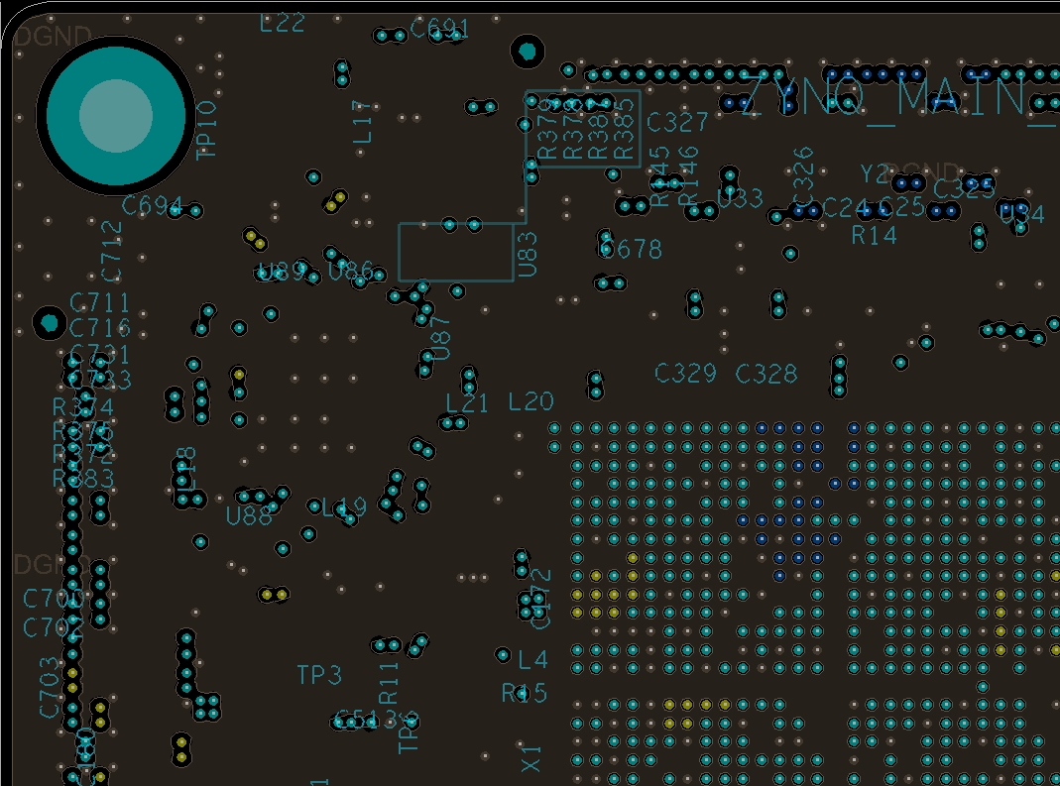
Layout: layer6

Slide 9

Layout: layer7

Slide 10
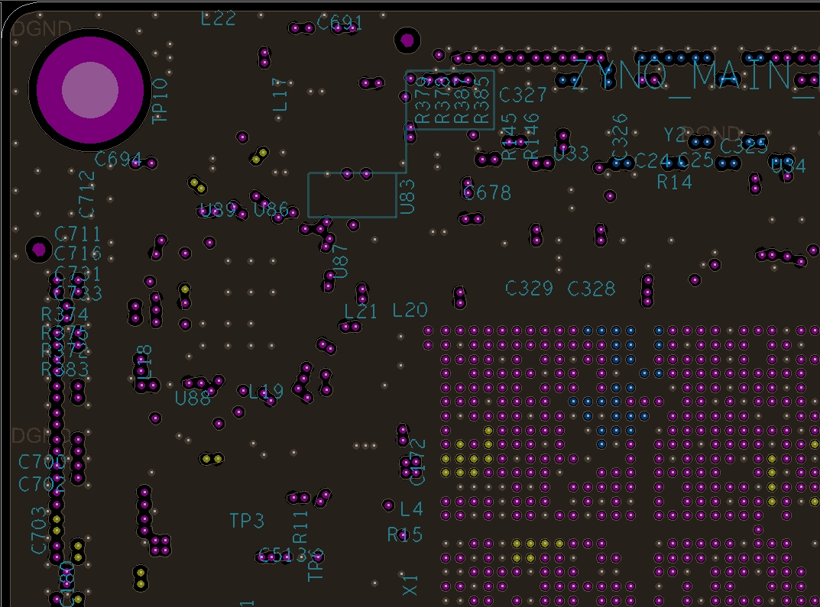
Layout: layer8

Slide 11
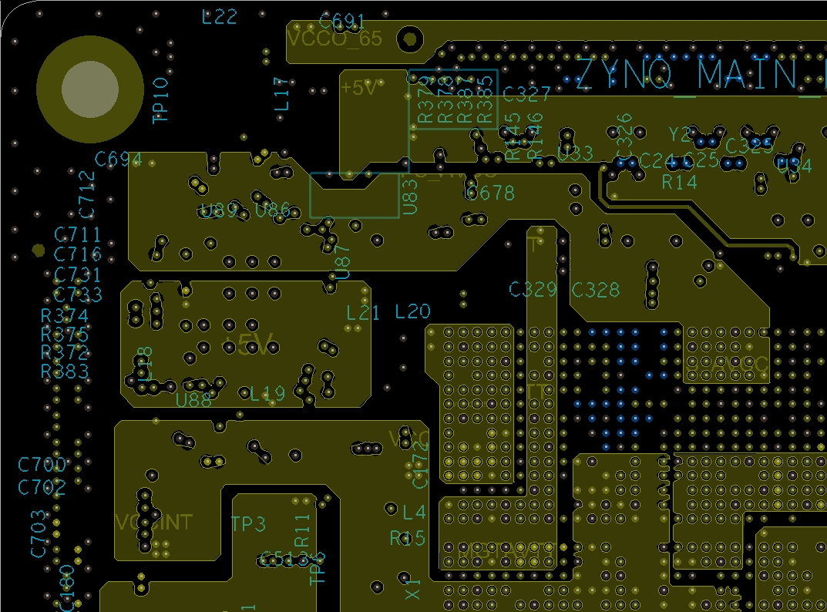
Layout: layer9

Slide 12
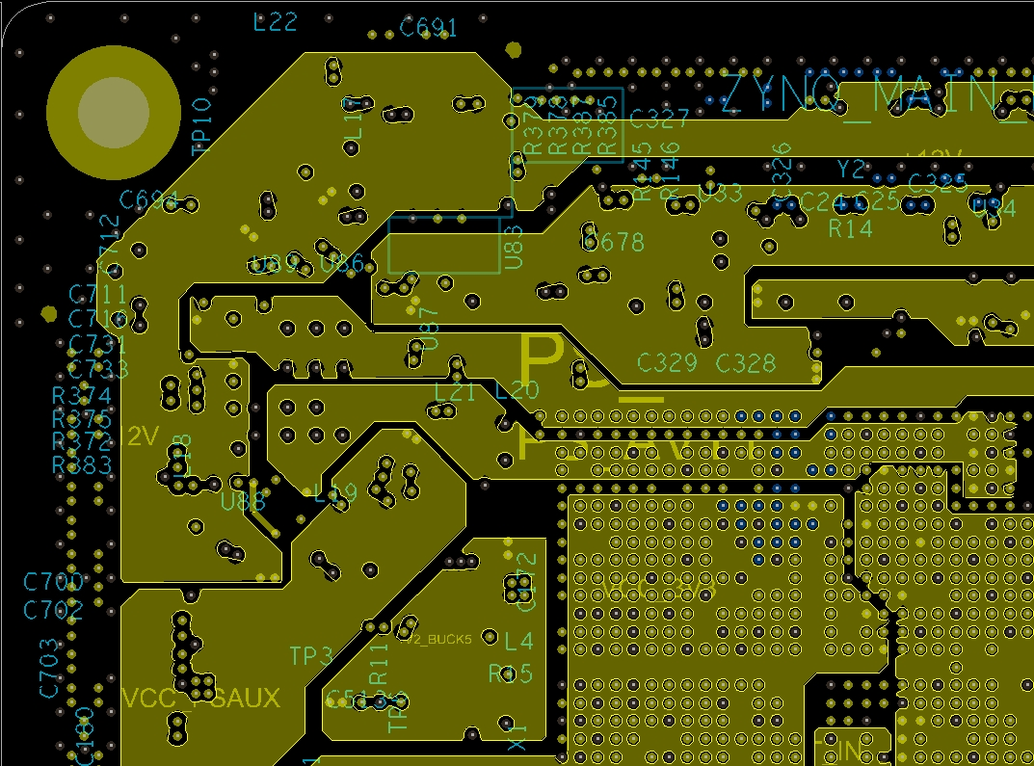
Layout: layer10

Slide 13
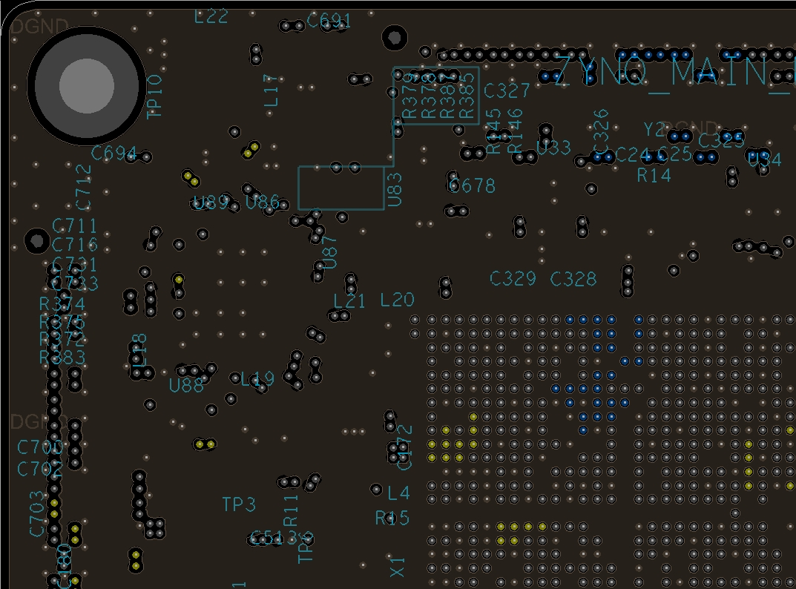
Layout: layer11

Slide 14
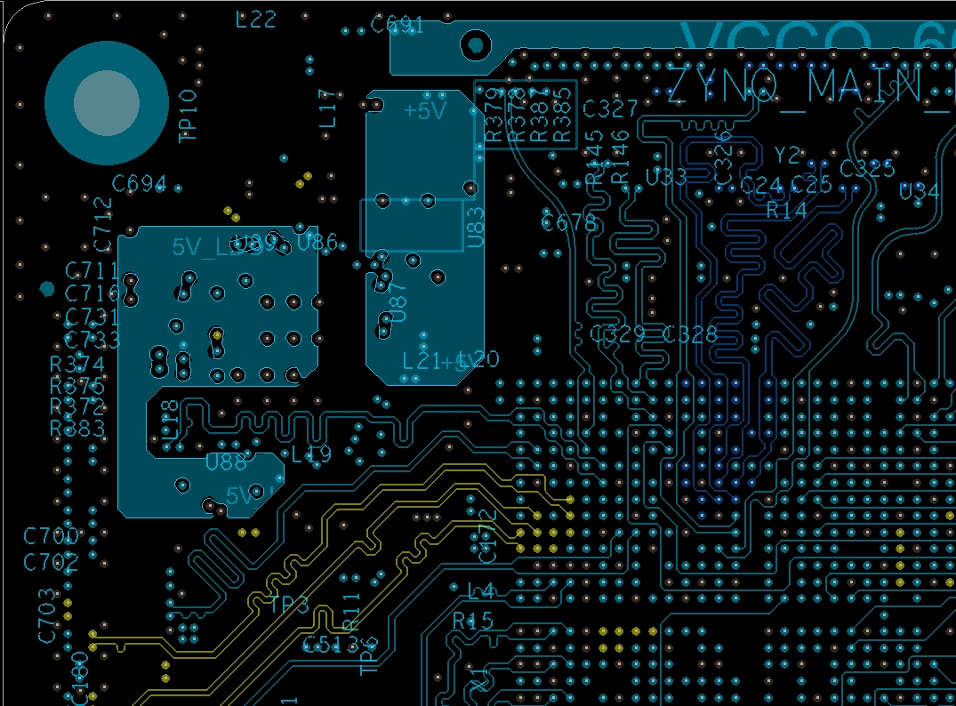
Layout: layer12

Slide 15
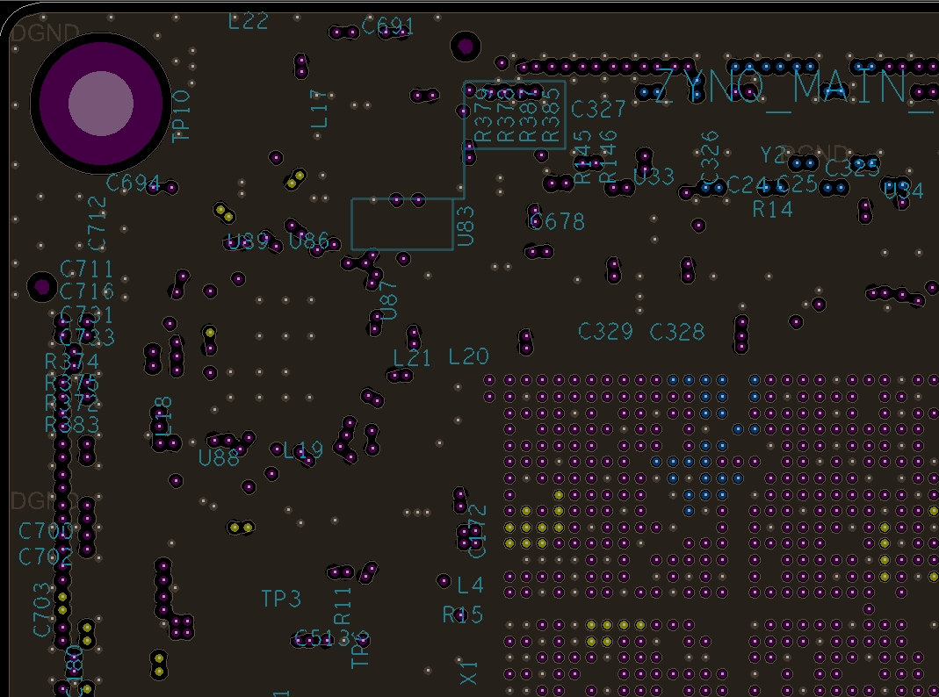
Layout: layer13

Slide 16
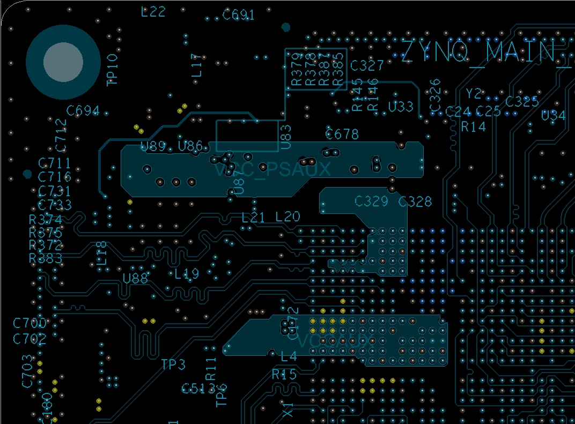
Layout: layer14

Slide 17
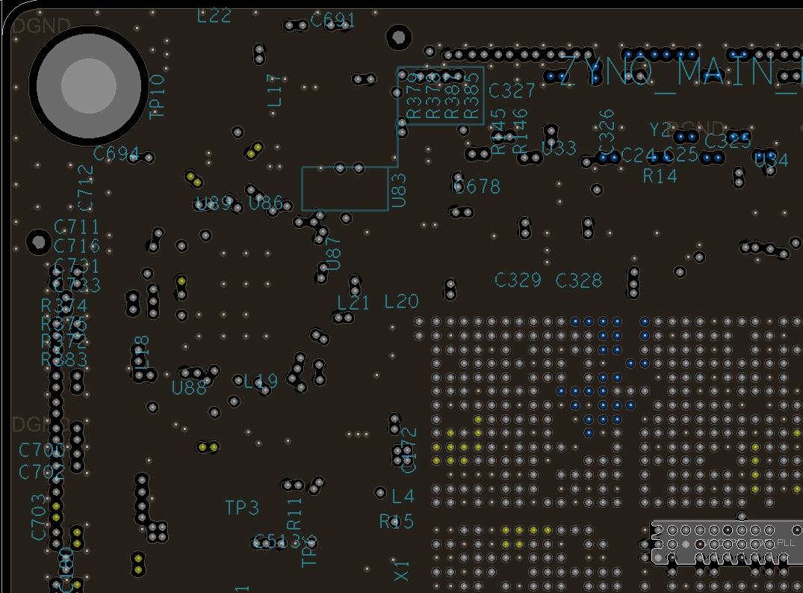
Layout: layer15

