Slide 1
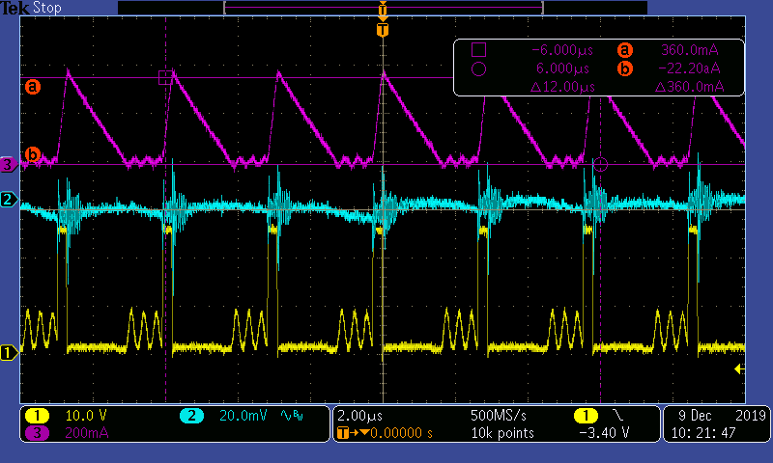
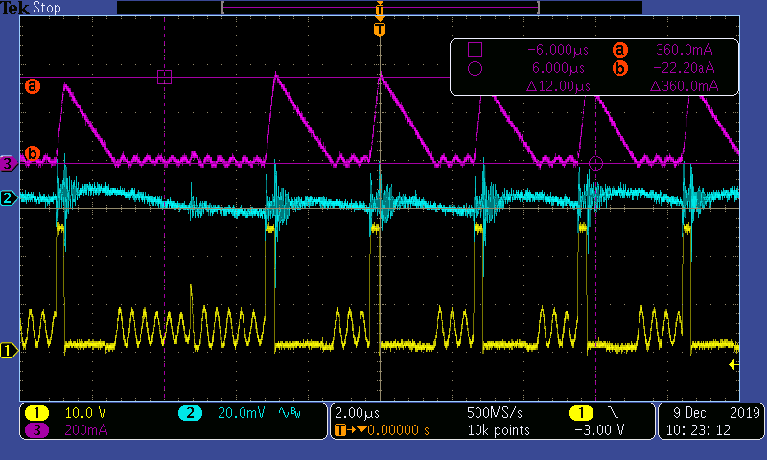
DCM
SKIP mode
Vin=24V
Vo=3.3V
Io=120mA
Upper( Purple): inductor current 200mA/div
Middle(Blue) : output voltage(AC) 20mV/div
Bottom(Yellow): PH (10V/div)
Vin=24V
Vo=3.3V
Io= approx. 90mA
Upper( Purple): inductor current 200mA/div
Middle(Blue) : output voltage(AC) 20mV/div
Bottom(Yellow): PH (10V/div)

Slide 2
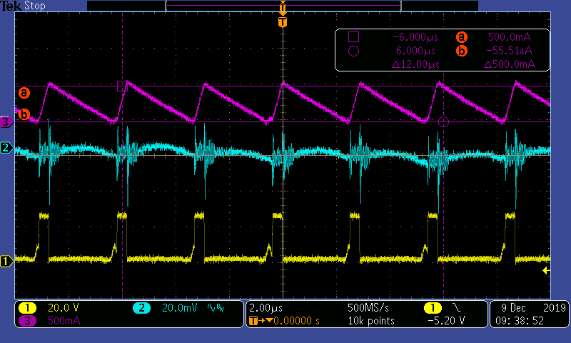
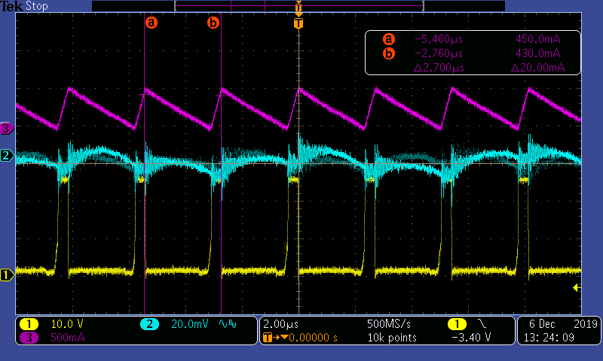
VIN=24V Vo=3.3V
VIN=24V Vo=3.3V
CCM starts below inductor peak current
= 500mA (approx.)
Vin=24V
Vo=3.3V
Io=120mA
Upper( Purple): inductor current 500mA/div
Middle(Blue) : output voltage(AC) 20mV/div
Bottom(Yellow): PH (10V/div)

