Slide 1
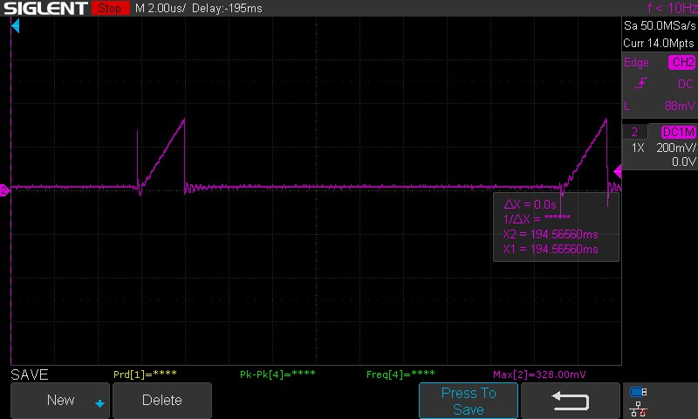
Vrcs :at Rcs in lower NV6117
Clean waveform (a) shows leading edge spike, the second one(b) does not.
Current thru it is approx. 2.53 amp at peak.
b
a

Slide 2
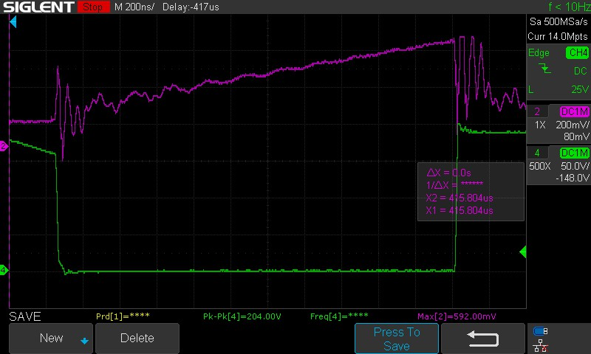
Waveform at CS pin: expanded look ‘C’ is leading edge, ‘d’ is trailing edge.
-green is at the primary lower drain of NV6117. Notice clean drain waveform.
c
d
Some waveforms at ‘d’ show values exceeding .6v: could these lead to shutdown?

Slide 3
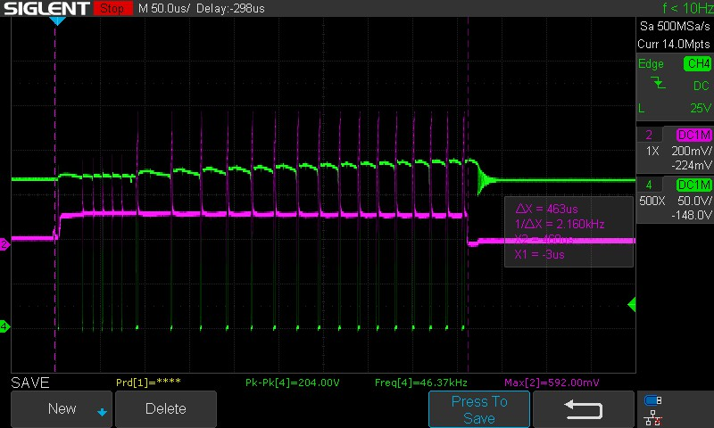
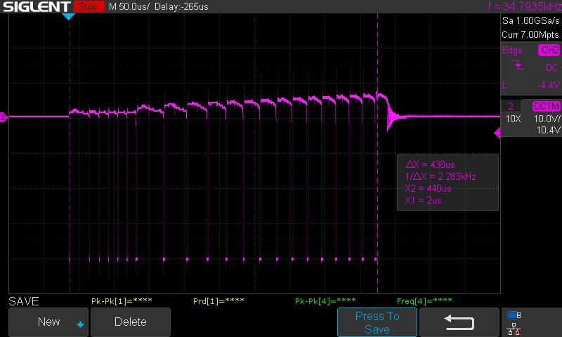
Green: Startup waveforms at
Green: primary
Cyan: Vrcs at Rcs.
Aux voltage at winding
-Notice it follows Vpri
With good match for Np:Naux ratio
Represents good transformer bandwidth

Slide 4
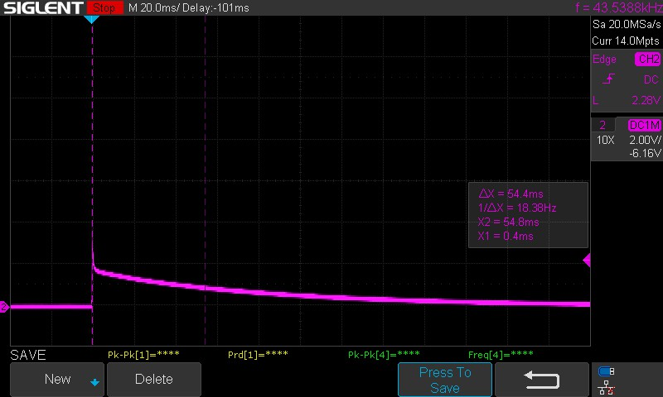
Vout during startup & shutdown.

