Slide 1
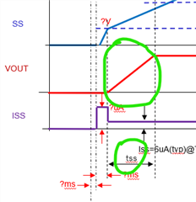
UVLO Clear to SS starting point
EN to UVLO Clear

Slide 2
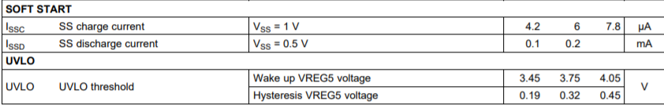

V
VIN
VREG5
3.75V
EN
UVLO
2V
SS
?V
0.765V=VFB
VOUT
ISS
?uA
Iss=6uA(typ)@TPS54527
tss
?ms
?ms

Slide 3
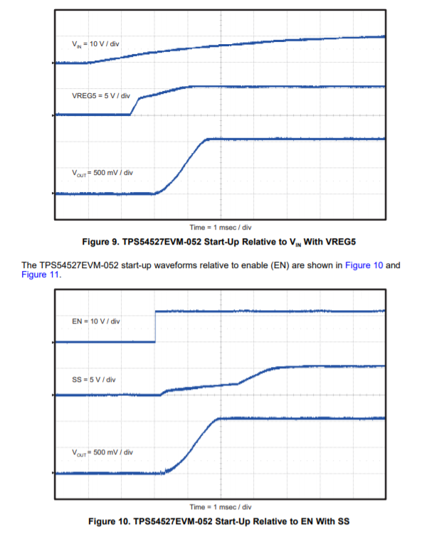
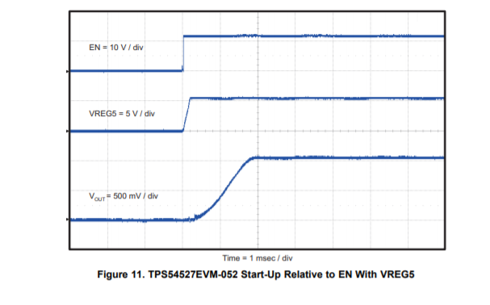
TPS54527EVM-052 Start-UP

