Slide 1
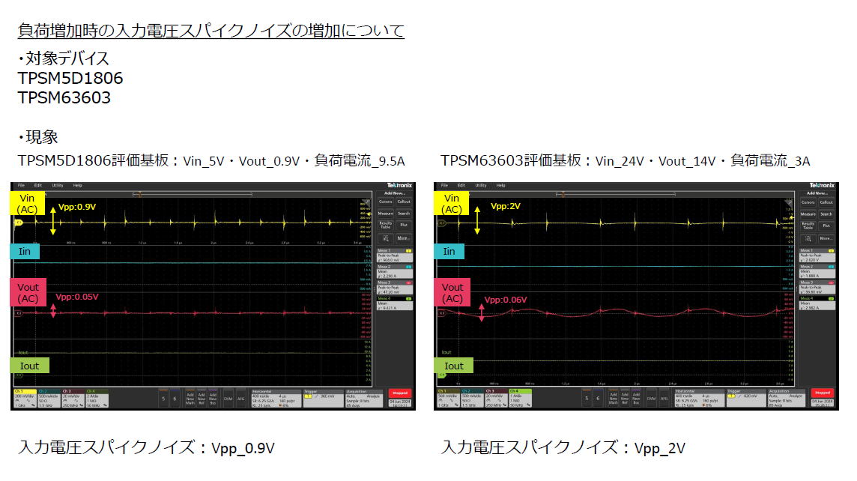
The input voltage spike noise increases as the load increases
Device
Phenomenon
TPSM5D1806EVM : Vin_5V, Vout_0.95V, load current_9.5A
TPSM63603EVM : Vin_24V, Vout_14V, load current_3A
Input Voltage spike noise : Vpp_0.9V
Input Voltage spike noise : Vpp_2V

Slide 2
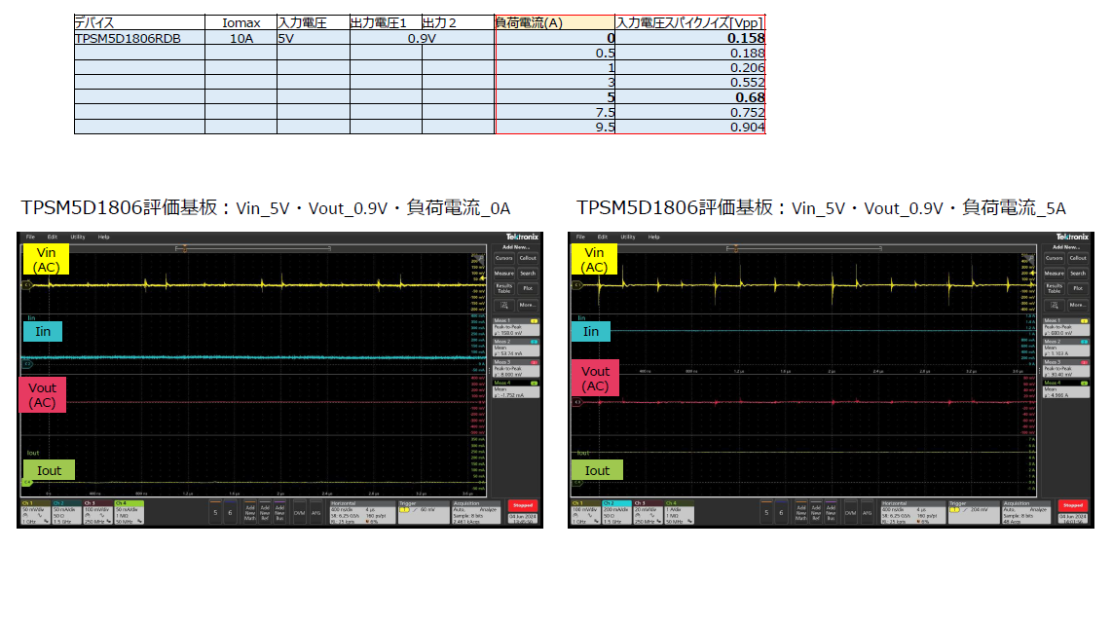
Input Voltage
Load current(A)
Input Voltage spike noise
Output Voltage
TPSM5D1806EVM : Vin_5V, Vout_0.95V, load current_0A
TPSM5D1806EVM : Vin_5V, Vout_0.95V, load current_5A

Slide 3
Input voltage waveform
Measurement point

Slide 4
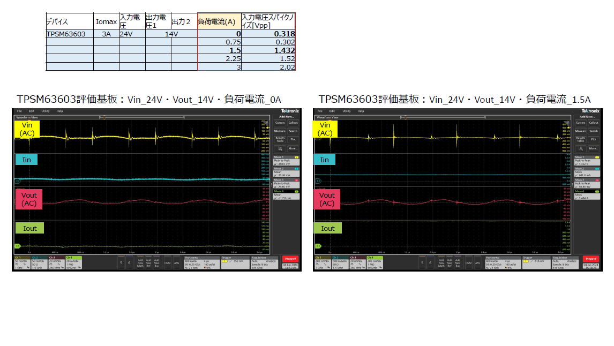
Input Voltage
Load current(A)
Input Voltage spike noise
Output Voltage
TPSM63603EVM : Vin_24V, Vout_14V, load current_0A
TPSM63603EVM : Vin_24V, Vout_14V, load current_1.5A

Slide 5
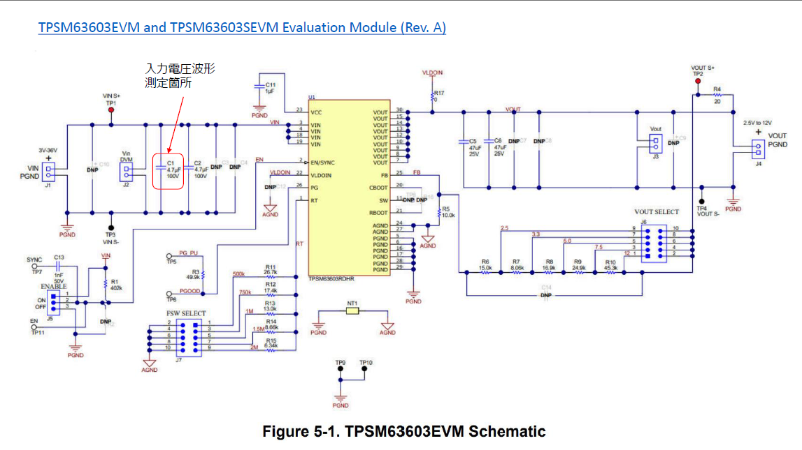
Input voltage waveform
Measurement point

Slide 6
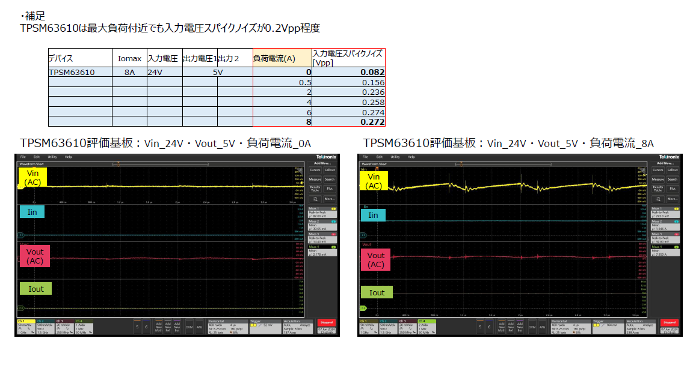
The reference
TPSM63610EVM has approximately 0.2 Vpp input voltage spike noise even maximum load
Input Voltage
Load current(A)
Input Voltage spike noise
Output Voltage
TPSM63610EVM : Vin_24V, Vout_5V, load current_0A
TPSM63610EVM : Vin_24V, Vout_5V, load current_8A

Slide 7
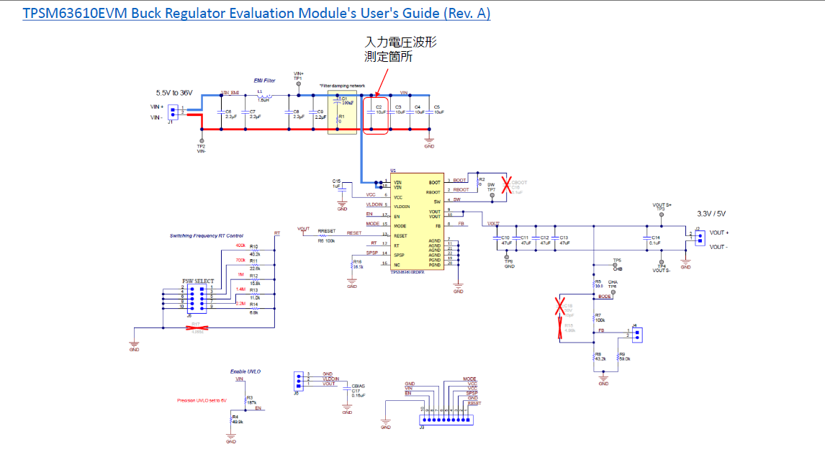
Input voltage waveform
Measurement point

Slide 8
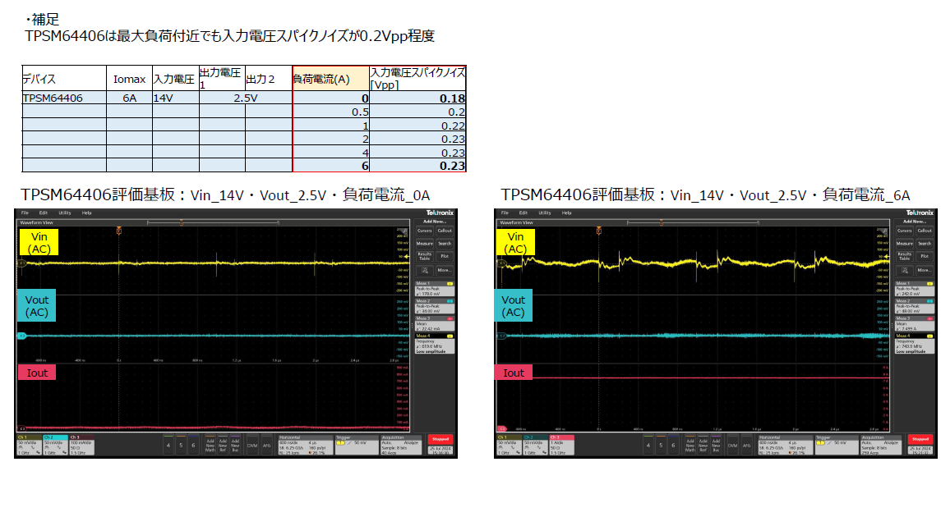
The reference
TPSM4406EVM has approximately 0.2 Vpp input voltage spike noise even maximum load
TPSM64406EVM : Vin_14V, Vout_2.5V, load current_0A
TPSM64406EVM : Vin_14V, Vout_2.5V, load current_6A

Slide 9
Input voltage waveform
Measurement point

