Slide 1
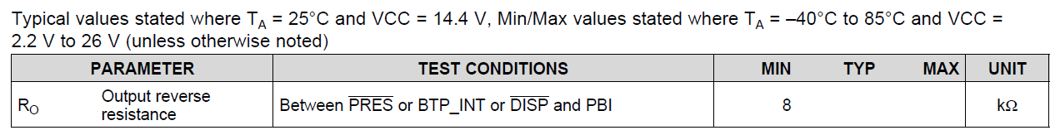
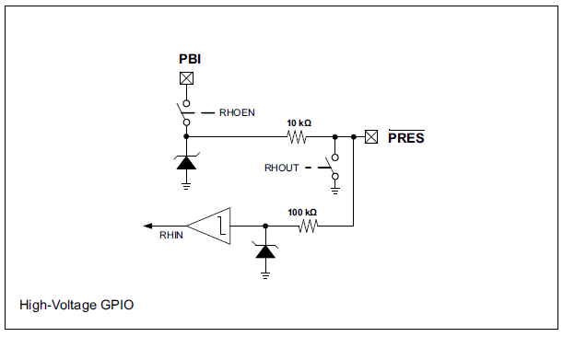
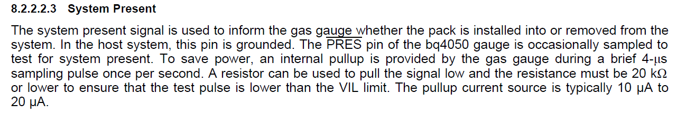
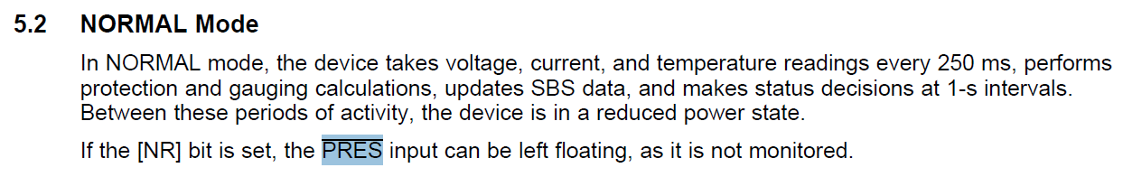
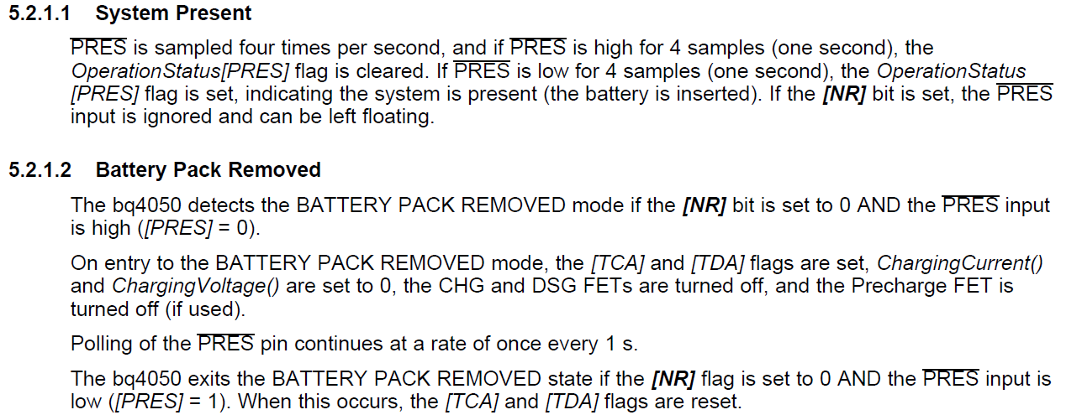
Close for every 250 ms
Expected to be open when RHOEN is close
10 k when battery is connected to main board
Open when battery is not connecting to main board
GND

Slide 2
ICU team finding with TI (NR bit set to 0):
TI- EVM with a raw battery
Without connected to system board : PRES bit = low
With system connected : ~ 0V. PRES bit = high
PRES pin operated per design
Resistivity measure indicated PRES have 250K to GND
250 ms
4V
0V
Battery cell with FG
Without connected to system board : ~ 0V (monitor by scope) PRES bit = high
With system connected : ~ 0V. PRES bit = high
If we connected an external power source to the pin, when voltage raise pass 1.3V, PRES but go low
Resistivity measurement indicated PRES have a 100 ohm to GND all the time.
Suspected “RHOUT” switch is closed all the time

