Slide 1
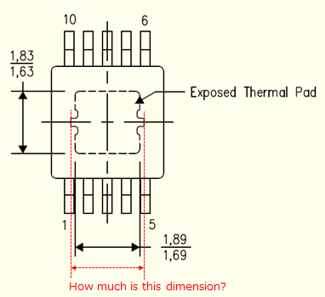
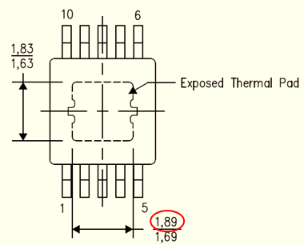
DataSheet28page

Slide 2

CAD file

Slide 3
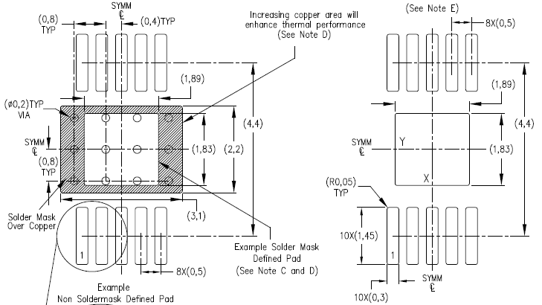
DataSheet29page

Slide 4
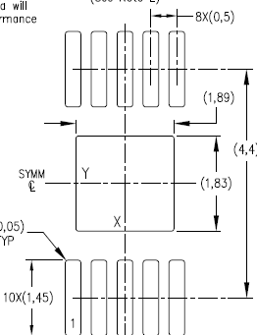
About the difference of shape
CAD File
DataSheet28page
Datasheet 29page
Why is the shape different depending on the material?
Which one is correct?

