Slide 1
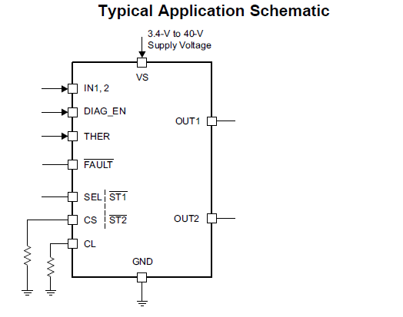
VS=12V
IN1=H
Sw ON( Hot-plug)
Iout
Iload
220uF
(Pre charged)
RL(4ohm)
ICL=1.8A
If SW was ON, Iload is limited to ICL.
/ST1 indicates low if Iout > ICL immediately.
Anyway, if cap(220uF pre-charged ) were at OUT1,
/ST1 indicates low with delay….. This is Customer’s problem.
So, large cap on OUTx terminal is not recommended for hot-plug detection.
Because Iload is supplied from cap which is pre-charged .
Is this idea ( I had talked customer so ) correct?
Please give me your opinion.
( I ‘ll ask customer to monitor Iout)
Iload
1.8A=ICL
limitted
/ST1
High
Low
Delays approx. 1ms

