Slide 1
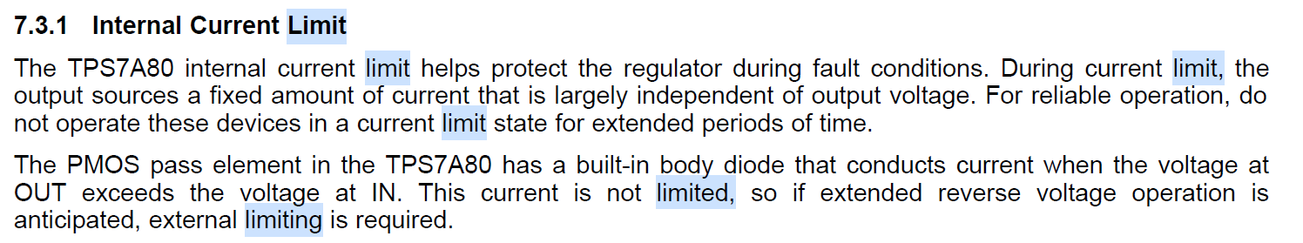
Q1. The soft-start time is expected to be approximately 1.6ms with CNR 10nF as noted in DS. I measured 1.71ms (CH3, purple) in slide 2 and it looks okay. But it can be divided into two sectors, even though I expected a RC charging waveform would appear with 33kohm series resistor and 10nF CNR.
My understanding about startup is as below.
<2ms : quick-start switch is closed → 33kohm series resistor + CNR
>2ms : quick-start switch is open → 250kohm series resistor + CNR
As 10nF of CNR would be fully charged within 2ms, I expected a smooth RC charging waveform, but it’s not the case here. Could you clarify quick-start switch operation? Why the soft-startup time is divided into two sector?
Q2. When I see the input current (CH4, green), it seems there is a high inrush current and there happens current limit, which is leading to the slow Vout ramp-up. I can’t understand why this slow Vout ramp-up time is shorten with higher CNR as compared in slide 2 and 3. Could you clarify the current limit operation?

Slide 2
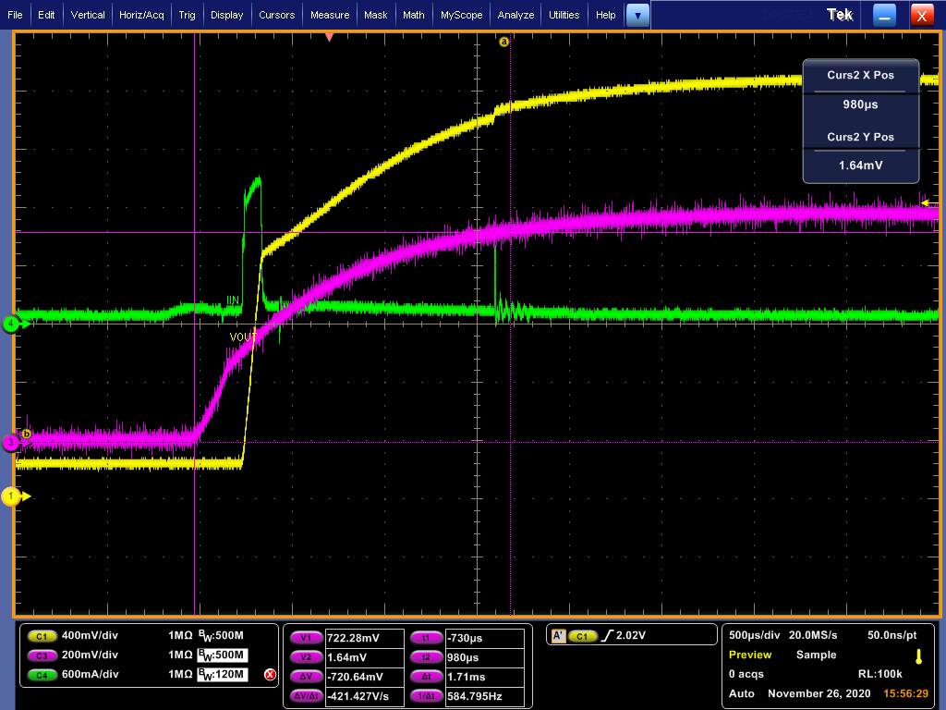
3.7Vin, 2.8Vout, CNR = 10nF, Cout = 10uF+66uF, other components as same as EVM itself
CH1 (yellow) : VOUT CH3 (purple) : CNR CH4 (green) : input current
Inrush current
Slow Vout ramp-up
1.71ms
when 0 to 720mV (0 to 90%)

Slide 3
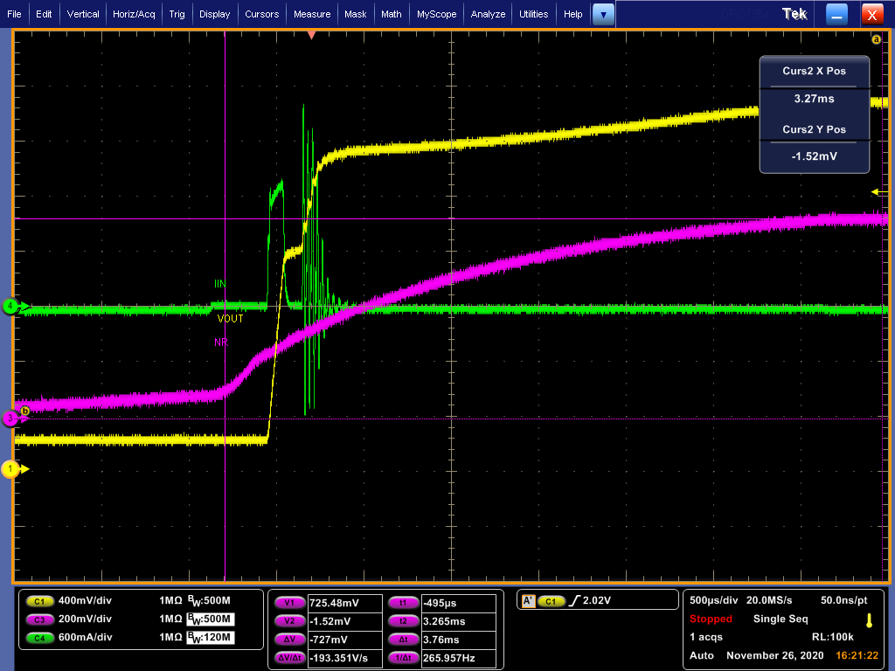
3.7Vin, 2.8Vout, CNR = 22nF, Cout = 10uF+66uF, other components as same as EVM itself
CH1 (yellow) : VOUT CH3 (purple) : CNR CH4 (green) : input current
Inrush current
Slow Vout ramp-up

