Slide 1
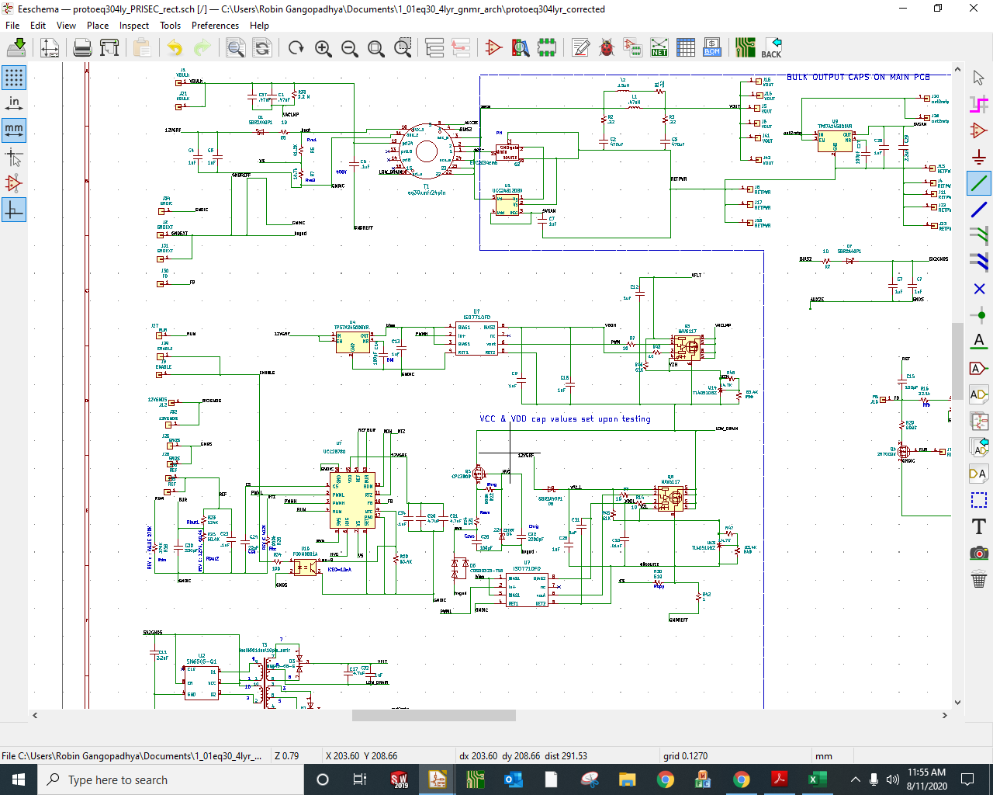
Planar magnetics
Auxiliary winding output
Upper NV bias vflt
Upper NV bias vflt
Upper NV bias vflt
fromSN6505B
5v
External

