Slide 1
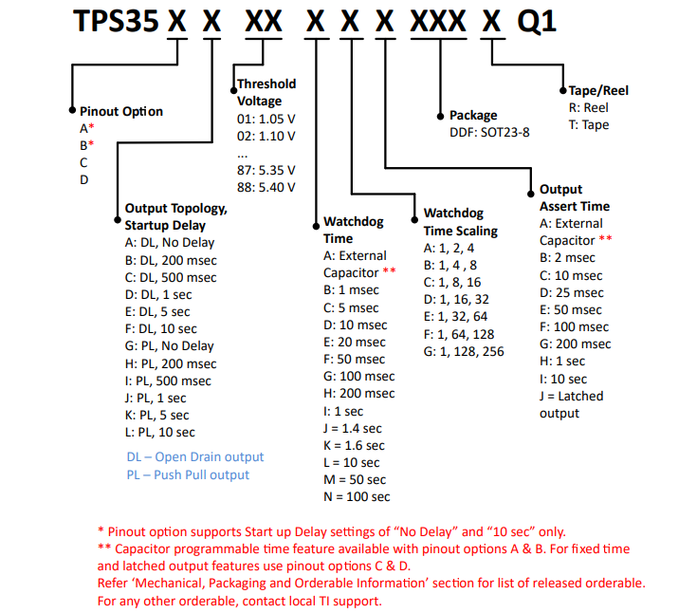
PPS35AA38AGADDFRQ1
→ Available part number in TI.com
Use case:
1. Need to output low from reset PIN during power up process for at least 8sec.
2. When the MCU go into error, we need to keep the reset pin in low level same as 8sec.
3.Twd for 200ms is okay for the woring status.
4. OC output.

Slide 2
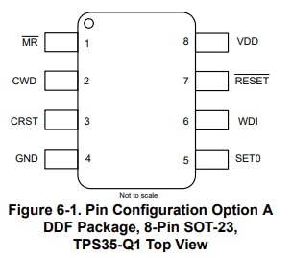
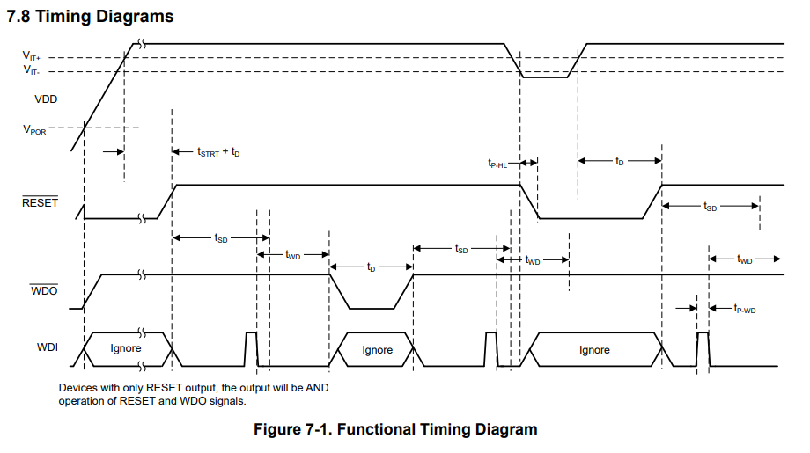
We need low level for 8s during power on
Here it is my understanding:
by setting Cap of Crst, we can set Td time as 8s as we need in the first page use case. But Tstart is fixed by above parameter.
so we can only by changing the cap of Crst?

Slide 3
And Operation=0
When MCU error, WDI no input, we need low level output as 8sec to wait for system back to normal

Slide 4
My understanding :
-> WD time = Twd X N(multiplier).
->by setting Cap of Cwd can set the baseline of Twd.
->by setting SET0 = 0, we get the N=1.
My question is :
What s the meaning of 10ms in SET0=0 and 1280ms in SET0=1?
How to calculate the n?

