Slide 1
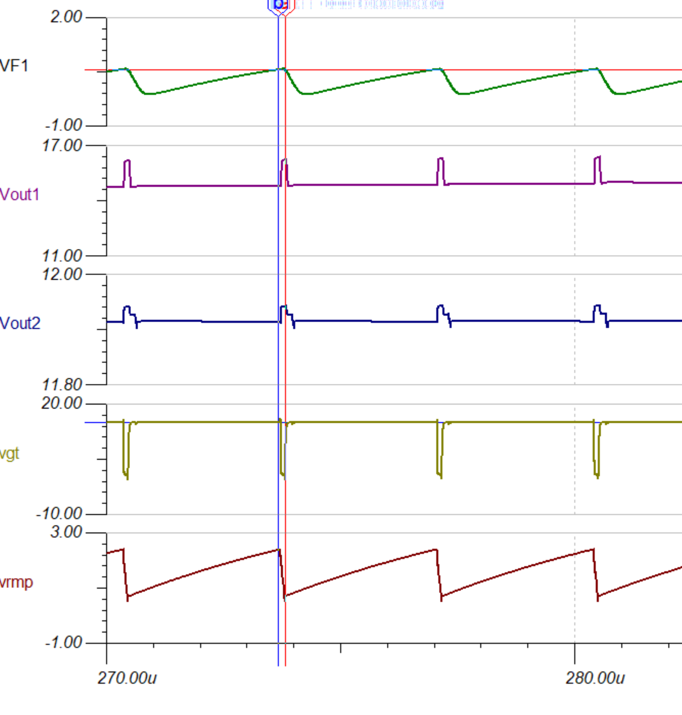
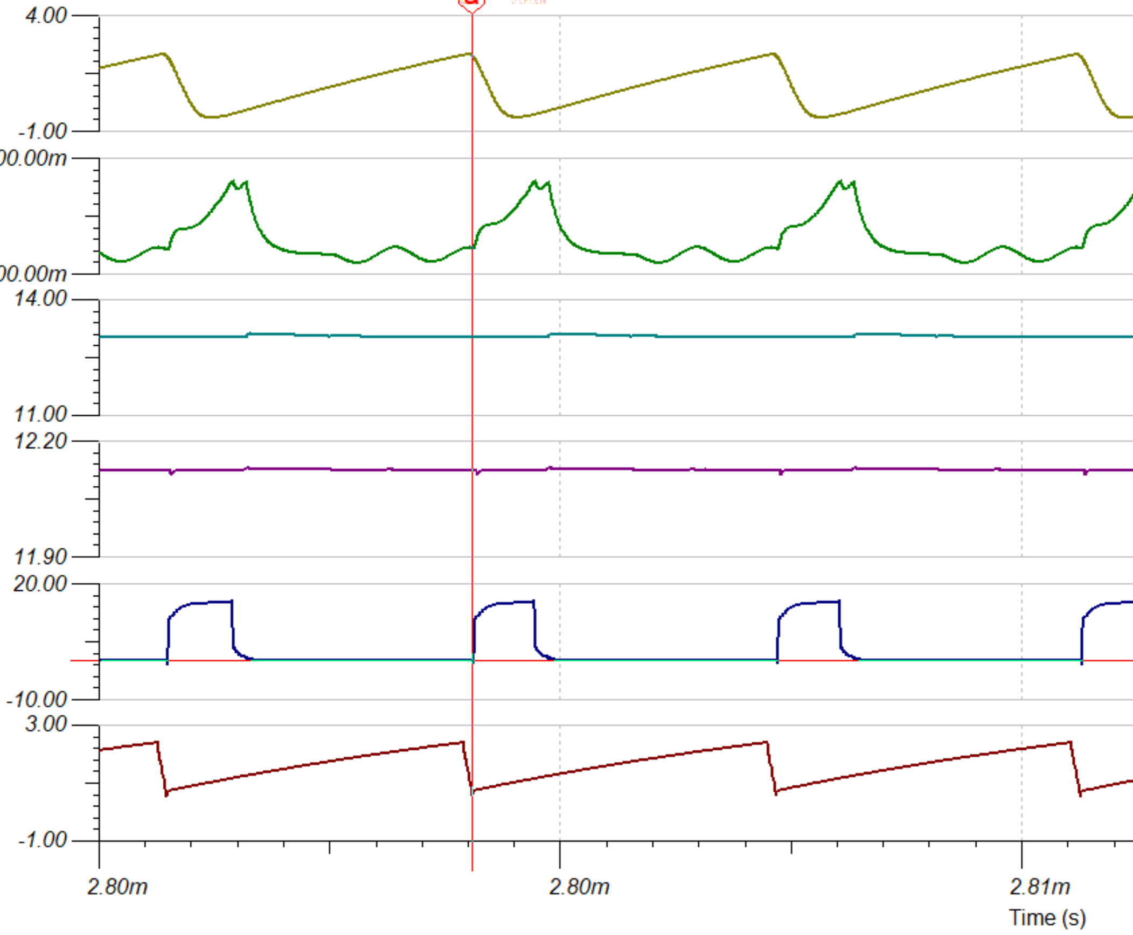
Signals from ucc28c42 current mode example: these show basic conflict of getting correct PWM if buffered ramp is applied at CS pin:
If peak of the buffered ramp is supposed to end the pulse, then there only a narrow fixed pulse width is obtained. Thus same ramp whose falling edge starts up gate pulse, cannot generate v/m operation with PWM
V/M CONNECTION
Buffered ramp at CS PIN
Buffered ramp
Current sense signal
Comp pin=2.5v
START OF GATE DR
GATE PULSE
Gate PULSE
end OF GATE DR
RTCT
start OF GATE DR
RTCT

