Slide 1
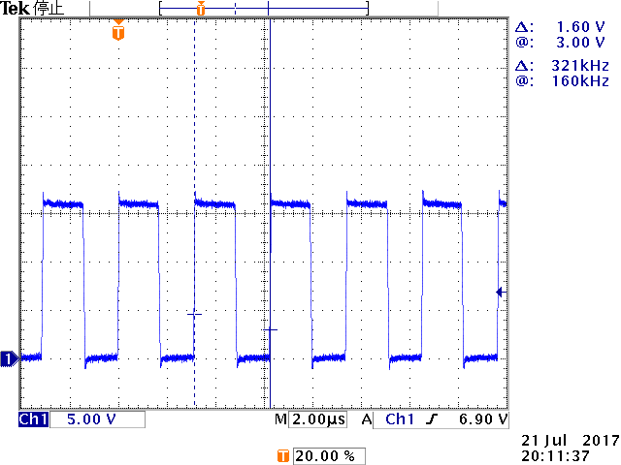
VIN=16V_Load=0A_SW

Slide 2
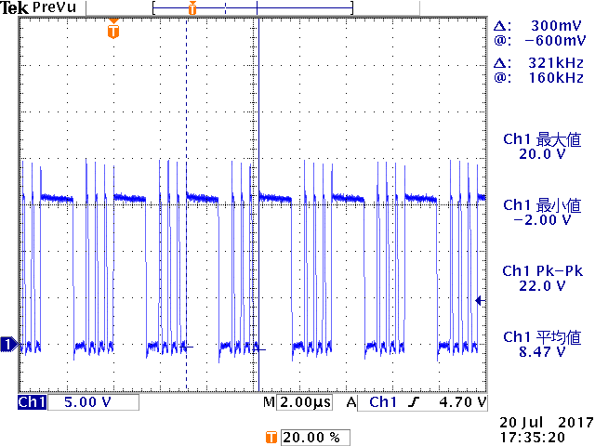
VIN=16V_Load=0.85A_SW

Slide 3
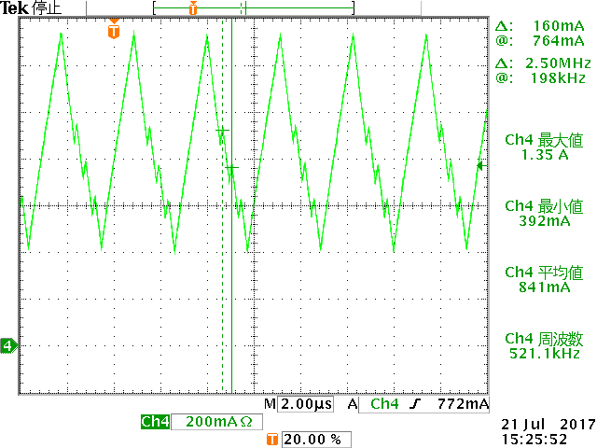
VIN=16V_Load=850mA_IL

