Slide 1
DAC38RF86EVM – Using JESD204B Interface for input data

Slide 2
DAC38RF82EVM setup details
Shunt JP10 removed, shunt JP3 installed.
DAC Sample rate: 2949.12 MSPS
LMK PLL2 set to VCO1 at 2949.12MHz. DAC CLK divider set to 1 to provide 2949.12MHz clock to DAC.
DAC EVM set to operate with JESD input data for output on CHA.

Slide 3
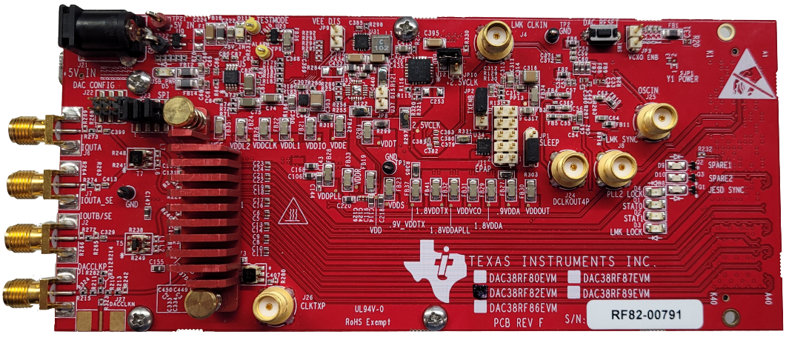
DAC38RF82EVM configuration
Shunt JP10 removed and shunt
JP3 installed
Connect spectrum analyzer

Slide 4
DAC38RF82EVM configuration
1. Toggle reset
Wait until red
Toggle again
2. Press Load Default

Slide 5
DAC38RF82EVM configuration
If you see this message, ignore it and press OK.

Slide 6
Setup as shown then click “CONFIGURE DAC”

Slide 7
Go to DAC38RF8x Clocking tab and unselect External Clock Select box.

Slide 8
Go to the LMK0428 PLL2 Configuration tab as shown below. Set VCO Mux to “VCO 1” Set Prescalar to “2” Set N divider to “12” Unselect Charge Pump Tri-State

Slide 9
Go to the LMK0428 Clock Outputs tab. Set DCLK Type to “LVPECL 2000 mV”. Set DCLK Divider to “16”. Make sure SDCLKout_PD is unselected for both CLKout 0 and 1 and CLKout 2 and 3

Slide 10
Setup HSDC Pro as shown below. Either send a custom test file or use the I/Q Multitone Generator. Click on ‘Send”.

Slide 11
Go to the Quick Start tab then click on “Reset DAC JESD Core & SYSREF TRIGGER”

Slide 12
There now should be an output tone on J6 (IOUTA).

