Slide 1
Building Vivado Ref Design

Slide 2
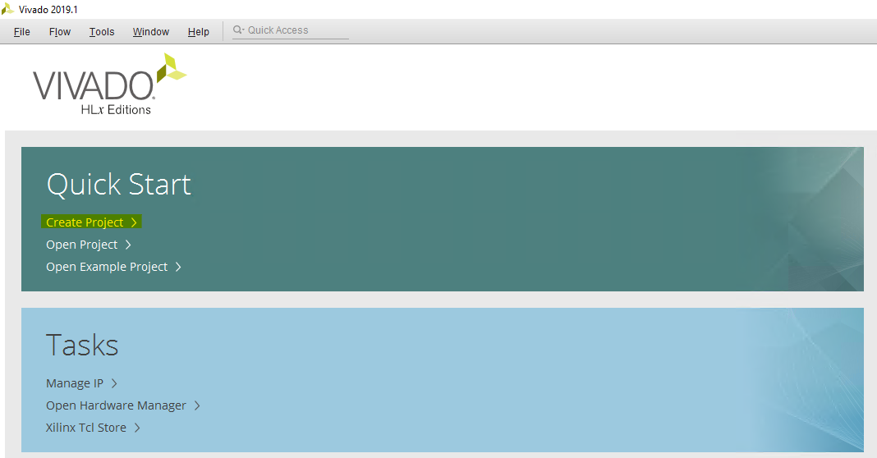
Step 1: Create New Project
The TI204c IP was built using Vivado 2019.1 so this version or a newer version must be used.
Once Vivado is open a new RTL project should be created.

Slide 3
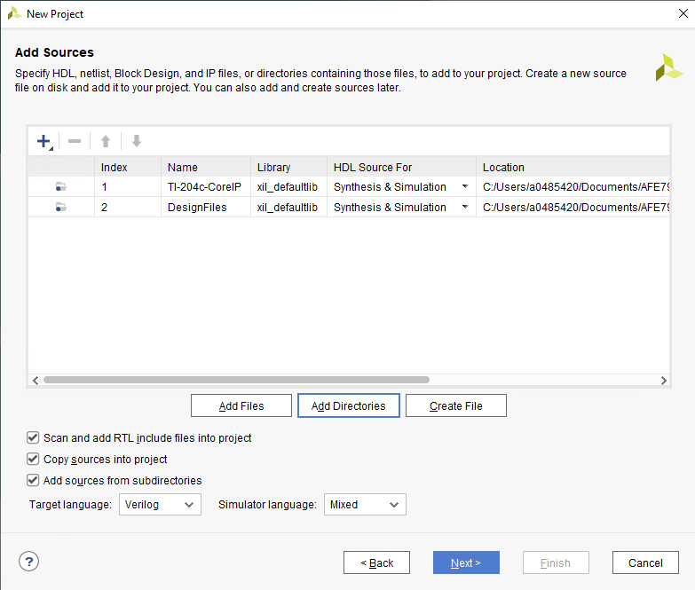
Step 2: Import Sources and constraints
Two directories should be imported for the sources:
  The DesignFiles folder from the AFE79xx_ZCU102 reference design.
  The TI-204c-CoreIP from the TI204c IP secure folder download.
The constraint file from the reference design should also be imported.

Slide 4
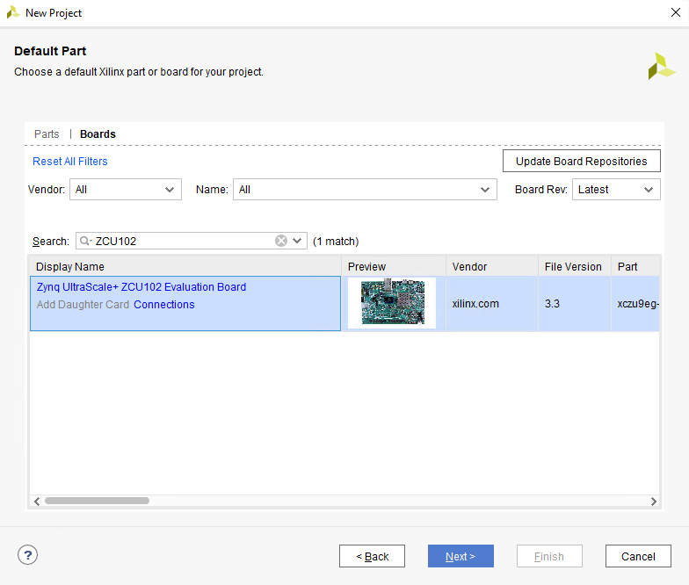
Step 3: Select FPGA/DevKit
The last step to create the project is to select the FPGA or dev kit that is being used.
In the case of using a ZCU102 dev kit you can search for the dev kit under the ‘Boards’ tab.

