Slide 1
DAC38RF82 EVM NCO Only Output

Slide 2
Test Setup
Download the DAC38RF8xEVM Graphical User Interface (GUI) software that controls the DAC EVM: https://www.ti.com/lit/zip/slac722
Connect a 9GHz external clock @ 14dBm to SMA J1 (DACCLKP)
Connect provided USB cable between host PC and connector J16, located on bottom side of board.
Verify shunt on JP10 is installed. This located near the middle top edge of the board.
Connect a SMA cable between a spectrum analyzer and J6 (IOUTA).
Connect the provide power cable between a 5VDC power supply rated @ 3A to connector J21. Turn on the power supply.

Slide 3
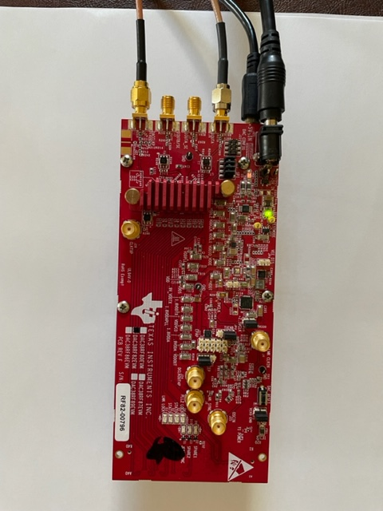
Board Setup

Slide 4
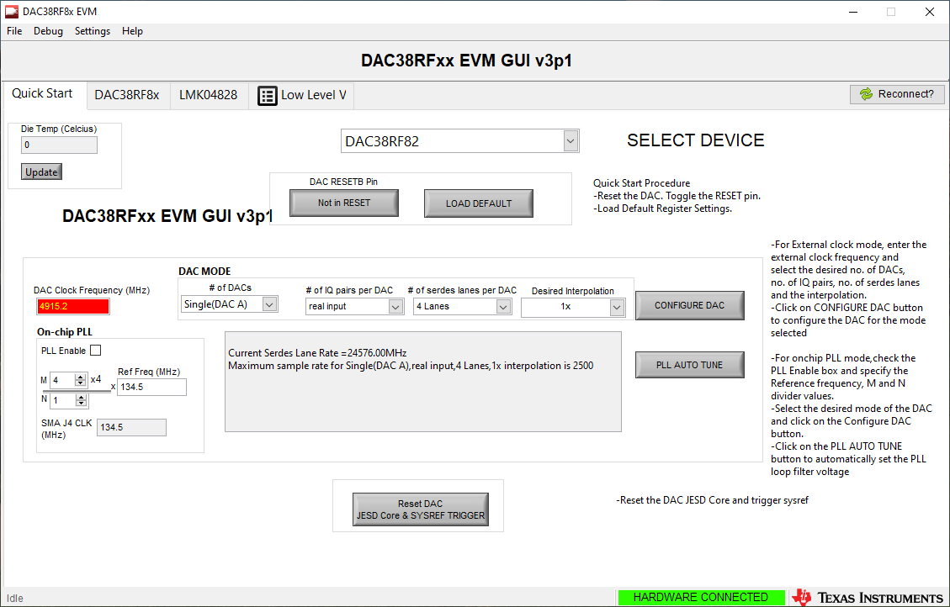
Open the DAC38RFxx GUI. Verify the message “HARDWARE CONNECTED” is highlighted in green as shown below.
Verify the current device selected is “DAC38RF82”.
If not, click on the drop down arrow and select “DAC38RF82”.

Slide 5
1. Click on “Not in RESET”. This will change to “DAC in RESET”.
2. Click on it one more time to take DAC out of reset.
3. Click on “Load DEFAULT”. This will load all of the registers with the default values.

Slide 6
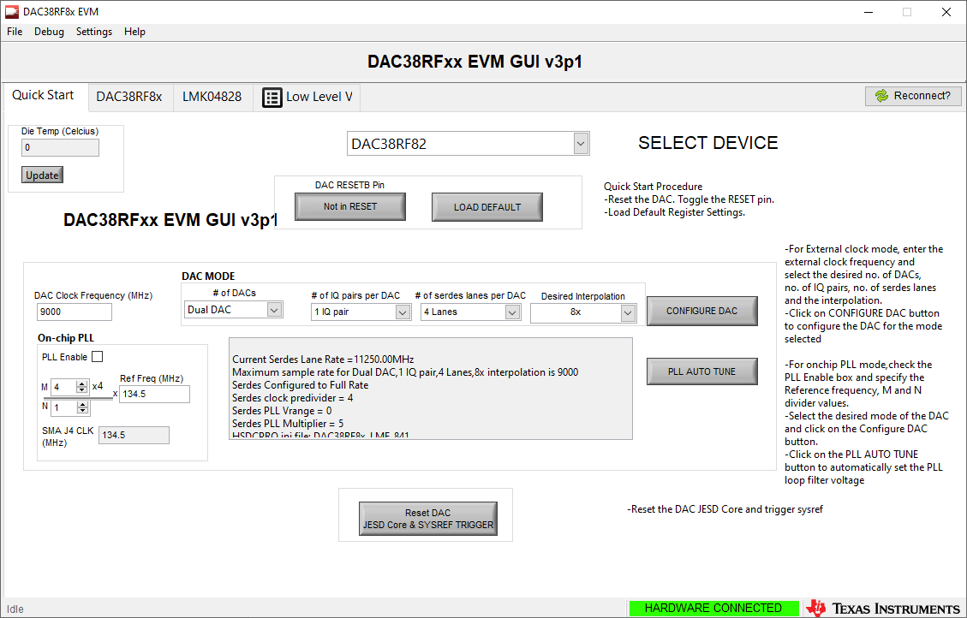
Enter 9000 for the DAC clock frequency.
Set # of DAC’s to Dual DAC, set # of IQ pairs to 1 IQ pair, set # of serdes lanes per DAC to 4 Lanes, and set Desired Interpolation to 8x, as shown below.
Click on “CONFIGURE DAC”.

Slide 7
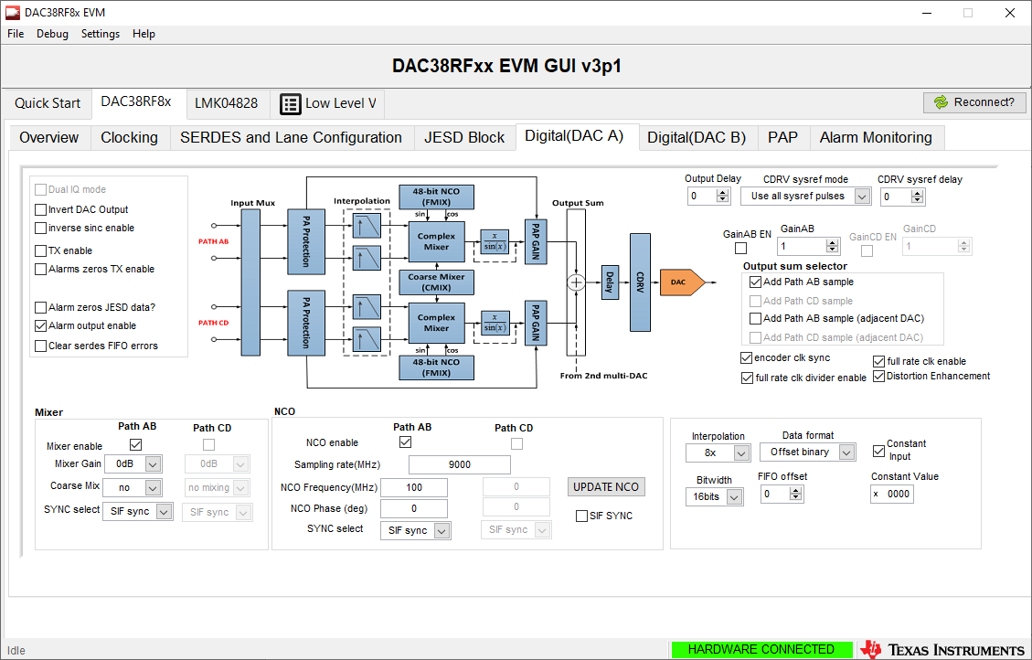
1. Click on “Digital(DAC A)” tab 2. Click on Mixer enable, Path AB, and NCO enable Path AB
3. Set the Data format to “Offset binary”.
4. Enable Constant Input as shown.
7

Slide 8
1. Enter desired NCO frequency in the NCO frequency box. Example below is set to 100MHz. 2. Click on “UPDATE NCO”. There should now be a 100MHz tone at SMA J6.
8

