Slide 1
Environment
Orange
Green
Yellow
Blue
LMK04832
DAC38RF83
2560 MHz
2560 MHz
420 MHz /
1020 MHz

Slide 2
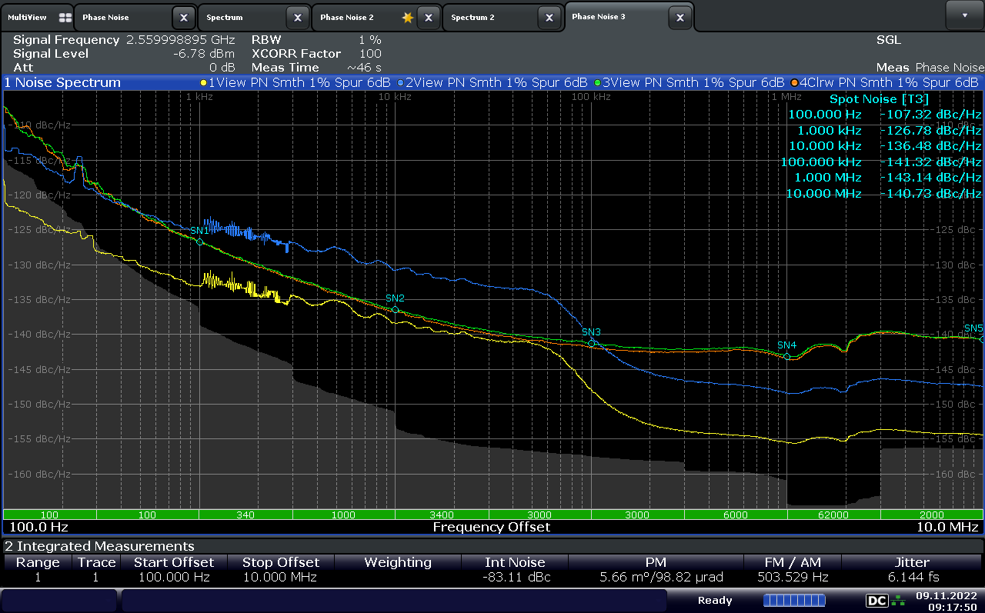
1020 MHZ
2560 MHZ
420 MHZ

