Slide 1
DAC38RF82 SYSREF NCO Test

Slide 2
DAC38RF82 SYSREF NCO Test
Test Setup:
6000MHz external clock to J1
Shunt on JP10
NCO = 100MHz
Monitor CHA output with spectrum analyzer
Make sure SYSREF is continuously running and not a frequency that is a whole integer multiple of the NCO frequency.
In this example the NCO will be set o 100MHz and SYSREF will be at 4.6875MHz. The NCO will be synchronized by every pulse of SYSREF. If the DAC is capturing SYSREF properly, the output will be many tones (second from last slide) as the NCO will be reset by a non-coherent frequency.
If the DAC is not receiving SYSREF properly, the NCO will be a solid tone (last slide).

Slide 3
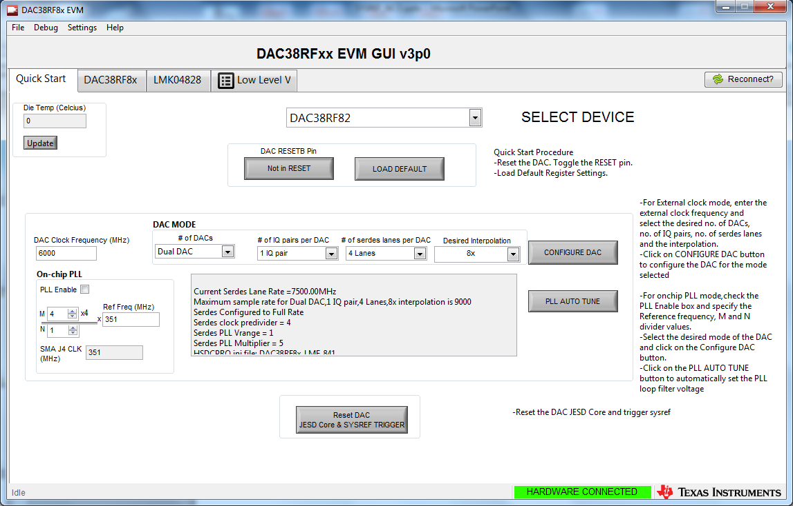
Open DAC38RFxx EVM GUI. Select DAC38RF82. Double click on “Not in RESET”. Click on “Load DEFAULT”. Set DAC Clock frequency to 6000MHZ. Click on “CONFIGURE DAC”

Slide 4
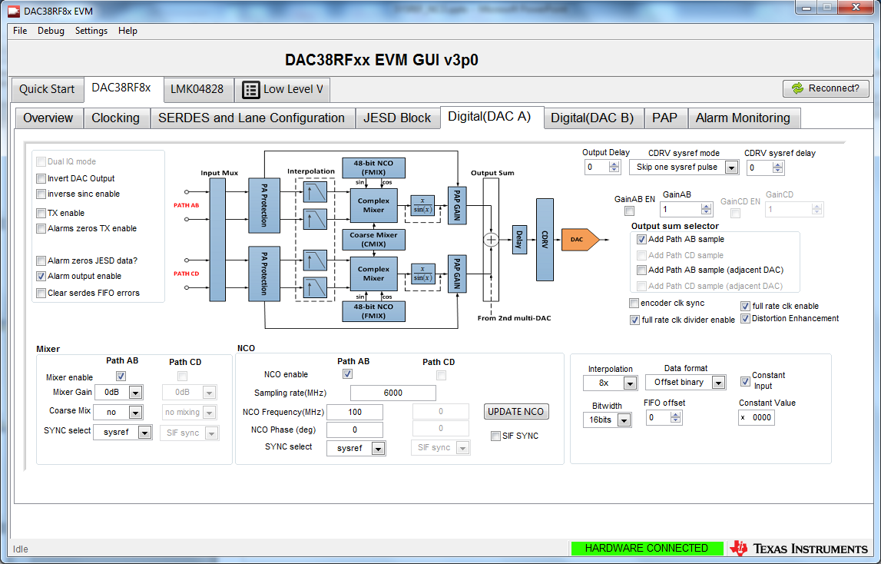
Click on “DAC38RF8x “ Digital(DAC A)” tab 1. Select the “Constant Input” box. 2. Set the ”Constant Value” to “0000”. 3. Set “Data Format” to “Offset binary. 4. Setup NCO as shown below. Click on “UPDATE NCO”

Slide 5
To make the changes from the previous slide, write to the following addresses
Add 0x10C Data 0x2420
Add 0x127 Data 0x2828
Add 0x12F Data 0x0001
Add 0x130 Data 0x0000
Add 11E Data 0x4444
Add 11F Data 0x4444
Add 120 Data 0x0444

Slide 6
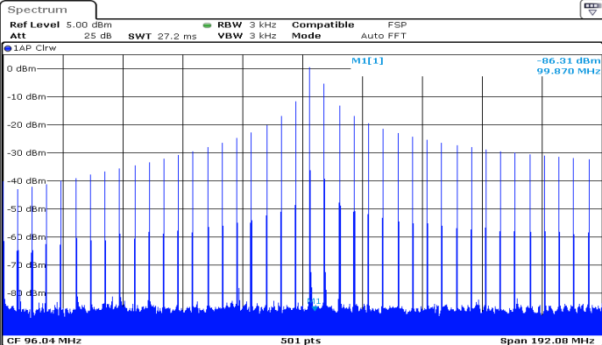
DAC CHA output with SYSREF latched properly

Slide 7
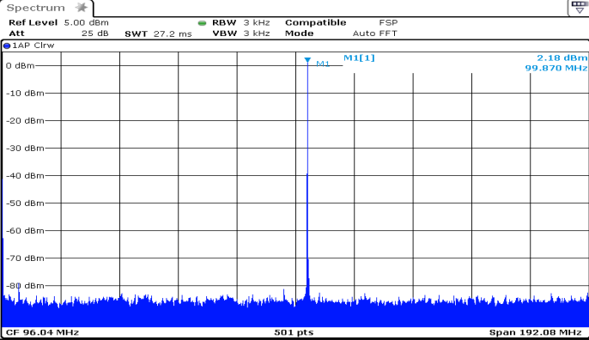
SYSREF not latched properly are missing

