Slide 1
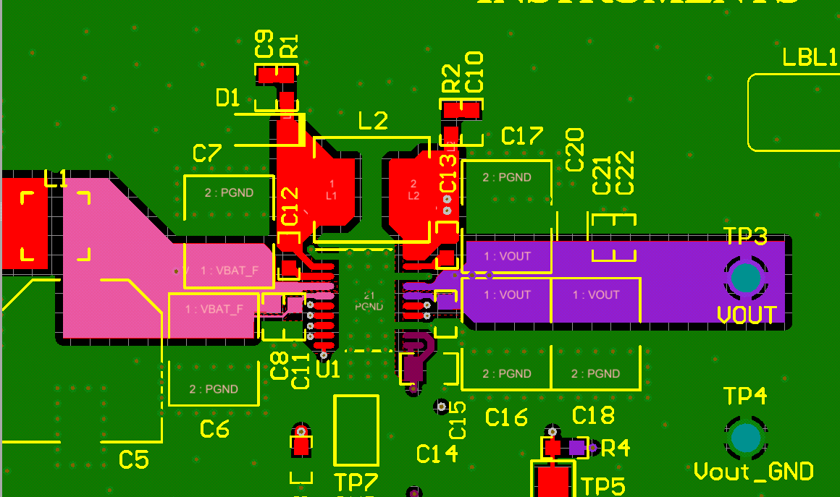
Top Layer
AGND and the PGND connected on top layer.
Input and output cap should very close to the IC. Please
follow the above picture

Slide 2
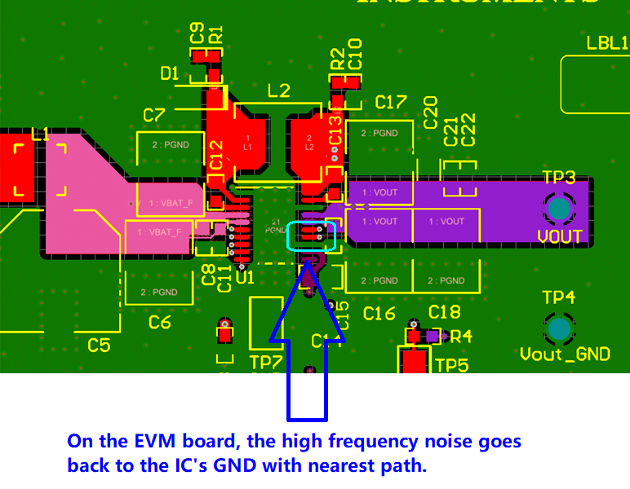

Slide 3
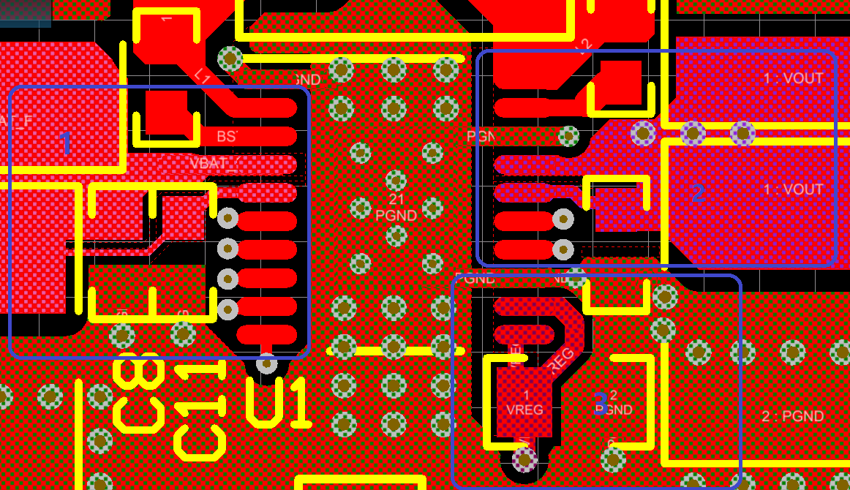
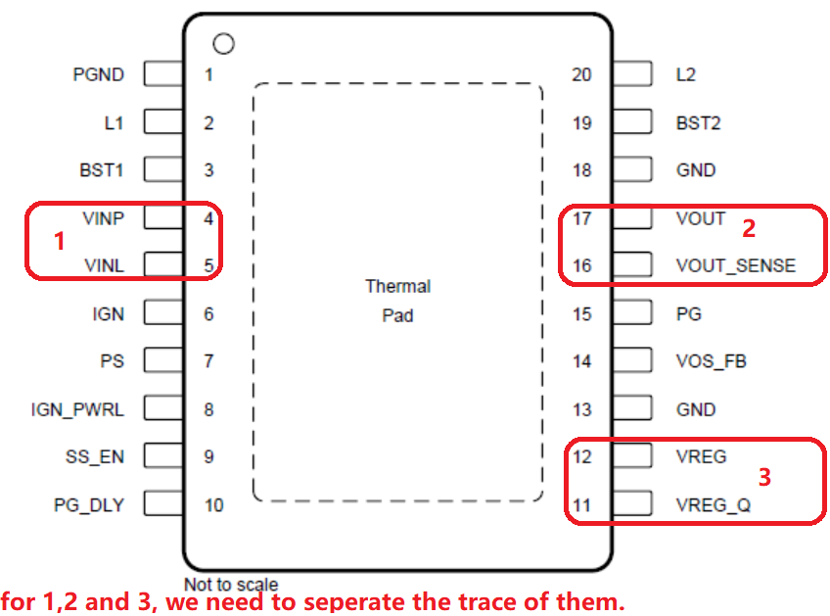

Slide 4
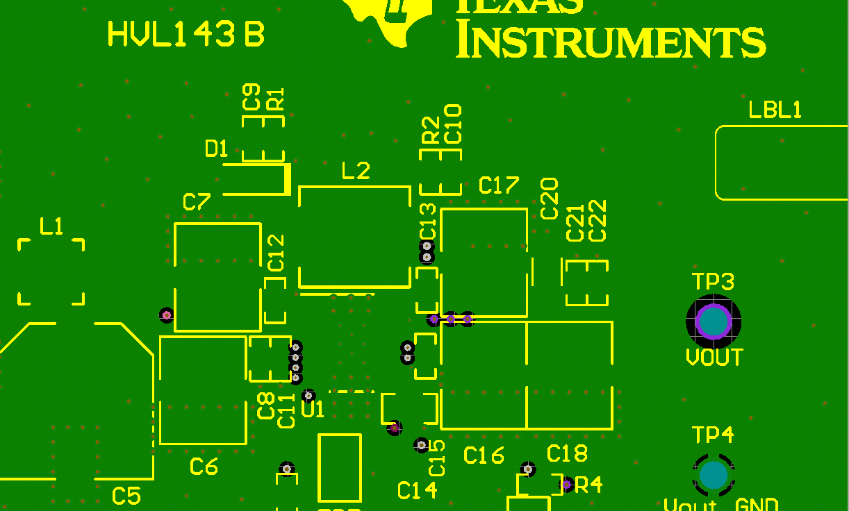
Inner Layer-1
Whole GND plane

Slide 5
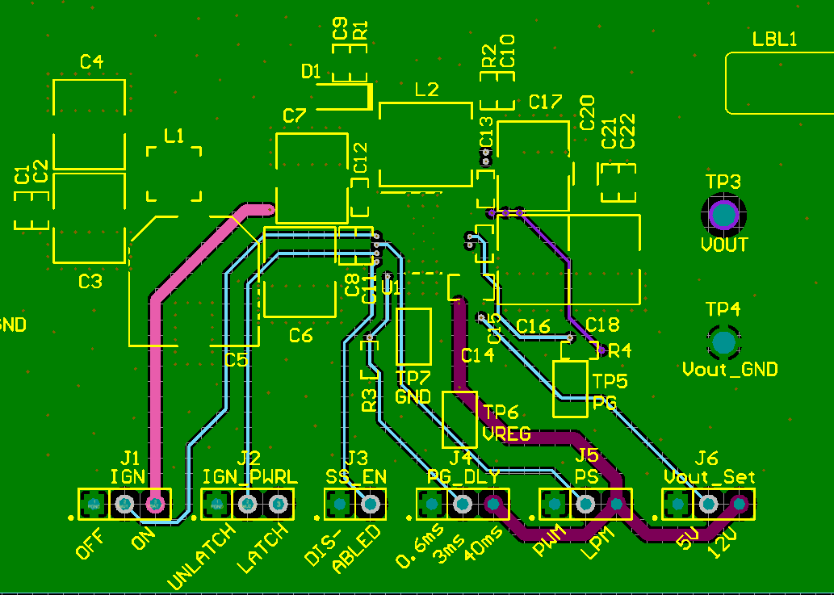
Inner Layer-2 –Test trace

Slide 6
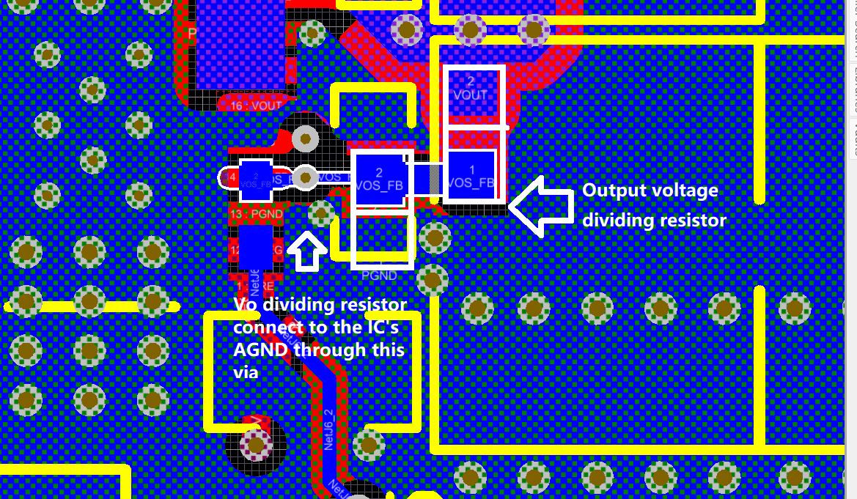
Output dividing resistor connection

