Slide 1
Summary
We download Pspice from TI website and run with Simplorer (ANSYS) however the result is not good.
We compare with TINA-TI. TINA should be functioned but Simplorer not.
We contact with ANSYS to verify the root cause. As of today ongoing action.
Request is to have unencrypted Pspice model to verify Toshiba internal.

Slide 2
Verification for TI PSPICE model to Simplorer

Slide 3
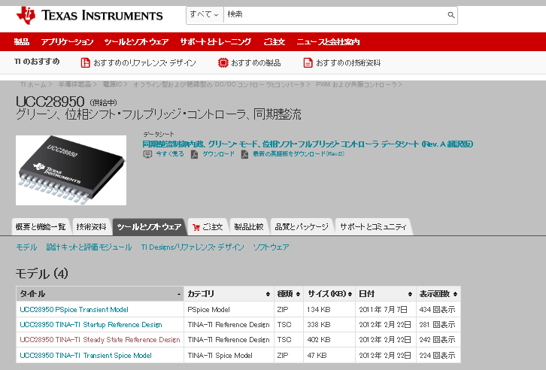
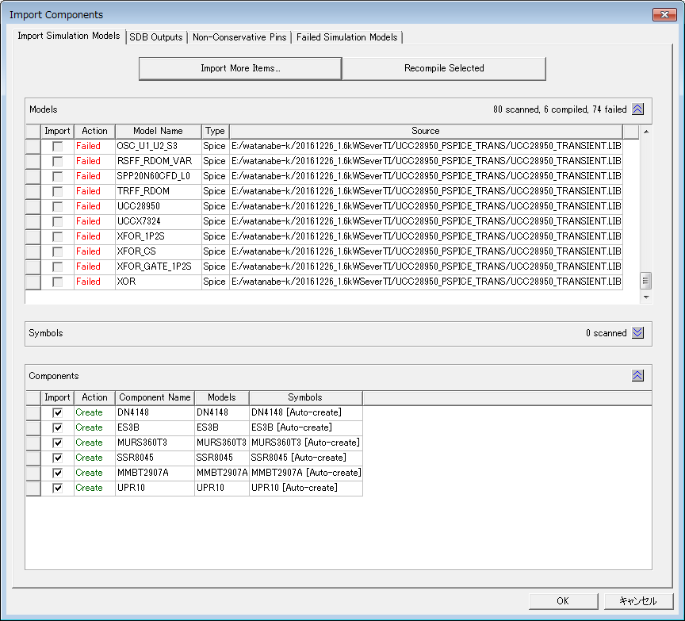
Load UCC28950 Pspice to Simplorer
Cannot verify the root cause (Potential cause is the file is encrypted?)
Pspice for UCC28950

Slide 4
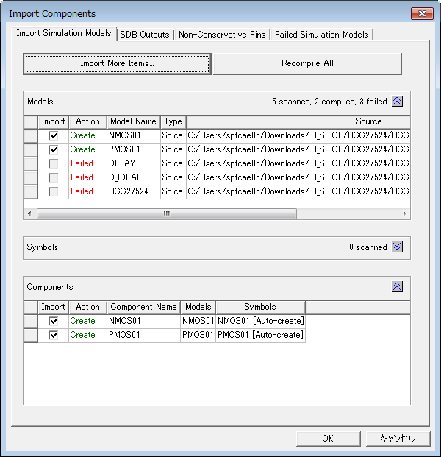
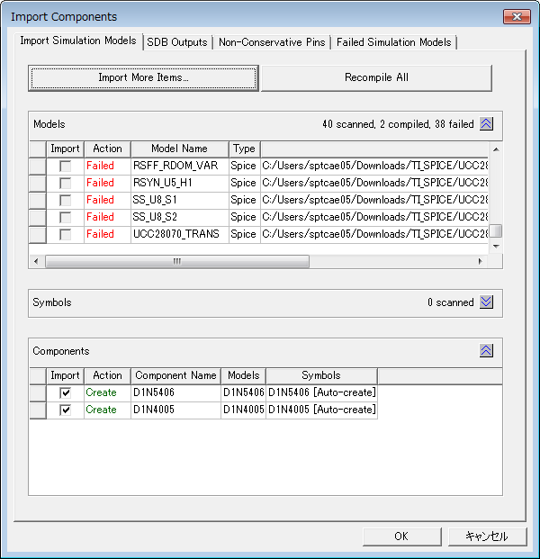
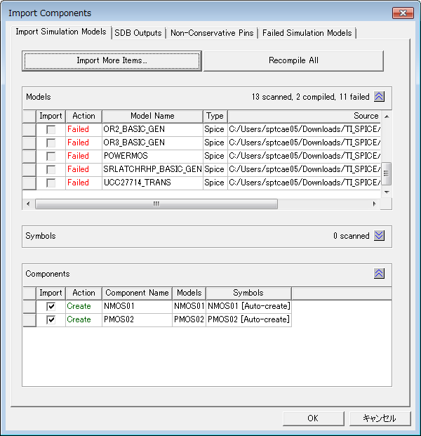
Other PSPICE loading to Simplorer
UCC27524
UCC28070A
UCC27714
（GateDriver）
Same error happen

Slide 5
Verification of built-in model with UCC28950 for Simplorer

Slide 6
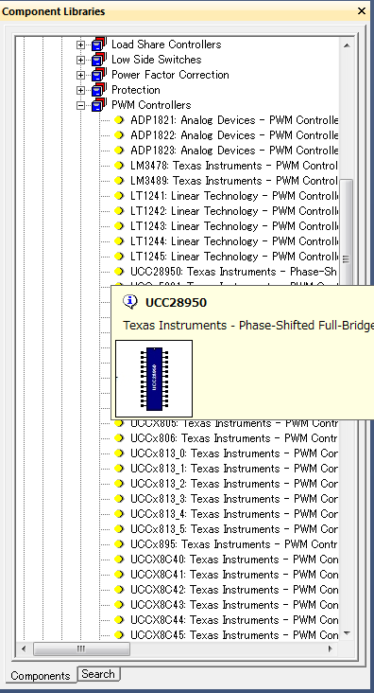
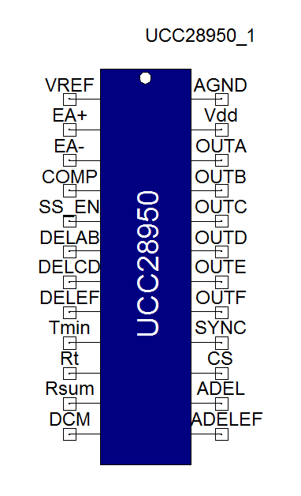
UCC28950 Simplorer model
Built-in model for Simplorer

Slide 7
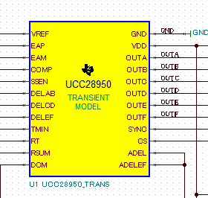
Tina-TI model
http://www.tij.co.jp/product/jp/UCC28950/toolssoftware
Tina-TI Macro model symbol
UCC28950 for Tina-TI model

Slide 8
Comparison between Simplorer and TINA-TI
ANSYS Simplorer
Tina-TI
Pin-out is matching

Slide 9
UCC28950 Simplorer model
Run verification with PSFB circuit
Simulation is now running…

Slide 10
Verification of built-in model with UCC1895 for Simplorer

Slide 11
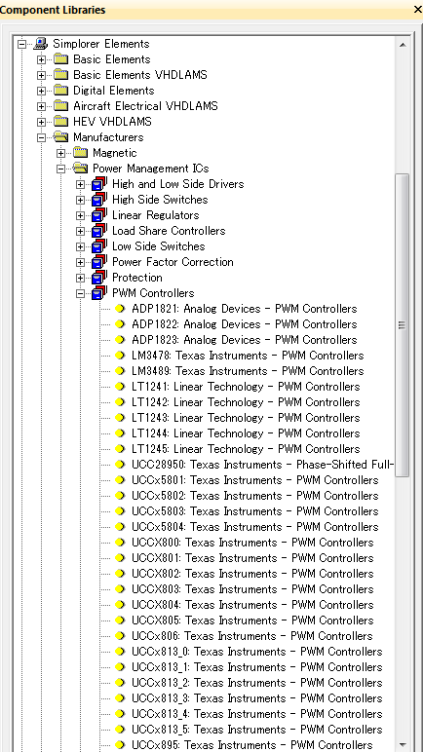
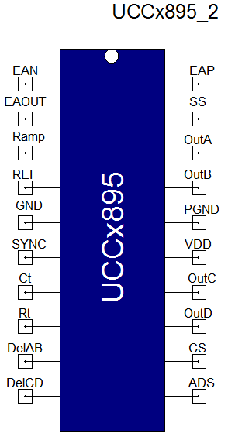
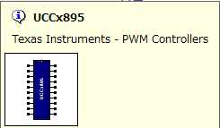
Simplorer model
Texas Instruments - PWM Controllers
Manufacturers\Power Management ICs\PWM Controllers:UCCx895
Built-in model for Simplorer

Slide 12
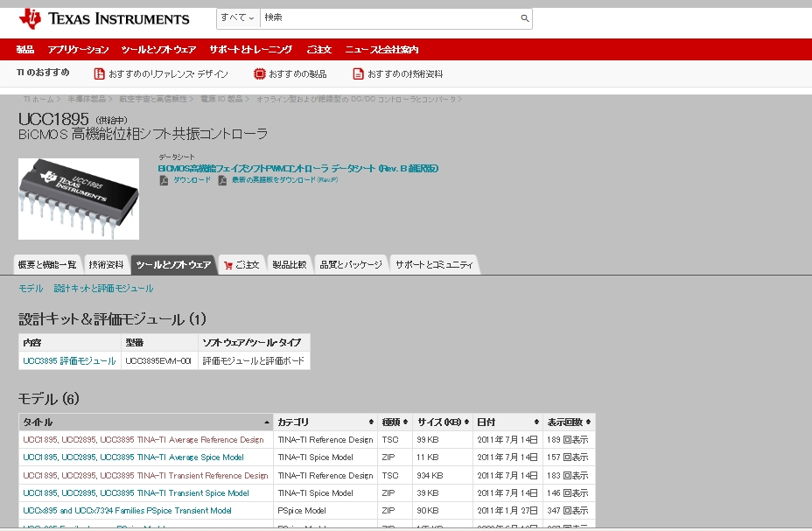
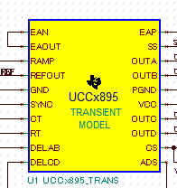
Tina-TI model
http://www.tij.co.jp/product/jp/UCC1895/toolssoftware
Tina-TI macro model symbol
UCC1895 for Tina-TI

Slide 13
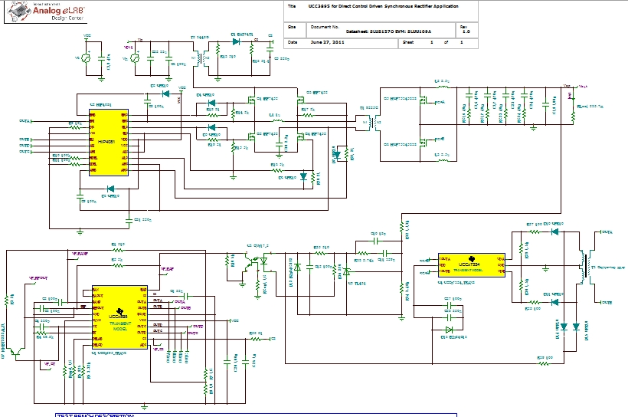
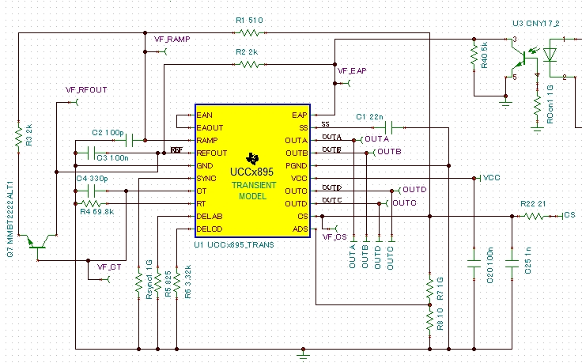
Tina-TI circuit model (slum186)
Tina-Ti model (slum186)
TINA-TI model for UCC1895

Slide 14
Simplorer circuit model
Develop UCCx895 circuit with Simplorer based on TINA-TI circuit model

Slide 15
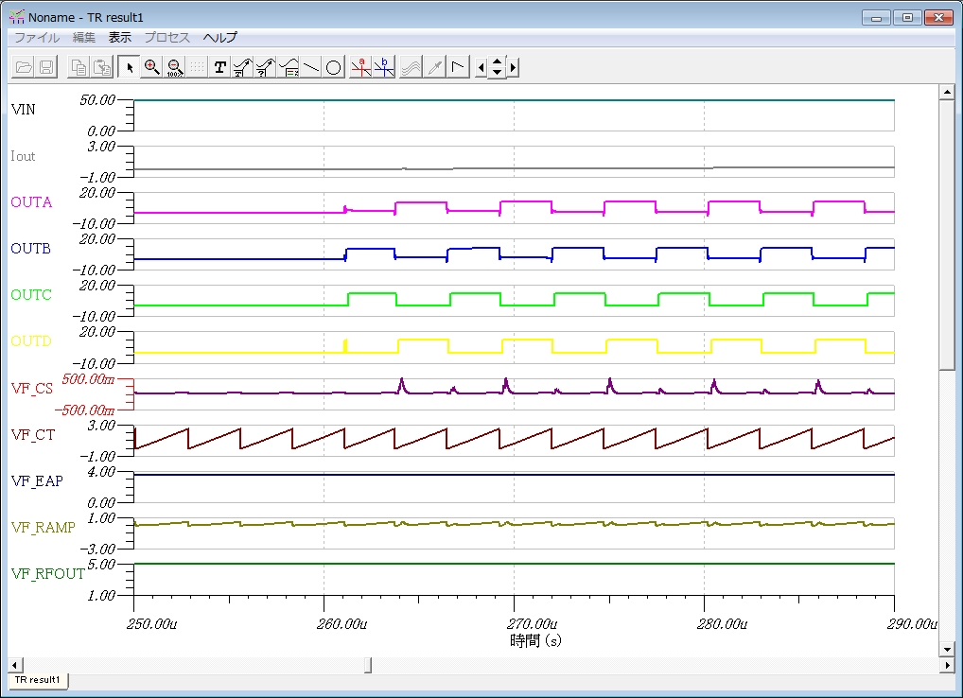
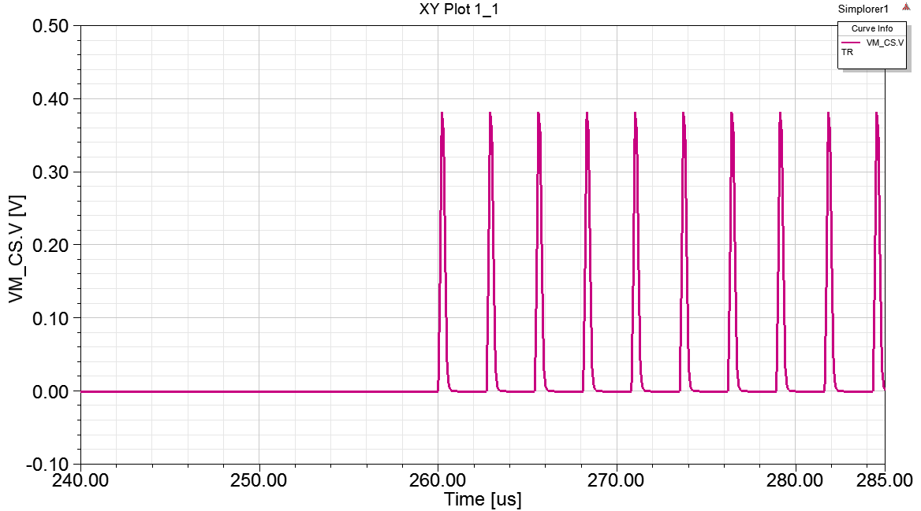
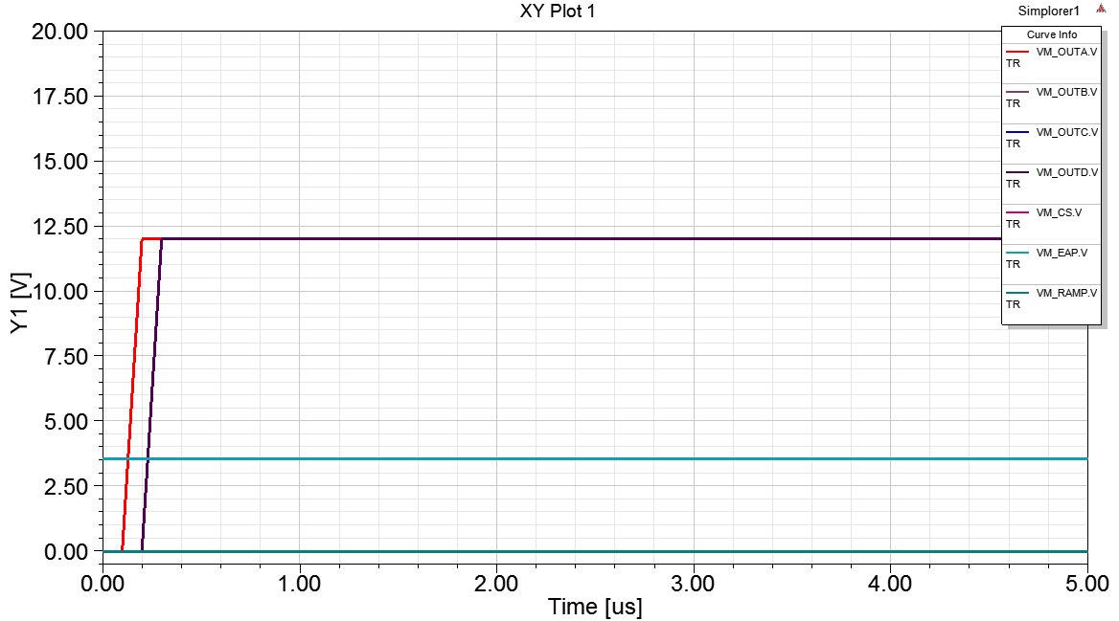
Comparison of simulation result
Result from Tina-TI(slum186)
Result from Simplorer
CS.V comes from the result of TINA-TI
Control signal (OutA,B,C,D) did not move after 12V.
（PSFB never do function）

