Slide 1
LMR51603X Analysis

Slide 2
BOM used for testing
L=100uH, 0.8A rated
Cout= (4.7uF || 10uF)
RFBB=7.15kΩ
RFBT=100kΩ
LMR51603X (PFM Variant)

Slide 3
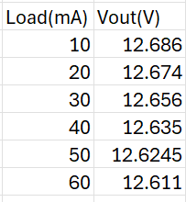
Load Regulation, Vin=48V

Slide 4
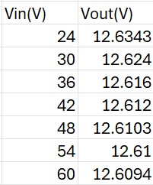
Line Regulation, Load=60mA

Slide 5
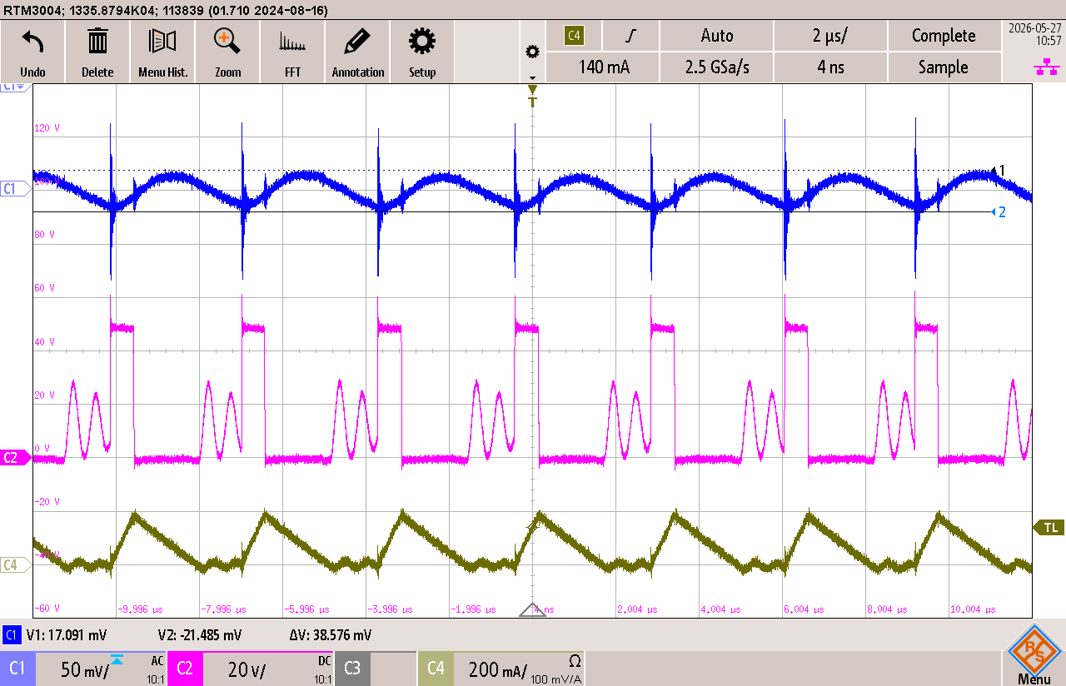
Vout Ripple, Vin=48V, Load=60mA
Coupled Switching Noise
Vout Ripple= 39mV

Slide 6
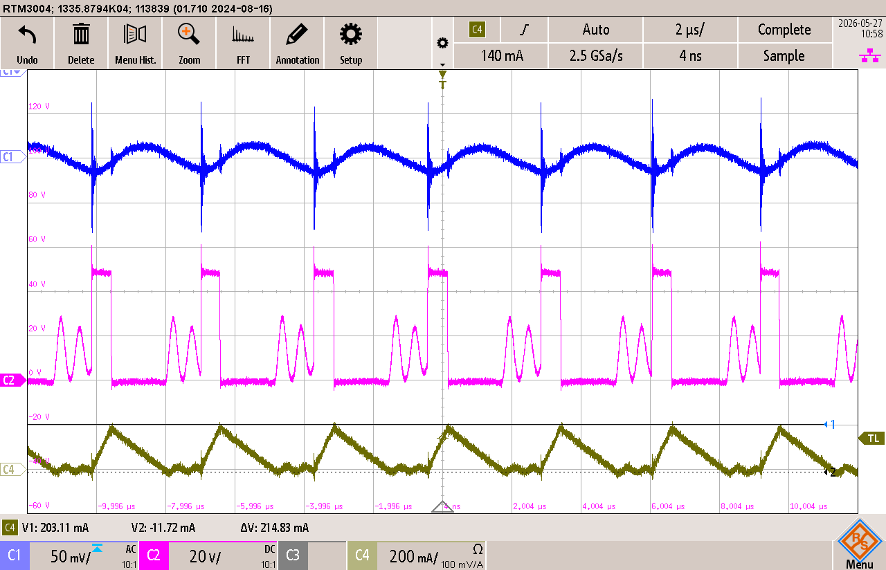
Inductor Current Ripple, Vin=48V, Load=60mA
IL Ripple= 215mA

Slide 7
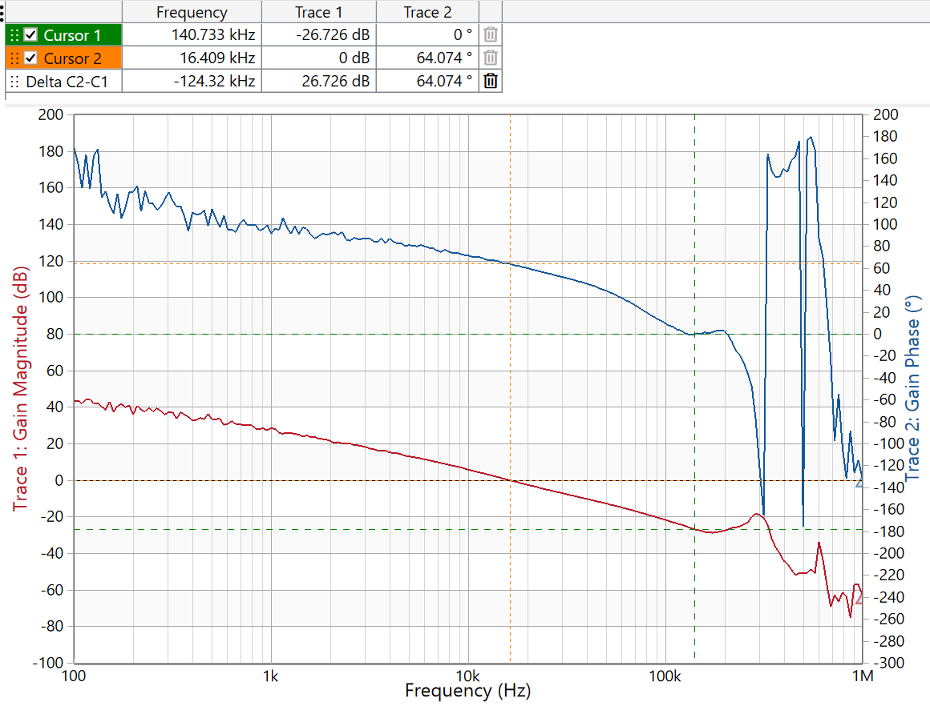
Bode Plot, Vin=48V, Load=60mA, Vout=12.7V
GM= 26dB
PM= 64⁰

