Slide 1
PMP41134 –
3.6kW Bi-directional SRC-DAB DCDC converter reference design
Power Design Services – Industrial High Power
Guangzhi Cui
November 10, 2024

Slide 2
List of Contents
PMP41134 Reference Design One Pager
Key Specifications
Block Diagram or Key (Simplified) Schematic
Key Design Considerations
Key Test Results
Reference/Related Materials

Slide 3
3.6KW SRC-DAB for Residential PCS
In Development
Features
Benefits
System Specifications:
  Nominal output power 3600W
  Output Voltage range 40-60V (48V typical)
  Input Bus Voltage range 360-550V (400V typical)
  Maximum charge/discharge current 75A
  Peak Efficiency > 98%
  Europe Efficiency > 97.5%
  Frequency range 100-300kHz
  Forward and reverse Switching time <10ms
Can achieve a high efficiency with a wide range.
Suitable for applications that require fast switching of bidirectional power flow
TPS + variable frequency help extend ZVS range and minimize resonant tank currents and reactive power
Applications
Power conversion systems (PCS) in energy storage system
Portable power system(PPS)
Tools & Resources
TIDA- Tools Folder
C2000 Digital Power SDK
Design Files: Schematics, BOM and BOM Analysis, Design Files
Key TI Devices: TMS320F28P55, UCC21551,INA199 AMC0311, AMC1302 ,UCC27301A, LMG3100R017

Slide 4
Key Specifications
PMP41134 is a SRC-DAB DC/DC converter which is aiming PPS & ESS end equipment
Need support wide battery range in low voltage side (normally 40V to 60V)
 | PARAMETER | Spec Range |  |  | Units
 |  | Min | Typ | Max
Battery charging Mode | Input voltage | 360 | 400 | 550 | V
 | Output voltage | 40 | 48 | 60 | V
 | Output Current | 0 | 75 | 75 | A
 | Continuous Output power | 3600 |  |  | Watt
Reverse power flow Mode | Input voltage | 40 | 48 | 60 | V
 | Output voltage | 360 | 400 | 550 | V
 | Continuous Output power | 3600 |  |  | Watt
Operating ambient temperature |  | -30 | 25 | 55 | °C
Dimension |  | 250*130 |  |  | mm
Back to list of contents slide

Slide 5
Block Diagram or Key (Simplified) Schematic
Design parameters
Resonant inductance: 168uH
Magnetizing inductance: 2mH
Resonant capacitor: 20nF
Resonant frequency: 90kHz
Frequency range:100-300kHz
Back to list of contents slide

Slide 6
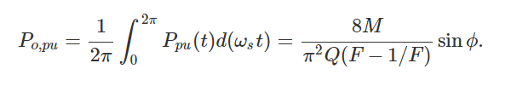



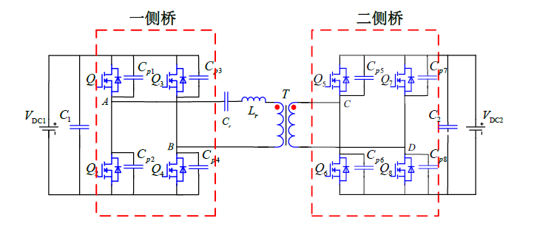
Key Design Considerations – control method selection
Compare the different control method used in SRC DAB
- Minimize the current stress and realize the wide range ZVS
- Compare the complexity of the control method
- The output power is controlled by the frequency and phase shift angle
Control scheme combos:
Primary
Secondary
Phase shift control | Frequency control
Single phase | Fixed Frequency
Dual phase
 | Variable Frequency
Triple phase
N:1

Slide 7
Comparison results
 | TPS + variable frequency | SPS + variable frequency | SPS + fix frequency
Number of control variables | 4 | 2 | 1
Switching frequency | variable | variable | fix
Soft-switching | Yes | Yes | Not below half load
RMS current | low | medium | high
Reactive power | low | medium | high
Control complexity | high | medium | low
Total efficiency | high | medium | low
Best performance

Slide 8
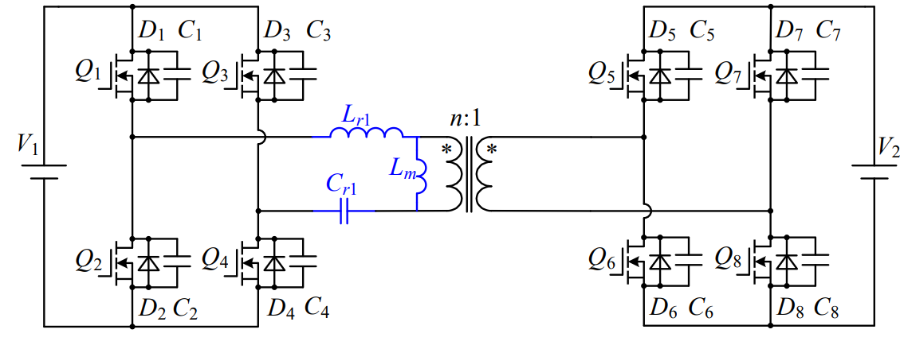
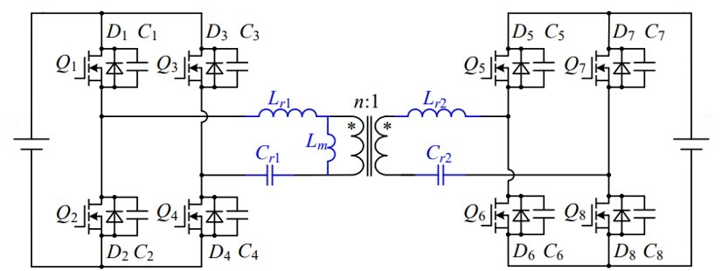
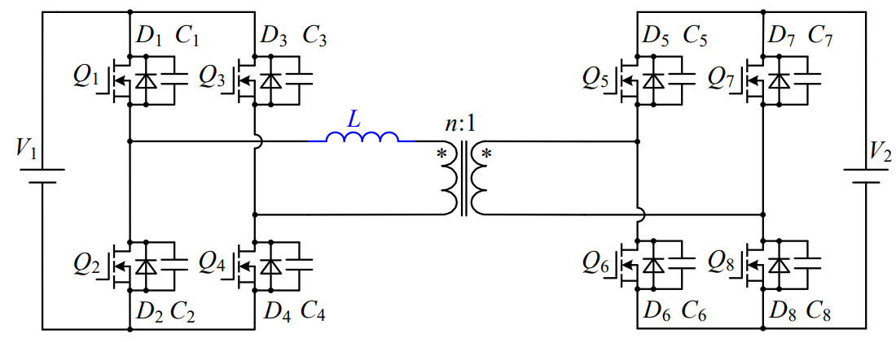
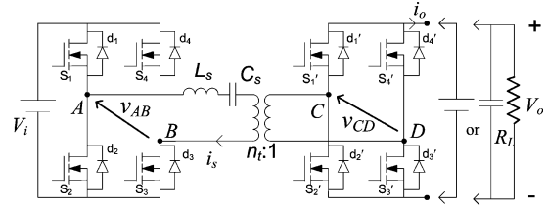
Key Design Considerations – Converter comparison
Bi-directional isolated DCDC topologies comparison
LLC | CLLLC | DAB | SRC DAB
Benefits： High efficiency Full range ZVS Low cost Simple control method Challenges: Narrow voltage adjust range Gain below 1 in reverse mode (need to boost gain using some control methods) Slow dynamic response and bidirectional power transition | Benefits： High efficiency Full range ZVS Symmetric gain features Simple control method Challenges: Narrow voltage adjust range High cost due to secondary resonant capacitor Slow dynamic response and bidirectional power transition | Benefits： Wide voltage adjust range Lowest cost Fast dynamic response and bidirectional power transition Challenges: Low efficiency and high turn off current with single phase control Hard to realize ZVS at light load Complex control method to optimize the performance | Benefits： Wide voltage adjust range Higher efficiency and lower turn off current compared to DAB Wider ZVS range than DAB Lower current in reverse mode compared to other topologies (based on simulation) Challenges: Complex control method (multiple phase shift control)

Slide 9
Key Design Considerations – Converter comparison
ZVS Range
Primary
Secondary
Both SRC-DAB and CLLLC could achieve all legs’ ZVS from 20% load to 100% load (720W to 3.6kW)
One leg lose ZVS at 20% load condition for DAB converter
SRC-DAB use the TPS+ variable frequency control, DAB use extended phase shift control, CLLLC use frequency control
 | 100%load, SRC-DAB/DAB/CLLLC | 50%load, SRC-DAB/DAB/CLLLC | 20%load, SRC-DAB/DAB/CLLLC
350V 60V(60A) | 1111/1111/1111 | 1111/1111/1111 | 1111/0011/1111
400V 48V(75A) | 1111/1111/1111 | 1111/1111/1111 | 1111/1111/1111
550V 40V(75A) | 1111/1111/1111 | 1111/1111/1111 | 1111/1100/1111
ZVS:1/Non-ZVS:0
1 means one leg
achieves ZVS

Slide 10
Key Design Considerations- Converter comparison
RMS current and turn off current (simulation results present in back up slides)
In forward operation, topologies including resonant tank could have lower RMS current and peak current
In backward operation, SRC DAB has lower turn off current and peak current but need multiple phase shift control to realize ZVS in different gain condition
SRC-DAB use the TPS+ variable frequency control, DAB use extended phase shift control, CLLLC use frequency control
Notes:
This page shows our design’s diagram. I will explain this page more detail. And I hope product line will give us some advice for the chip selection.
In this design, in order to reach high efficiency @ low line input, we must use bridgeless PFC to improve the efficiency.
Here we used H-PFC, instead of totempole PFC. Because so far as I know, totempole has potential risk with inrush and surge issue, that may reduce the system Reliability.
(…..more discuss about this diagram.)

Slide 11
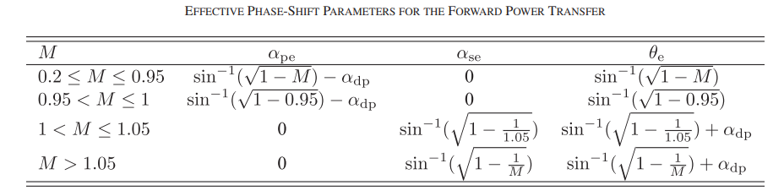
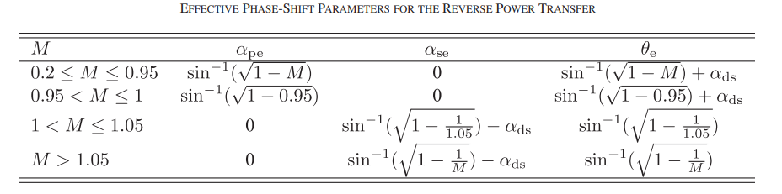
Key Design Considerations- Four freedom Control methods
The phase shift angle is calculated based on the gain to ensure ZVS, optimize RMS current and reactive power
Needs to control dead time or give more reactive power to realize ZVS under light load condition
Notes:
This page shows our design’s diagram. I will explain this page more detail. And I hope product line will give us some advice for the chip selection.
In this design, in order to reach high efficiency @ low line input, we must use bridgeless PFC to improve the efficiency.
Here we used H-PFC, instead of totempole PFC. Because so far as I know, totempole has potential risk with inrush and surge issue, that may reduce the system Reliability.
(…..more discuss about this diagram.)

Slide 12
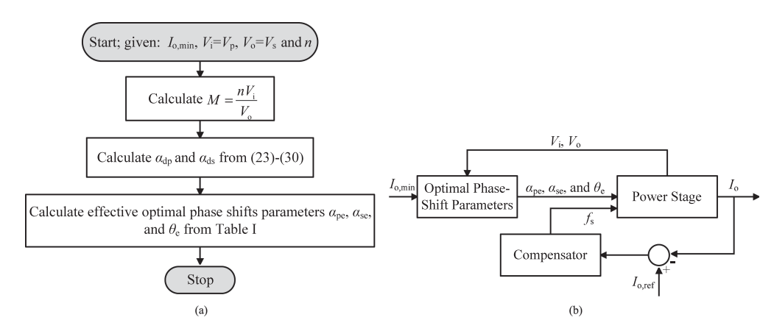
Key Design Considerations- Four freedom Control method
Control block diagram
Notes:
This page shows our design’s diagram. I will explain this page more detail. And I hope product line will give us some advice for the chip selection.
In this design, in order to reach high efficiency @ low line input, we must use bridgeless PFC to improve the efficiency.
Here we used H-PFC, instead of totempole PFC. Because so far as I know, totempole has potential risk with inrush and surge issue, that may reduce the system Reliability.
(…..more discuss about this diagram.)

Slide 13
Key Design Considerations- ZVS realize at light load condition
Control block diagram
Notes:
This page shows our design’s diagram. I will explain this page more detail. And I hope product line will give us some advice for the chip selection.
In this design, in order to reach high efficiency @ low line input, we must use bridgeless PFC to improve the efficiency.
Here we used H-PFC, instead of totempole PFC. Because so far as I know, totempole has potential risk with inrush and surge issue, that may reduce the system Reliability.
(…..more discuss about this diagram.)

Slide 14
Key Design Considerations
Remove secondary resonant capacitors to cost down
Currently split the resonant caps in both sides to block the DC current to avoid flux saturation
Need do flux balance control scheme to cost down
Notes:
This page shows our design’s diagram. I will explain this page more detail. And I hope product line will give us some advice for the chip selection.
In this design, in order to reach high efficiency @ low line input, we must use bridgeless PFC to improve the efficiency.
Here we used H-PFC, instead of totempole PFC. Because so far as I know, totempole has potential risk with inrush and surge issue, that may reduce the system Reliability.
(…..more discuss about this diagram.)

Slide 15
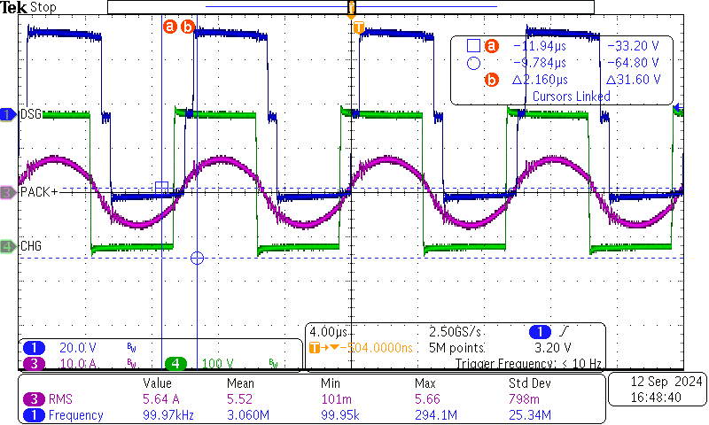
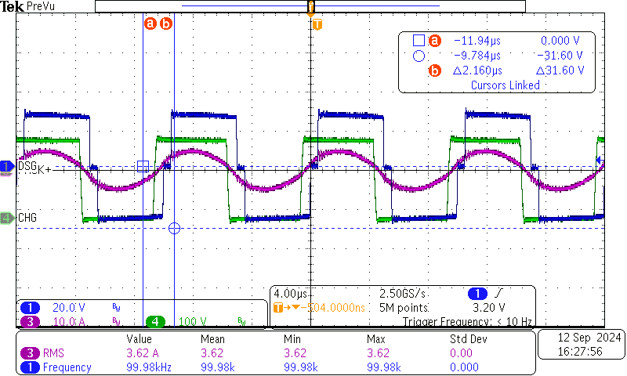
Test results - Normal operation (open loop)
Charging mode
CH1: Vsec on transformer
CH3: Pri Tank current
CH4: Pri Vds
300Vin 40Vo 1500W
300Vin 30Vo 1500W

Slide 16
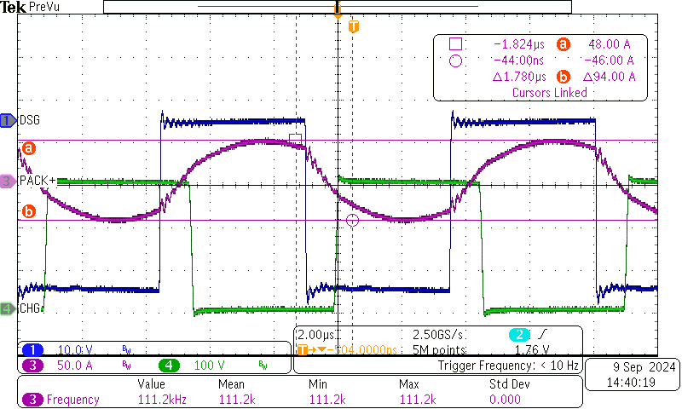
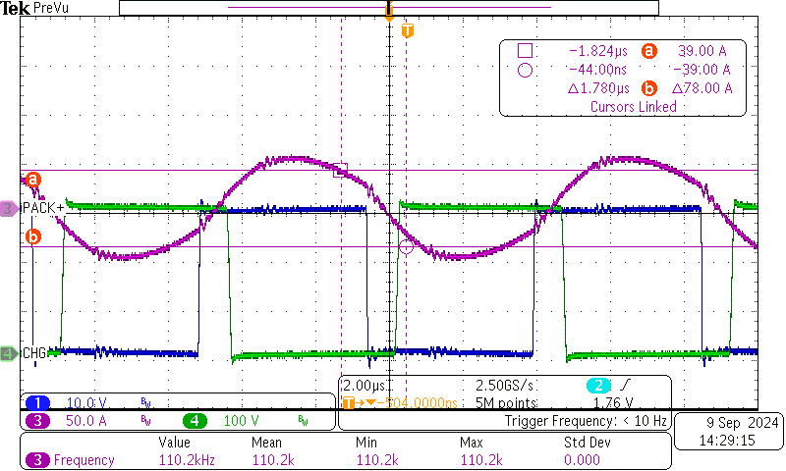
Test results - Normal operation (open loop)
Discharging mode
CH1: Sec Vds
CH3: Sec Tank current
CH4: Pri Vds
40Vin 300Vo 1200W
30Vin 300Vo 1200W

Slide 17
Test results - efficiency
Efficiency Test Result in Discharging Mode （without heatsink）
52Vin, 400Vo
40Vin, 400Vo
60Vin, 400Vo
 | Pin | Po | Eff
500W | 476.008 | 466.4 | 0.979815
700W | 725.9178 | 716 | 0.986338
900W | 926.0176 | 912.4 | 0.985294
1100W | 1151.966 | 1134 | 0.984404
1500W | 1501.895 | 1472.8 | 0.980628
1800W | 1795.217 | 1755.2 | 0.977709
2100W | 2249.363 | 2192 | 0.974498
2400W | 2528.327 | 2456.4 | 0.971551
2700W | 2785.656 | 2694.8 | 0.967384
3000W | 3107.648 | 3004.8 | 0.966905
 | Pin | Po | Eff
500W | 546.5148 | 536.8 | 0.982224
700W | 718.228 | 704 | 0.98019
900W | 916.4235 | 897.6 | 0.97946
1100W | 1127.378 | 1104.4 | 0.979619
1500W | 1432.287 | 1400.8 | 0.978016
1800W | 1859.817 | 1810 | 0.973214
2100W | 2143.9 | 2082.4 | 0.971314
2400W | 2487.04 | 2400 | 0.965003
2700W | 2765.861 | 2658.4 | 0.961147
3000W | 3044 | 2908.4 | 0.955453
 | Pin | Po | Eff
500W | 594.413 | 567.2 | 0.954219
700W | 692.868 | 671.2 | 0.968727
900W | 881.0244 | 859.2 | 0.975228
1100W | 1093.018 | 1064.4 | 0.973818
1500W | 1483.584 | 1440 | 0.970622

Slide 18
Test results - efficiency
Efficiency Test Result in Discharging Mode （without heatsink）

Slide 19
Test results - efficiency
Efficiency Test Result in Charging Mode
Vin=400V
 | Vo | Po | Pin | eff
500W | 40.148 | 560.5062 | 569.3216 | 98.45%
600W | 40.179 | 660.141 | 670.142 | 98.51%
1000W | 40.276 | 991.8771 | 1008.229 | 98.38%
1400W | 40.392 | 1366.3 | 1392.403 | 98.13%
1800W | 40.514 | 1784.034 | 1825.908 | 97.71%
 | Vo | Po | Pin | eff
500W | 52.095 | 542.9341 | 566.5024 | 95.84%
700W | 52.077 | 690.2806 | 712.7579 | 96.85%
1000W | 52.149 | 982.8001 | 1011.245 | 97.19%
1400W | 52.281 | 1365.737 | 1406.897 | 97.07%
1800W | 52.288 | 1746.942 | 1807.21 | 96.67%

Slide 20
Reference/Related Materials
Wide-Range ZVS Control Technique for Bidirectional Dual-Bridge Series-Resonant DC–DC Converters | IEEE Journals & Magazine | IEEE
Unified Boundary Control With Phase Shift Compensation for Dual Bridge Series Resonant DC-DC Converter | IEEE Journals & Magazine | IEEE Xplore
A Four-Degrees-of-Freedom Modulation Strategy for Dual-Active-Bridge Series-Resonant Converter Designed for Total Loss Minimization | IEEE Journals & Magazine | IEEE Xplore
Back to list of contents slide

Slide 21
RMS Current
Primary side resonant current
Secondary side resonant current

Slide 22
RMS Current
Primary side resonant current
Secondary side resonant current

Slide 23
RMS Current
Primary side resonant current
Secondary side resonant current

Slide 24
RMS Current (reverse mode)
HV resonant current
LV side resonant current

Slide 25
RMS Current (reverse mode)
HV side resonant current
LV side resonant current

Slide 26
RMS Current (reverse mode)
HV side resonant current
LV side resonant current

Slide 27
Turn-off current
Vin=350V,Vo=60V

Slide 28
Turn-off current
Vin=400V,Vo=48V

Slide 29
Turn-off current
Vin=550V,Vo=40V

