Slide 1
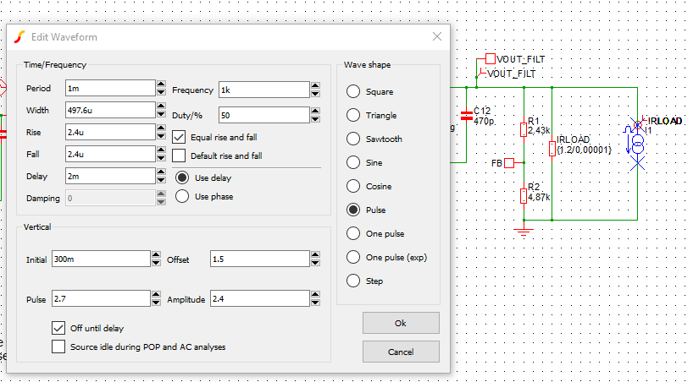
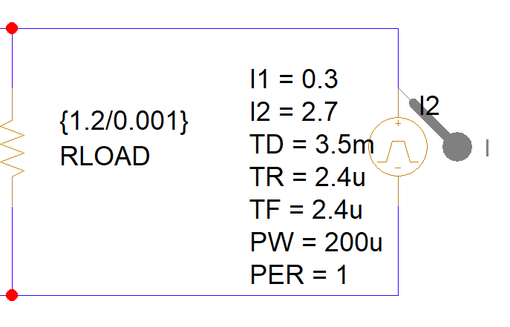
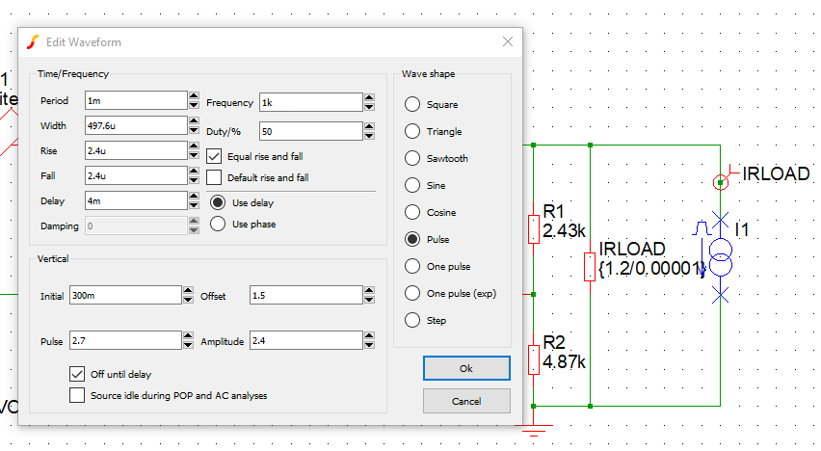
Load transient: TD=3.5ms after Vout stable, 2.4us: 1A/us with 2.4A load step, pulse width is 200u
Place-Pspice component-Source-current-pulse

Slide 2
