Slide 1
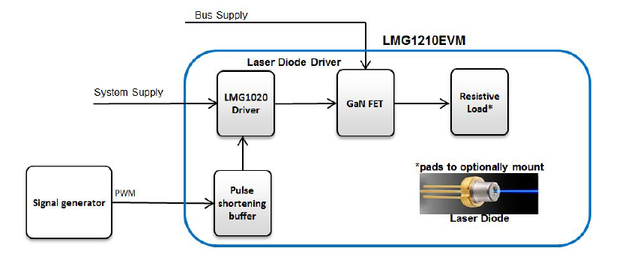
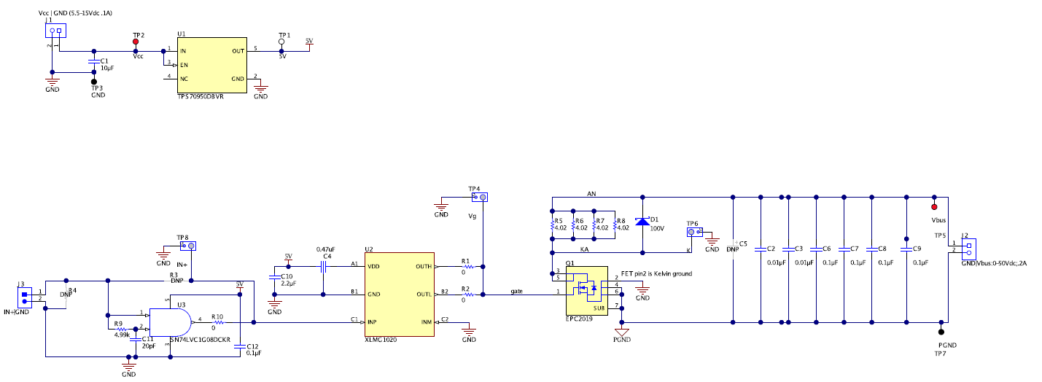
Regarding TIDA-01573
Question
Are R5,R6,R7,R8 load resistance? Should we remove these resistors when we connect its LASER diode?
How can I adjust the laser current with this board?
1

Slide 2
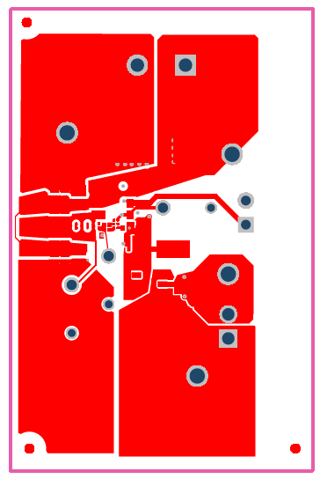
Regarding TIDA-01573
Question
Can you give me a reference circuit diagram that includes the current adjustment part?
Can you give me tools that allow constant design of peripheral parts? For example, do you have an online tool such as WEBENCH or a sheet that calculates the constants of peripheral parts by inputting the power supply voltage, laser VF, laser current, pulse frequency, duty etc. in the excel sheet?
In TIDA - 01573, the anode side terminal is branched to 2 places on the right side with the wiring of Top Layer, but should we care for board layout as well?
anode
casode
anode
2

