Slide 1
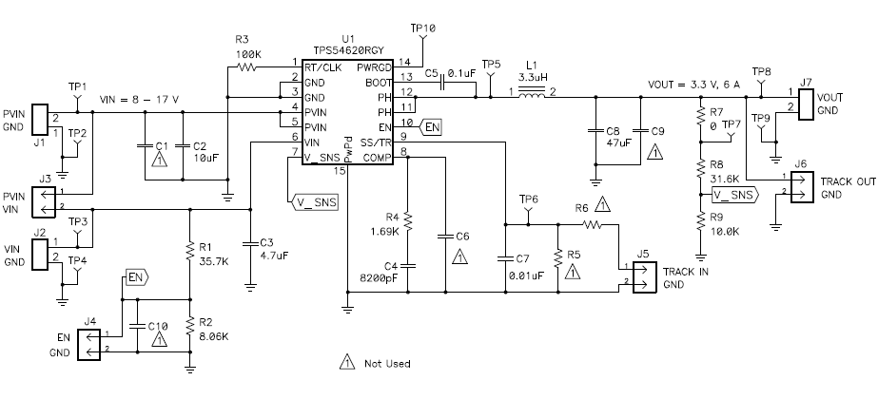
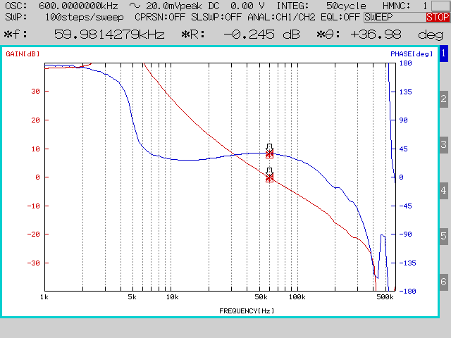
Change to 51 ohm
Change to 2.7k ohm
Change to 560 ohm
Add 100pF
Actual measurement Bode plot

Slide 2
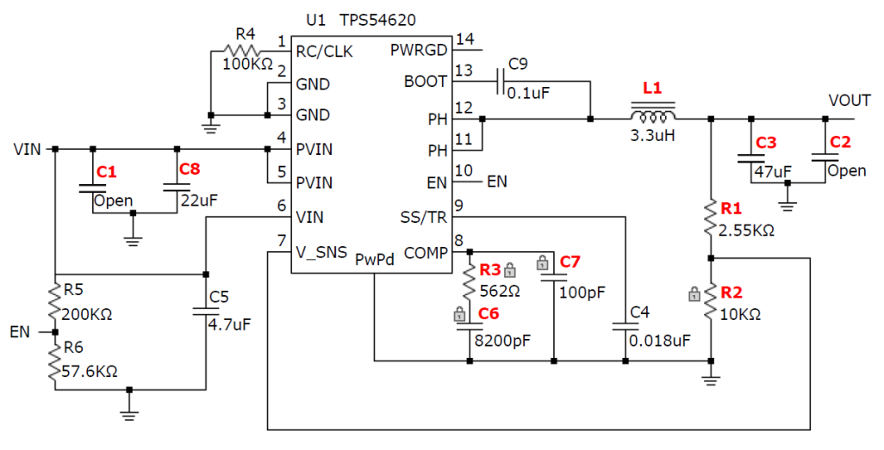
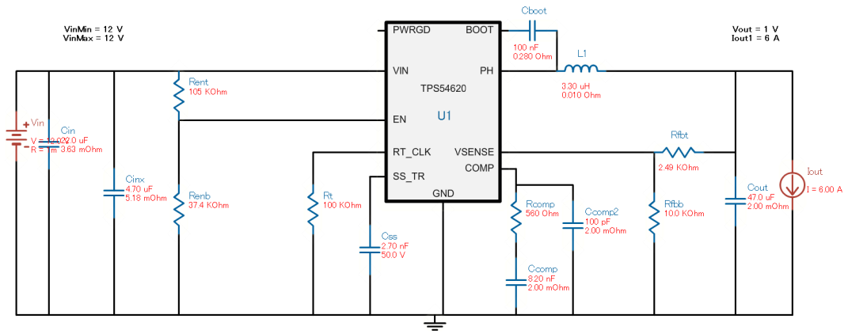
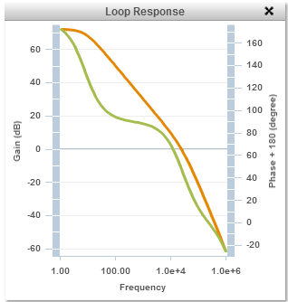
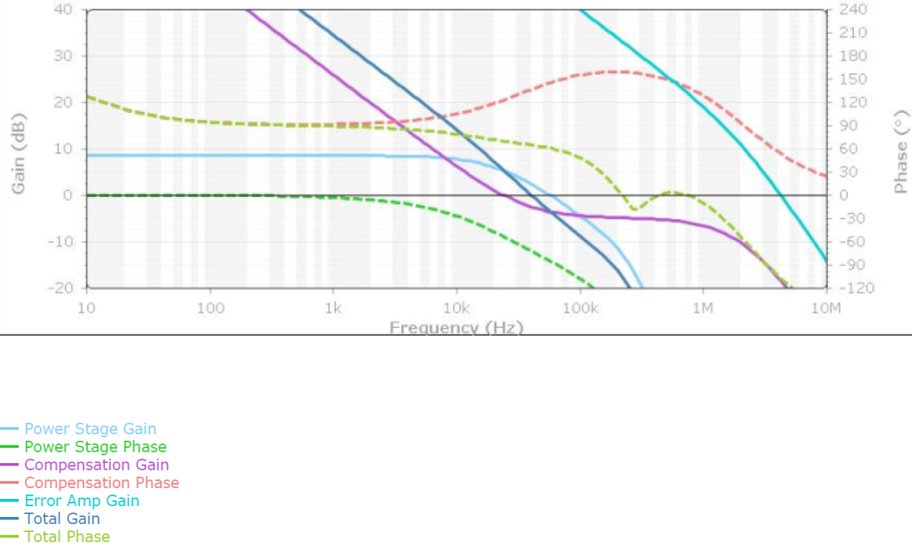
Switcher Pro result(Phase margin=65 degree, Fco=40kHz)
WEBENCH result(Phase margin=48.2 degree, Fco=24.5kHz)

