Slide 1
Schematic

Slide 2
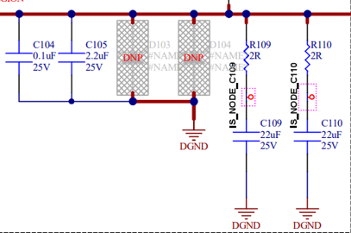
Changelist
12uH
100k
22pF, 33R

Slide 3
Bode Plot-Iout=2A

Slide 4
Bode Plot-Iout=1.5A

Slide 5
Bode Plot-Iout=1A

Slide 6
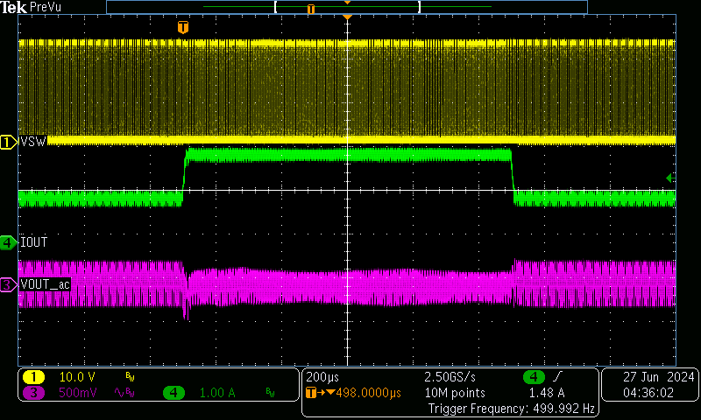
Load jump from 1A to 2A

