Slide 1
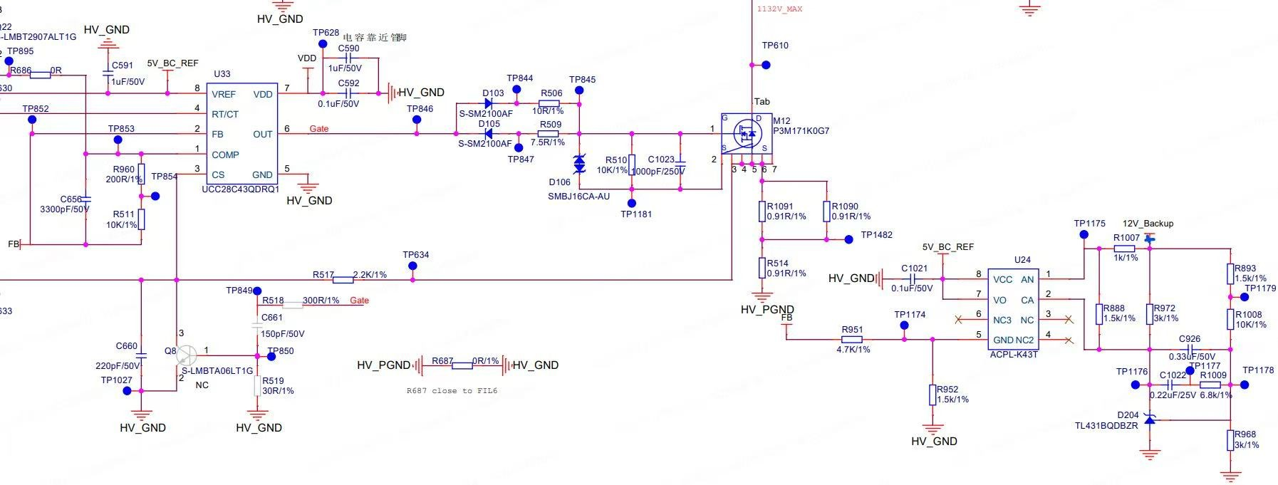
UCC28C43 SCH

Slide 2
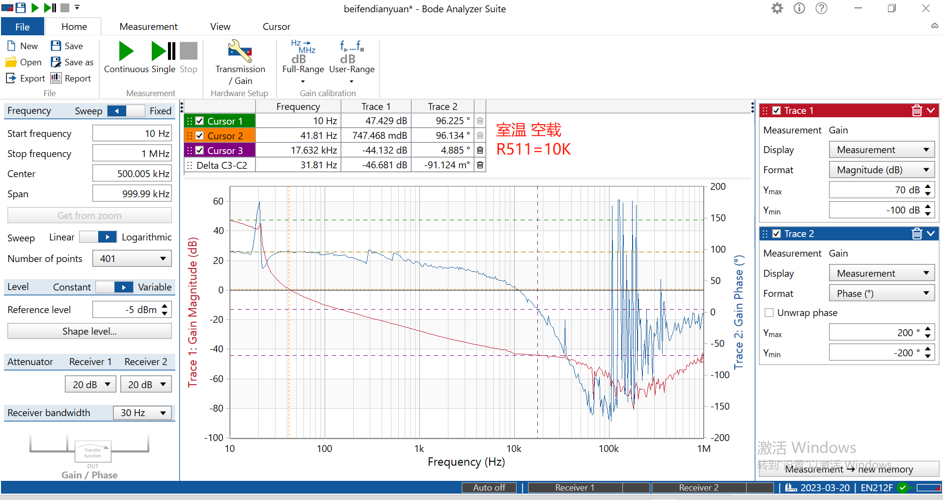
No load
UCC28C43 Bode with R511=10k

Slide 3
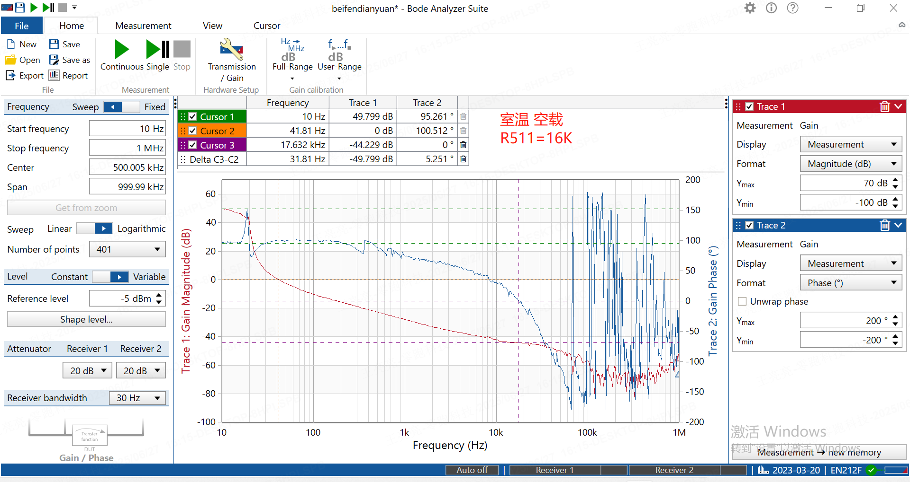
No load
UCC28C43 Bode with R511=16k

Slide 4
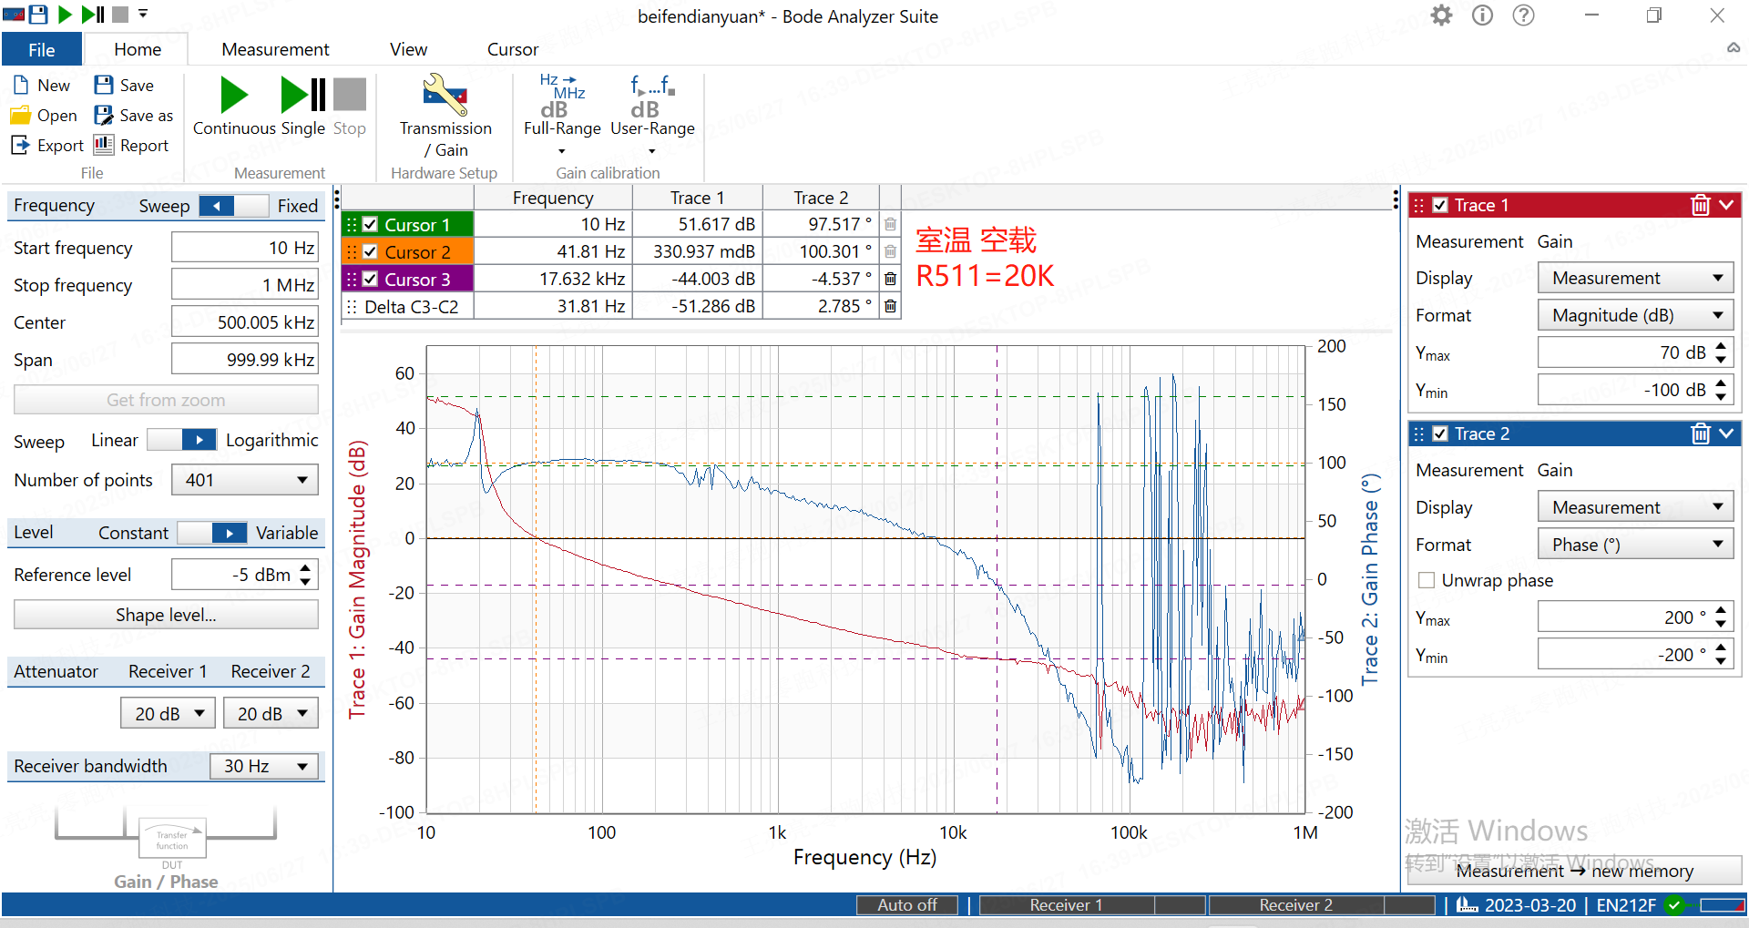
No load
UCC28C43 Bode with R511=20k

Slide 5
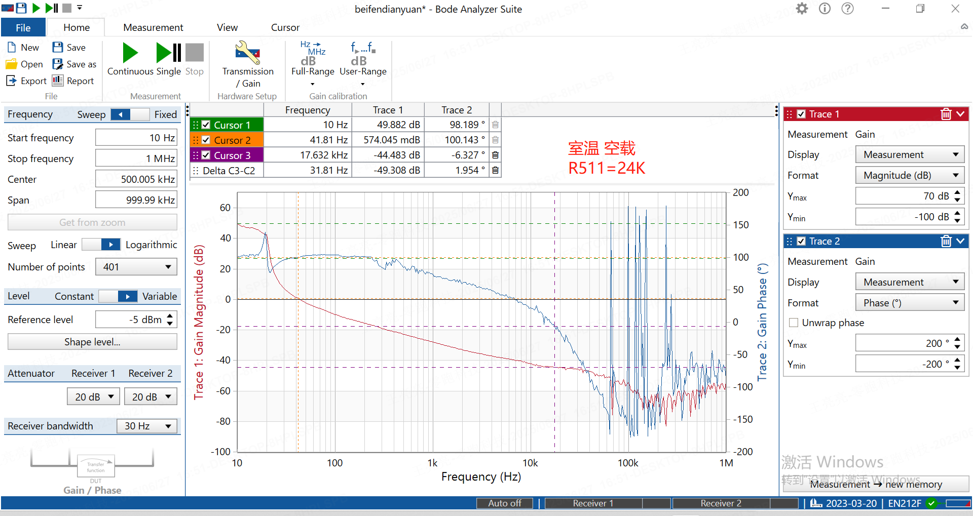
No load
UCC28C43 Bode with R511=24k

Slide 6
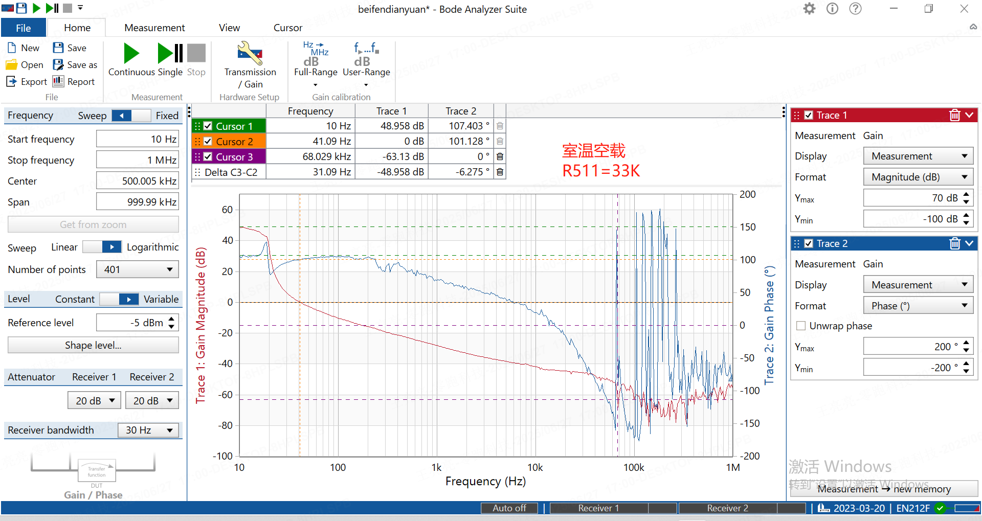
No load
UCC28C43 Bode with R511=33k

Slide 7
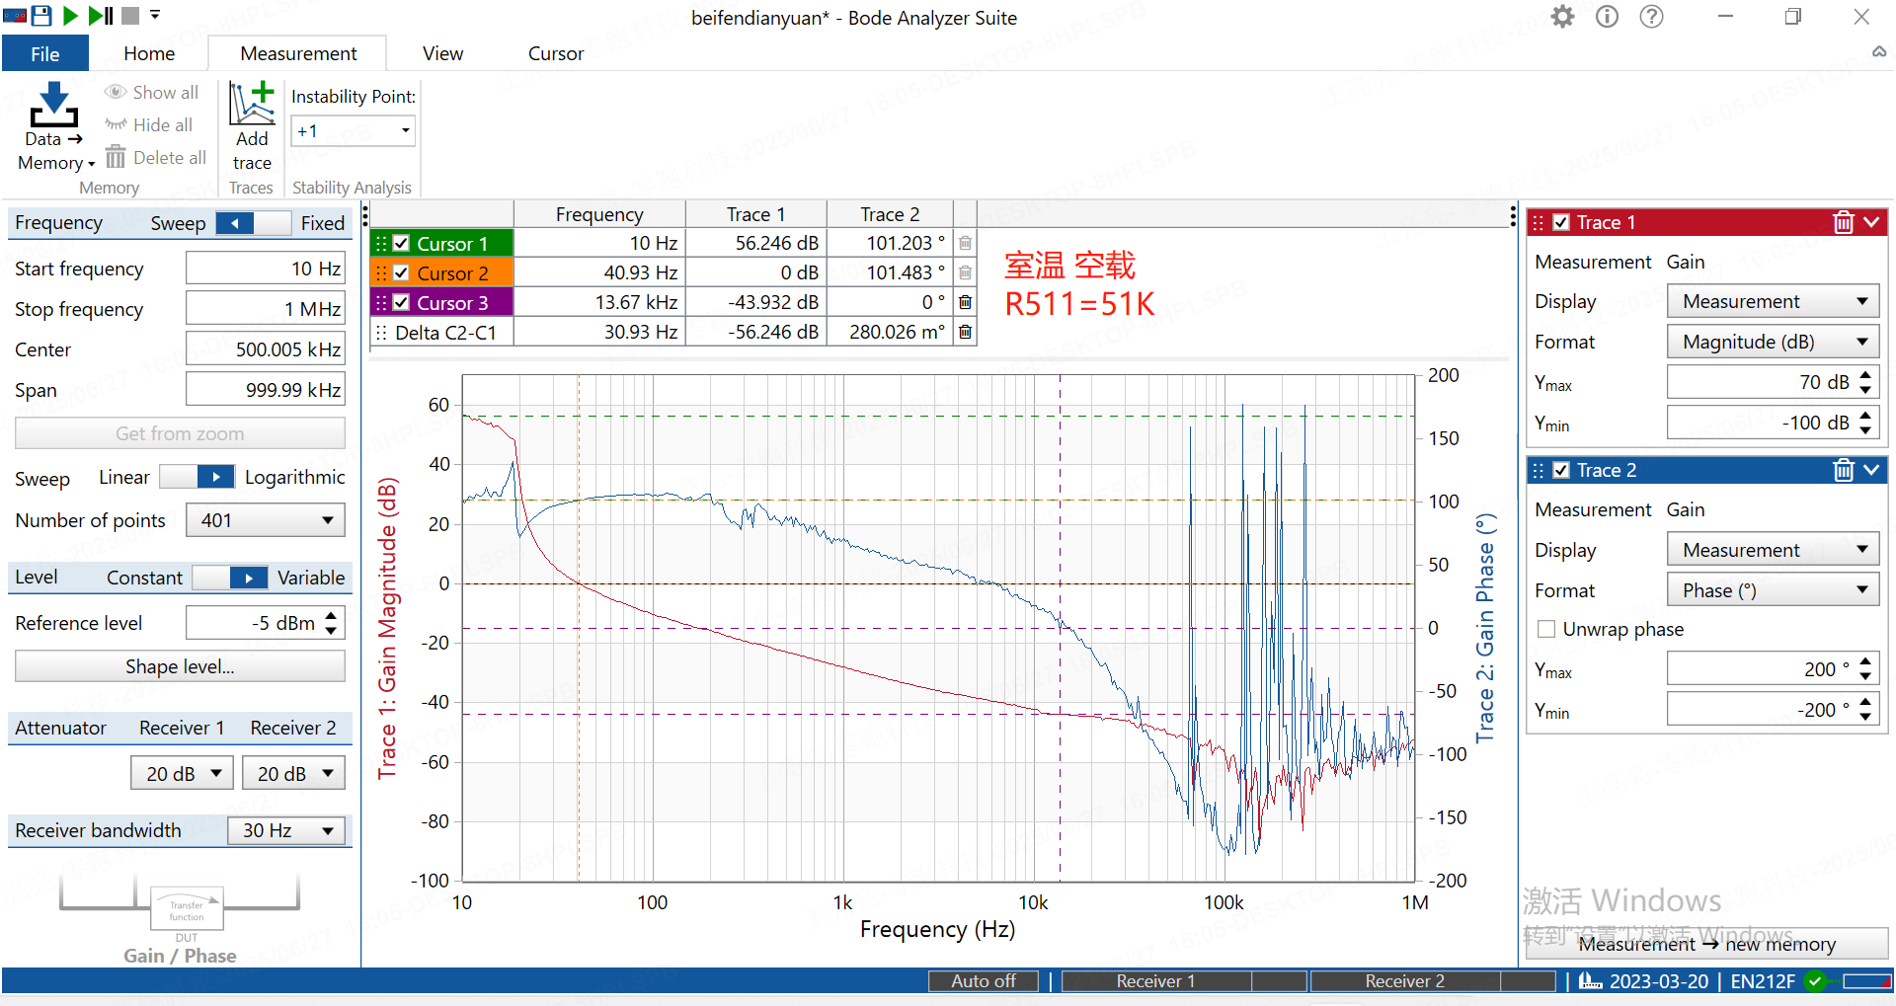
No load
UCC28C43 Bode with R511=51k

Slide 8

No load
UCC28C43 Bode with R511=68k

