Slide 1
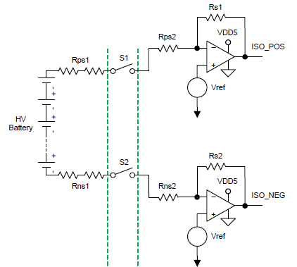
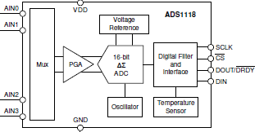

Insulation
VDD5
VIN
ISO P/S
VIN -> 5V
Chassis GND
Chassis GND
VDD5
1000V
Vref
VDD5
3.3V
Chassis GND
ISO Digital
SPI
Vref
Chassis GND
Chassis GND
Chassis GND
Chassis GND
VDD5
3.3V
Chassis GND
S1, S2 control signal
ISO Digital
ADC FSR and output code
ISO POS or ISO NEG output range
FSR : ±2.048V
ISO_POS or ISO_NEG Output code
4.5V → 7CFFh
2.5V → 0000h
0.5V → 8301h
max
4.5V
Chassis GND
Vref
2.5V
min
0.5V

