Slide 1
Test circuit
5V
VDD
TPA2005D1
1uF
4.7kΩ
/SHUTDOWN
GND
Load
(6 ohm Speaker)
1uF
300kΩ
IN+
OUT+
IN-
OUT-
3.3V pp Sin wave
From function generator
1uF
300kΩ
0.1uF
0.1uF

Slide 2
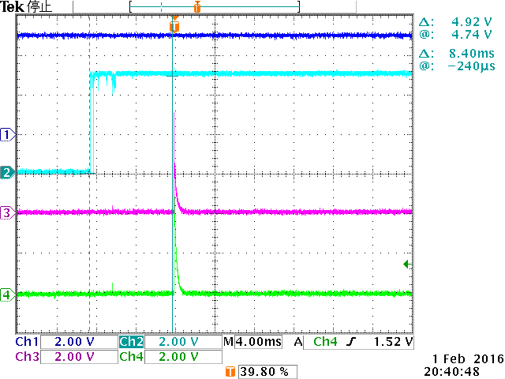
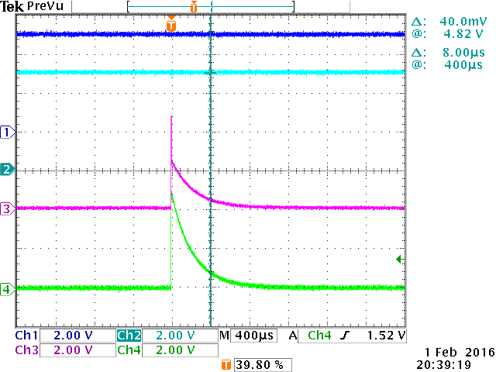
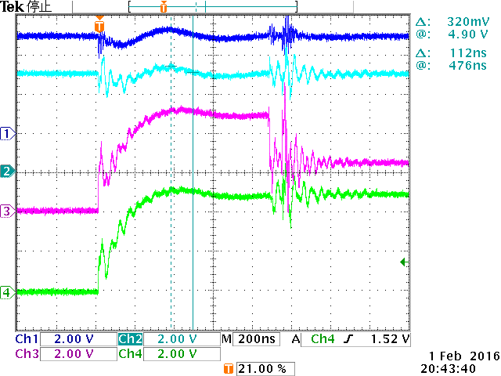
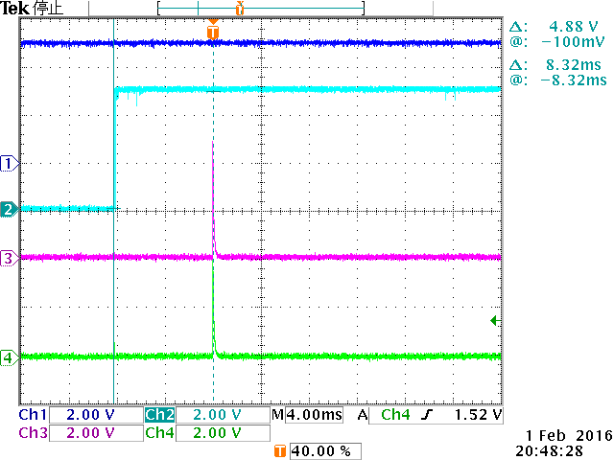
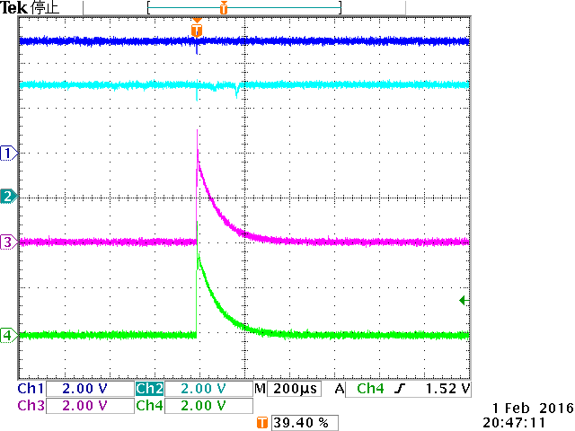
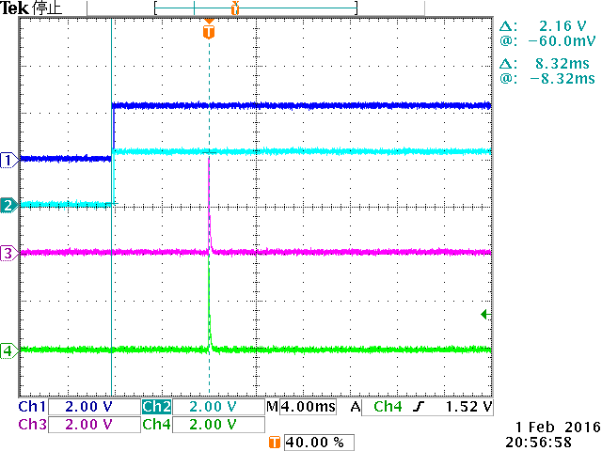
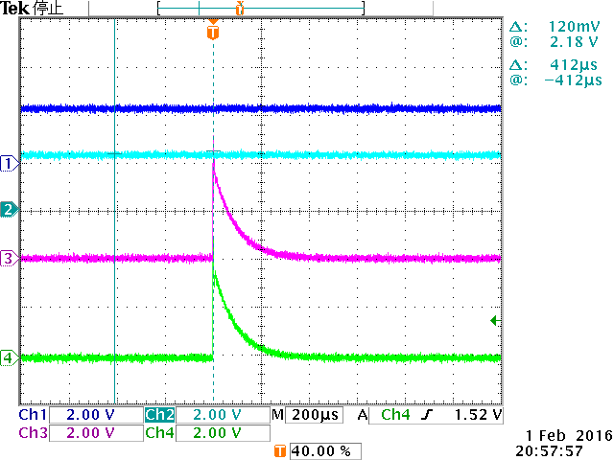
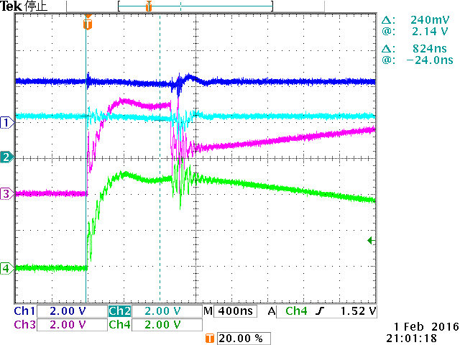
Waveform with 0.1uF capacitor at Vo+/Vo-
/Shutdown:LO⇒Hi, Sin wave: no input
4ms/div
400us/div
200ns/div
With Speaker Load
1ch_VDD
2ch_/SHUTDOWN
3ch_OUT+
4ch_OUT-
No Speaker Load
1ch_VDD
2ch_/SHUTDOWN
3ch_OUT+
4ch_OUT-
With Speaker Load
1ch_IN+
2ch_IN-
3ch_OUT+
4ch_OUT-
No output switching with load and no load

