Slide 1
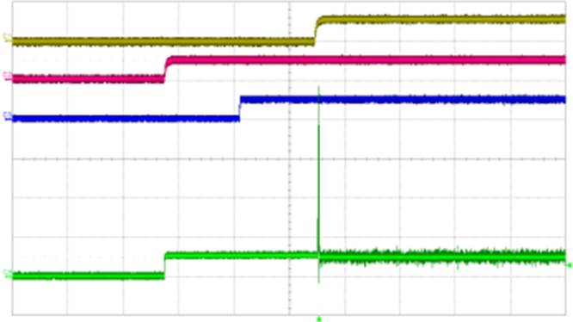
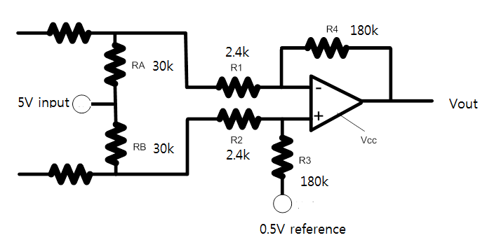
My customer has used TLE2142-Q1 as like below circuits and then they find that the output surge happens when the following conditions.
The 5V is supplied firstly and 0.5V reference is supplied next. And finally Vcc is supplied.
When Vcc is supplied, the output surge happens as like below waveform.
If Vcc is supplied firstly, there is no surge voltage.
So customer wants to know the reason why the surge voltage happens when Vcc is supplied finally.
Green is Vout, Yellow is Vcc(12V) and Red is 5V input. (Ignore the Blue waveform)
Vcc
5V
Vout

