Slide 1
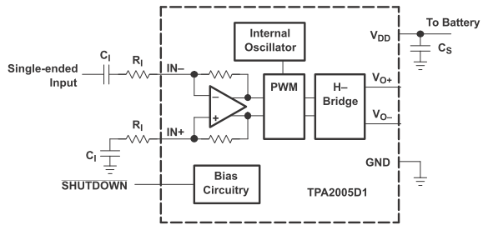
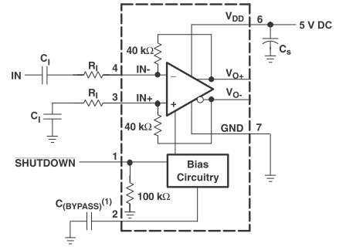
TPA2005D1-Q1
TPA6211
C1 Input
20k ohm
5V
1uF+0.1uF
1uF
SP+
SP-
speaker
800Hz
Sinn wave
SP-
1uF
20k ohm
7.6 ohm
8ms interval
High
TPA2005
Vo-
TPA6211A1-Q1
5V
Sign wave form TPA6211 driving
1uF
150k ohm
1uF+0.1uF
TPA2005 250kHz switching waveform
1kHz
Sinn wave
1uF
150k ohm
TPA6211
C1 Input
High
SP-
0.1uF
TPA2005
Vo-

Slide 2
Test Condition
TPA6211
C1 Input
1
2
Waveform number | TPA62111 input | TPA2005 input
1 | 0V | 1Vp-p
2 | 0.5Vp-p | 1Vp-p
3 | 1Vp-p | 1Vp-p
4 | 1.5Vp-p | 1Vp-p
SP-
TPA2005 250kHz switching waveform
Sign wave form TPA6211 driving
8ms interval
TPA2005
Vo-
TPA6211
C1 Input
3
4
SP-
TPA2005
Vo-

