Slide 1
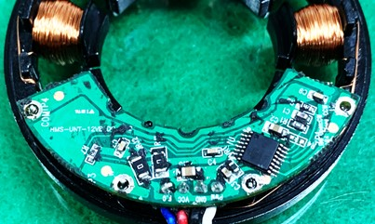
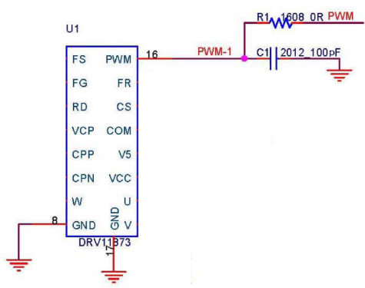
Cause of defect 1) Check for PCB Main IC abnormalities → External factors (surge, overvoltage, etc.) cause a short between the PWM circuit terminal and the GND terminal, resulting in damage to the main IC internal circuit and the motor not operating when voltage is applied.
→ Motor does not operate when voltage is applied
PWM & GND Short
- PCB defect phenomenon -
-Main IC Schematic-
→ Highest frequency of defect occurrence

