Slide 1
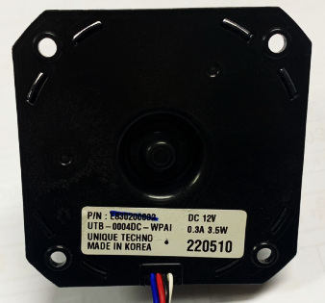
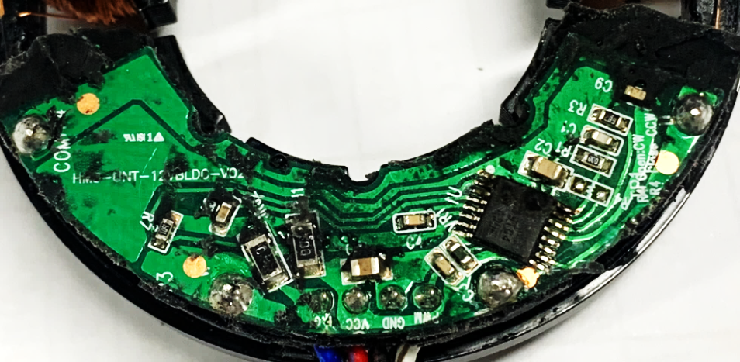
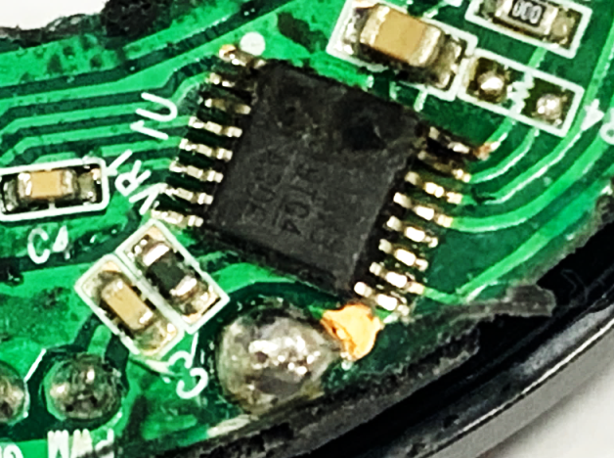
defect phenomenon → Does not operate when motor voltage is applied Cause of defect 1) The PCB Main IC is damaged and the MOTOR does not operate.
모델 | 품명 | 품번 | 생산LOT | defect phenomenon | Failuer Qty
 |  |  |  | Function ERROR | 2 ea
Mainb IC burnt

Slide 2
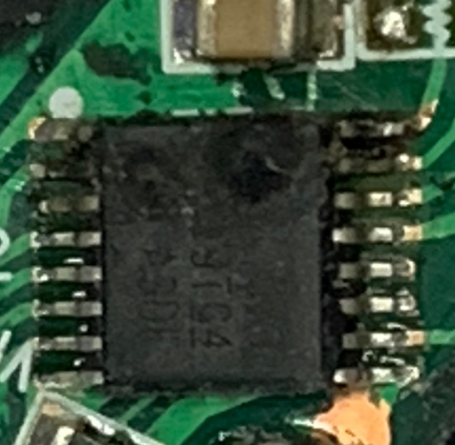
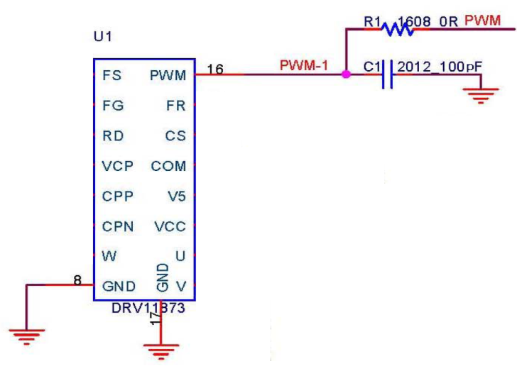
2) Surge voltage is applied to the FG and PWM terminals and the Main IC is damaged. Conclusion 1) High external overvoltage momentarily flows into the FG terminal and PWM terminal, causing IC burnout. 2) When inferred to have occurred when the water purifier was fully assembled, it appears that the damage occurred due to a surge in the water purifier set assembled with various types of electronic products rather than a defect in the individual motor.

