Slide 1
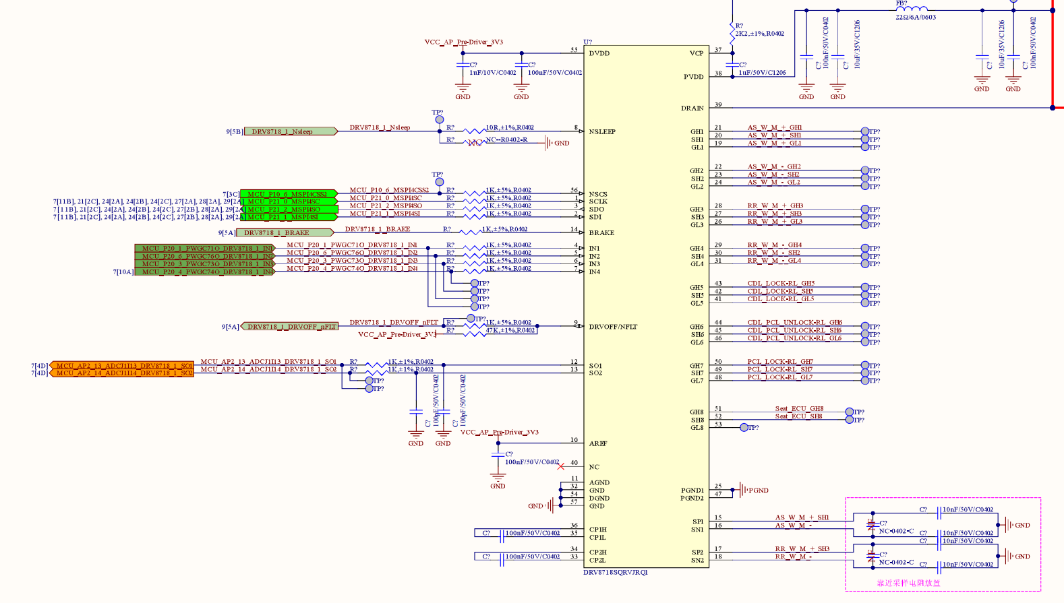

Slide 2
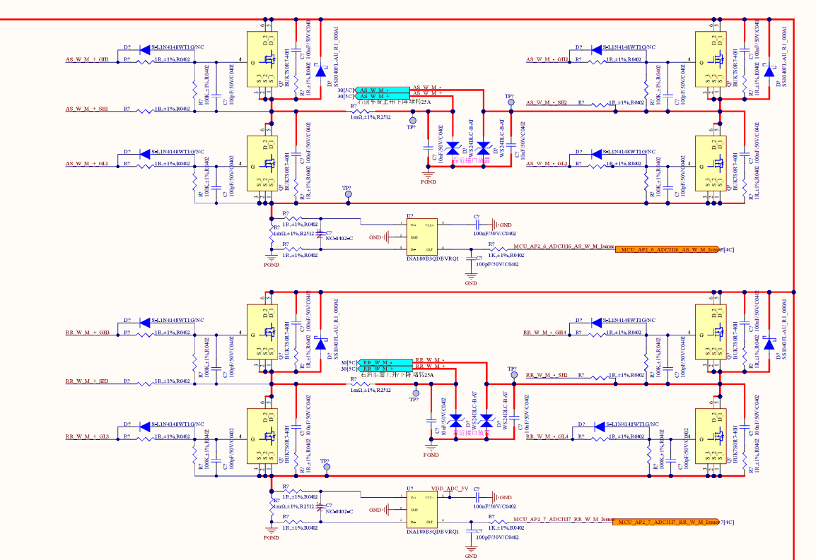
Recommended to have cap ~1uF + ~100nF close to FET- GND.
Optional: better for EMI
Recommended to have cap ~1uF + ~100nF close to FET- GND.
Optional: better for EMI

Slide 3
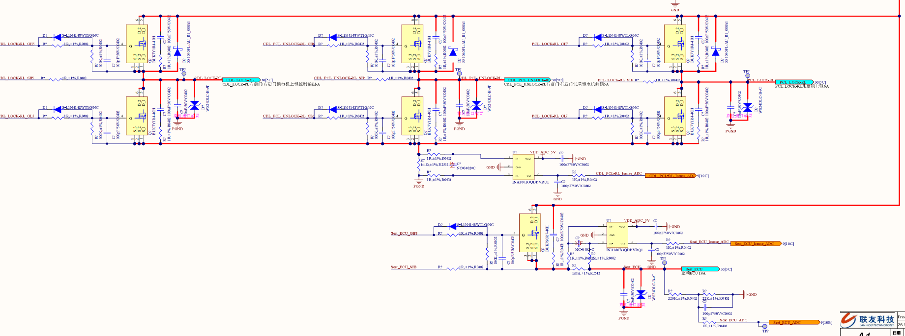
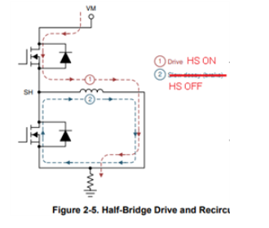
Recomended to have cap ~1uF + ~100nF close to FET- GND.
Optional: better for EMI
If load has long wire(parasitic inductance) or inductive, need diode to have low side recirculation path. Otherwise negative spike should happens on SHx right after turning off HS.

