Slide 1
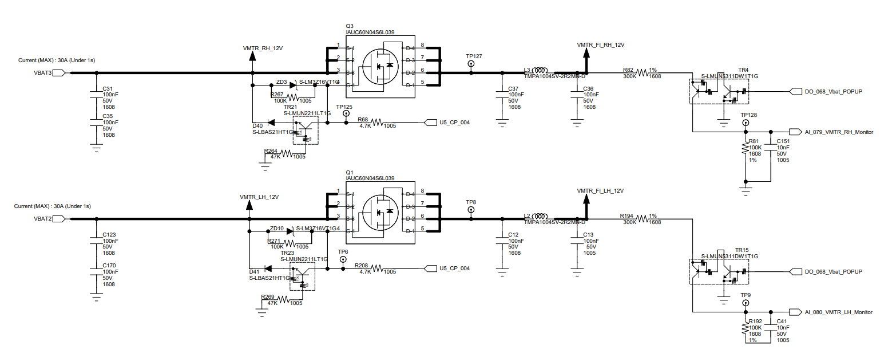

Slide 2
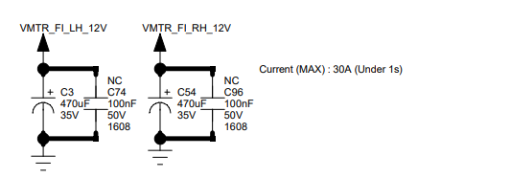
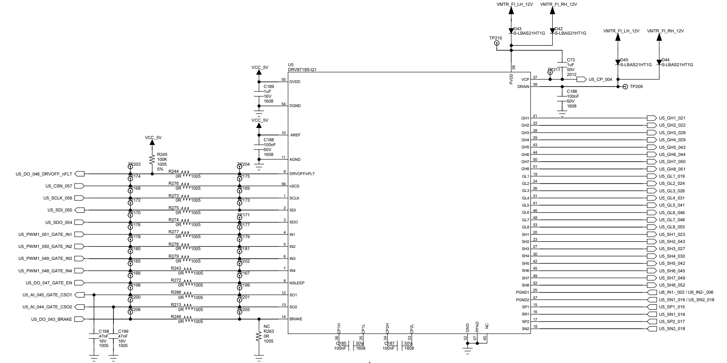
Diode need to be removed for proper VDS over current protection.
(Pls refer page 7)

Slide 3
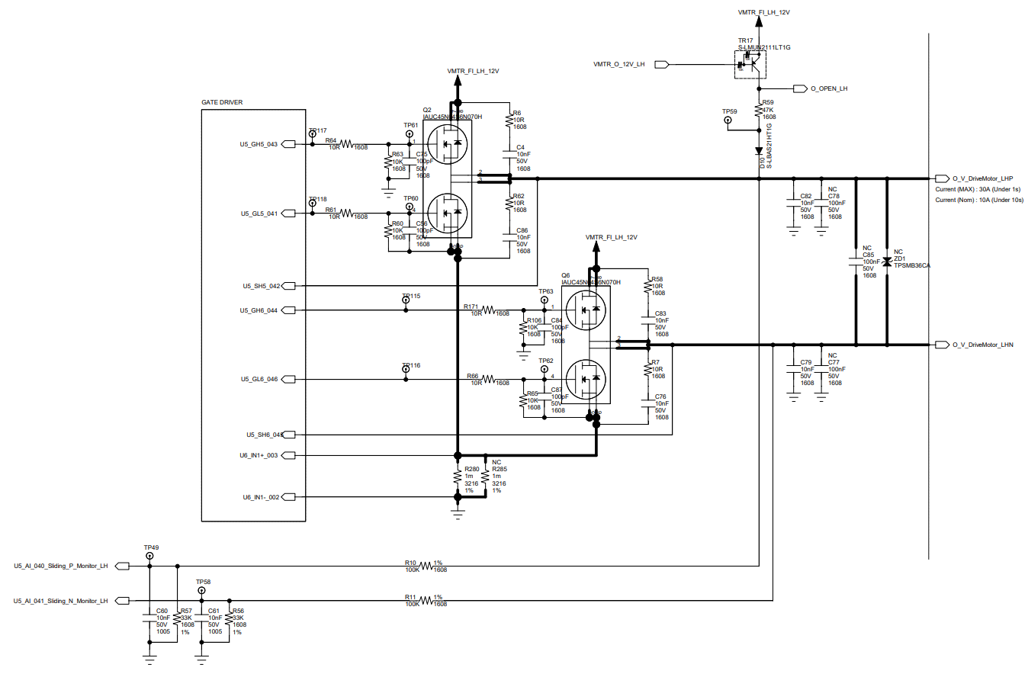
~1uF(DNP)
Close to FET is better for
EMI workaround as optional
Should remove 10K ohm and 100pF to GND
(please refer page 7)
Suggest to remove 10K and 100pF
Should be connected to upper side of sense Resister (please refer page 8)
TI:Suggest Inline current sense
~1uF(DNP)
Close to FET is better for
EMI workaround as optional

Slide 4
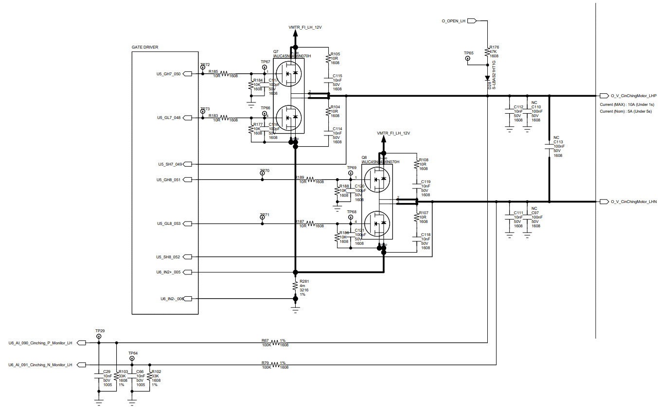
~1uF(DNP)
Close to FET is better for
EMI workaround as optional
Should remove 10K ohm and 100pF to GND
(please refer page 7)
Suggest to remove 10K and 100pF
Should be connected to upper side of sense Resister (please refer page 8)
TI:Suggest Inline current sense
~1uF(DNP)
Close to FET is better for
EMI workaround as optional

Slide 5
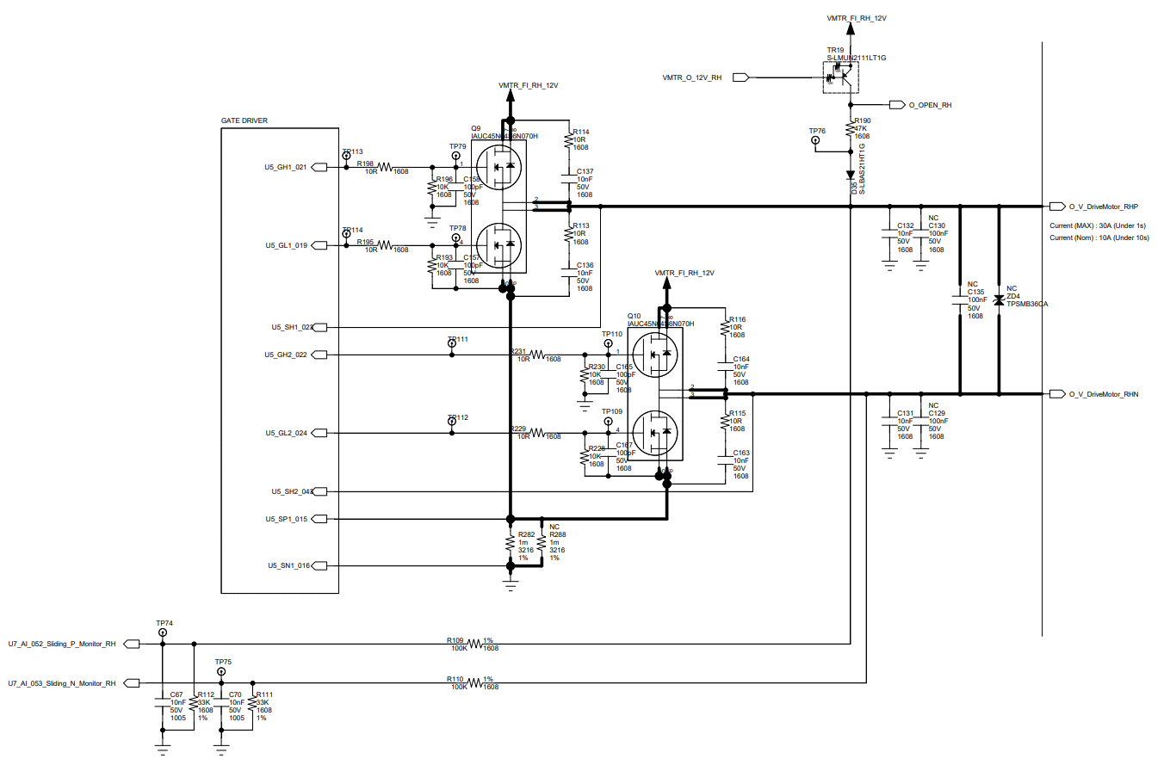
~1uF(DNP)
Close to FET is better for
EMI workaround as optional
Should remove 10K ohm and 100pF to GND
(please refer page 7)
Suggest to remove 10K and 100pF
Should be connected to upper side of sense Resister (please refer page 8)
TI:Suggest Inline current sense
~1uF(DNP)
Close to FET is better for
EMI workaround as optional

Slide 6
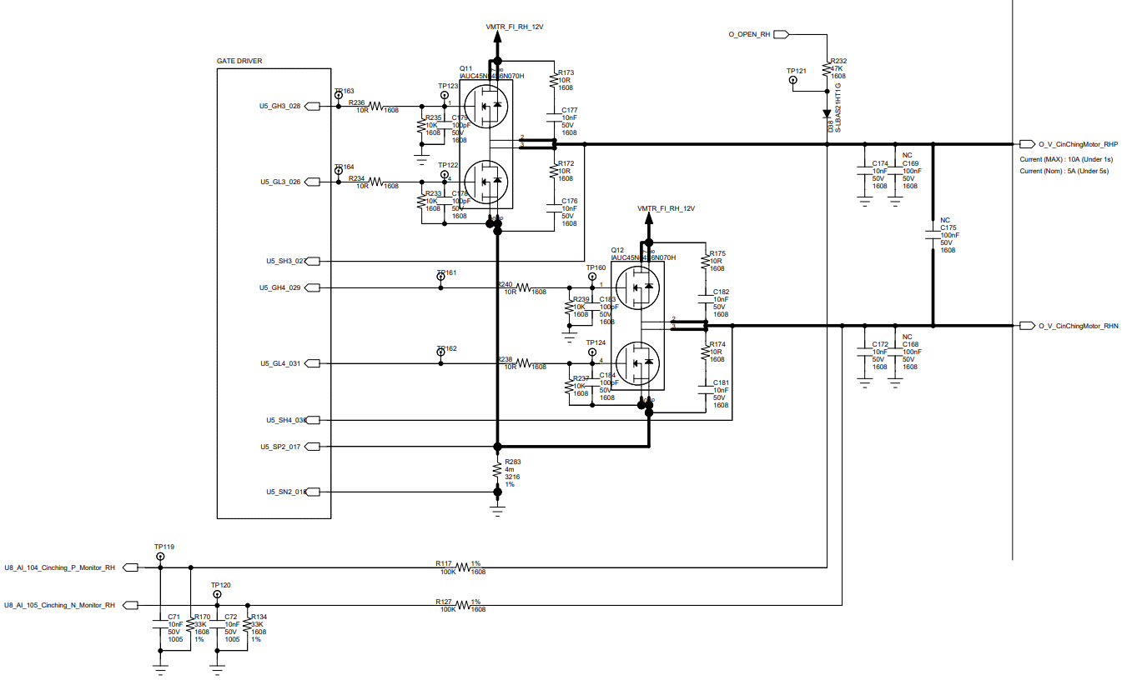
~1uF(DNP)
Close to FET is better for
EMI workaround as optional
Should remove 10K ohm and 100pF to GND
(please refer page 7)
Suggest to remove 10K and 100pF
Should be connected to upper side of sense Resister (please refer page 8)
TI:Suggest Inline current sense
~1uF(DNP)
Close to FET is better for
EMI workaround as optional

Slide 7
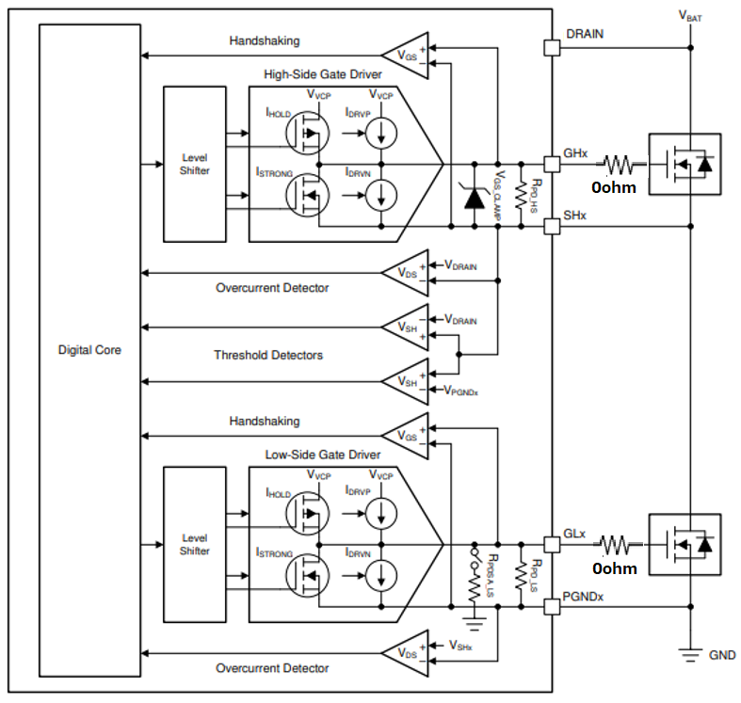
DRAIN pin should be connected “Drain of external FET” directly. DRAIN is used for VDS comparator

Slide 8
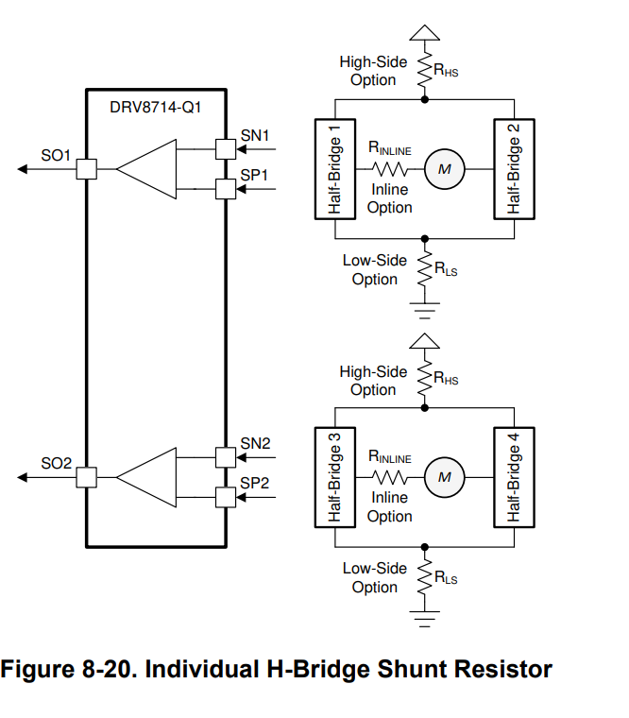
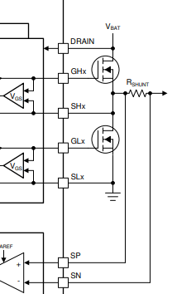
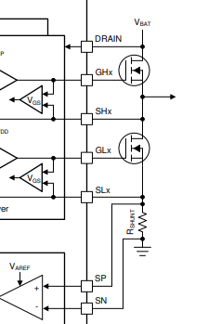
InLine
LowSide
DRV8718-Q1 can support Inline current sense. Could be preferable solution to measure the motor current waveform directly
PGNDx
PGNDx

