Slide 1
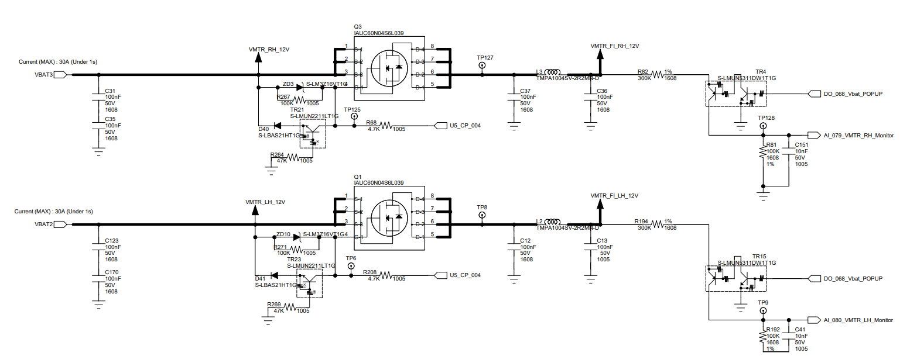

Slide 2
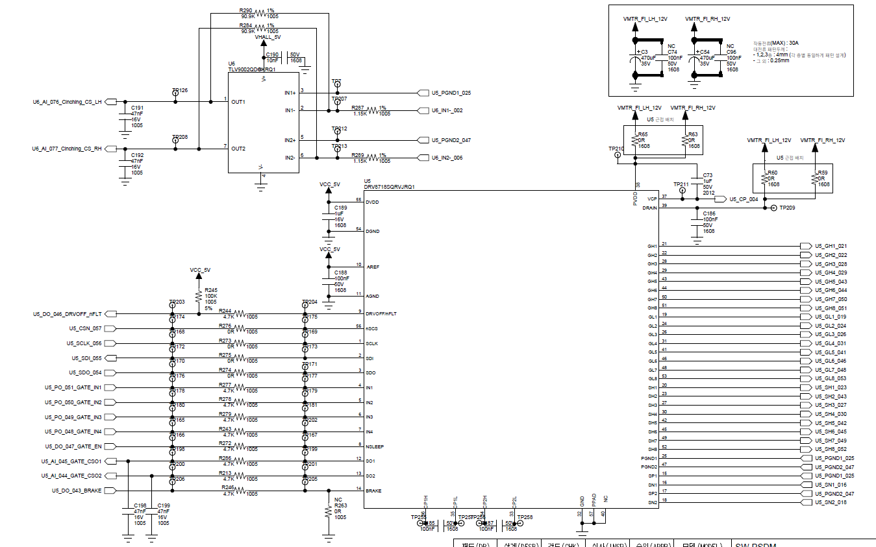

Slide 3
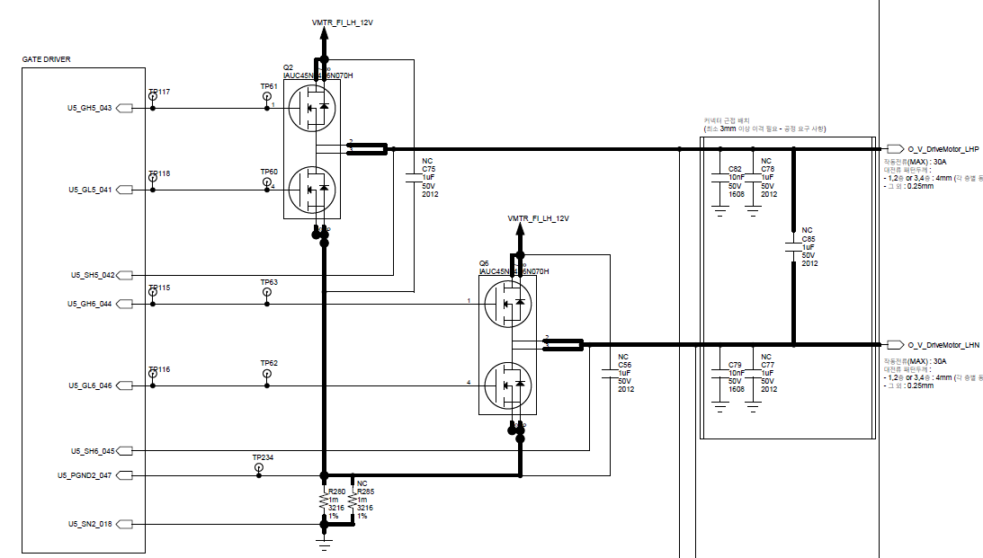

Slide 4
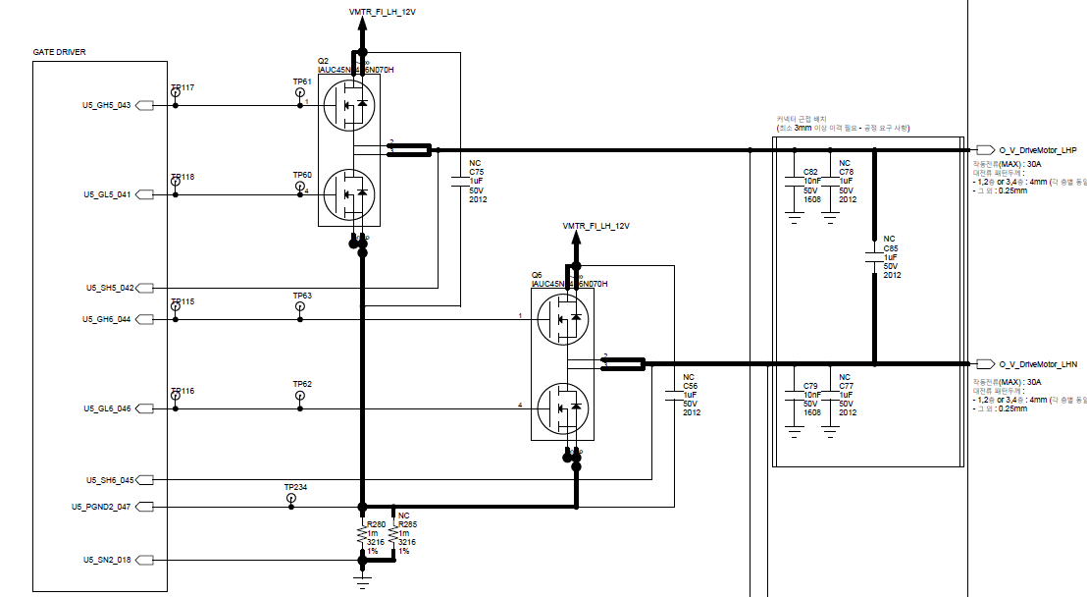

Slide 5
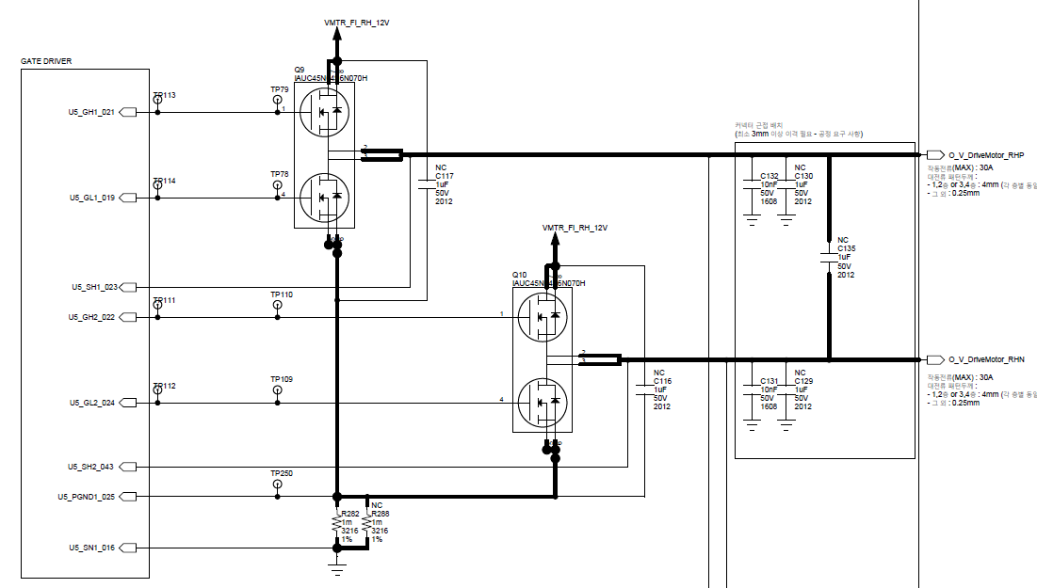

Slide 6
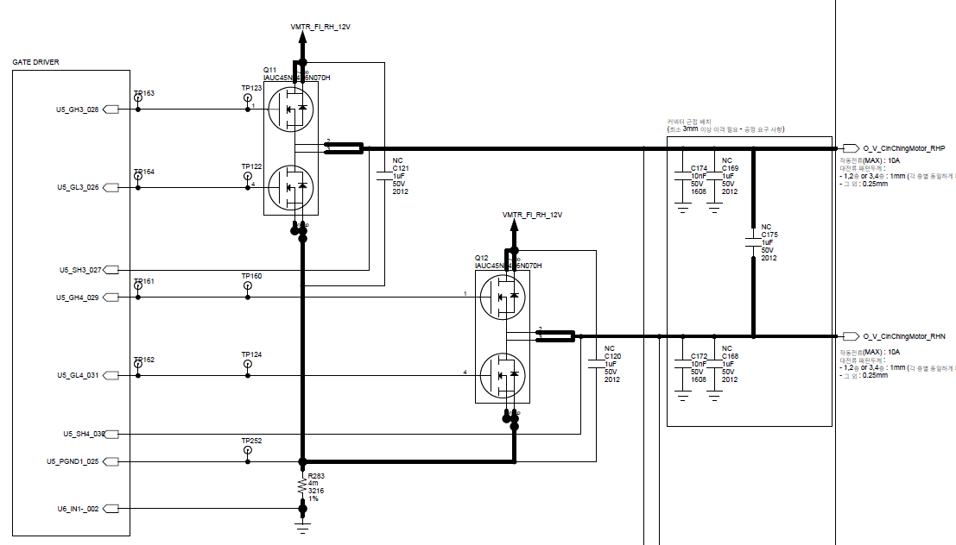

Slide 7
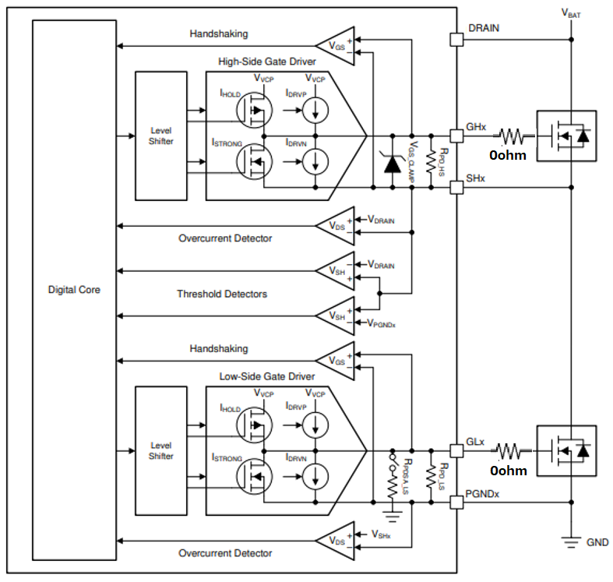
DRAIN pin should be connected “Drain of external FET” directly. DRAIN is used for VDS comparator
Changed Circuit

Slide 8
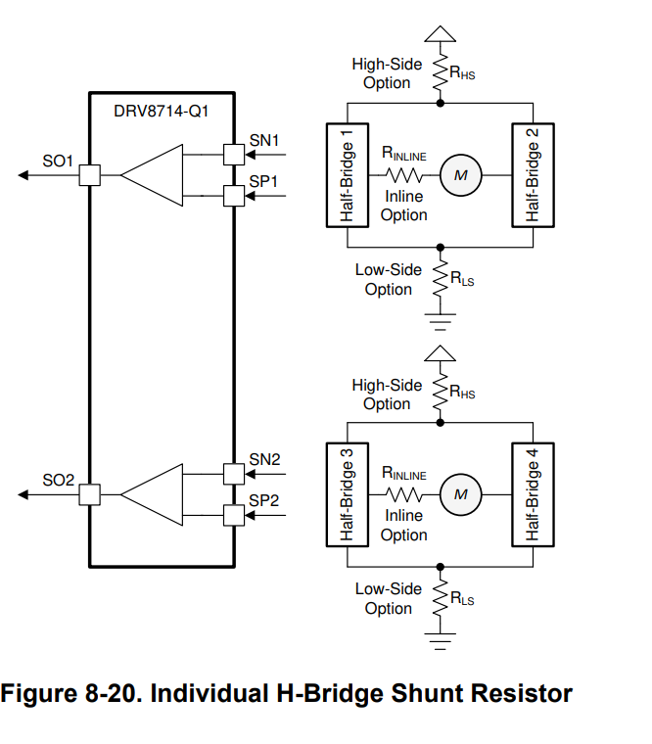
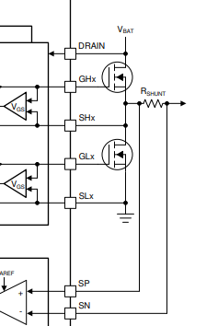
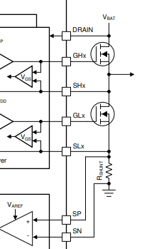
In this circuit we want to monitor the current using the low side concept. Is it correct to connect PGNDx to the + terminal of RSHUNT?
We are currently evaluating the product after production, and it appears that there is an offset in the DRV8718 diagnostic function, so we would like to contact you to confirm.
Additionally, there is current sensing voltage interference between loads that commonly use PGND1 or PGND2, so we are reviewing the impact on the PGNDx connection point above and would like to request confirmation of the above information.
InLine
LowSide
DRV8718-Q1 can support Inline current sense. Could be preferable solution to measure the motor current waveform directly
PGNDx
PGNDx

Slide 9
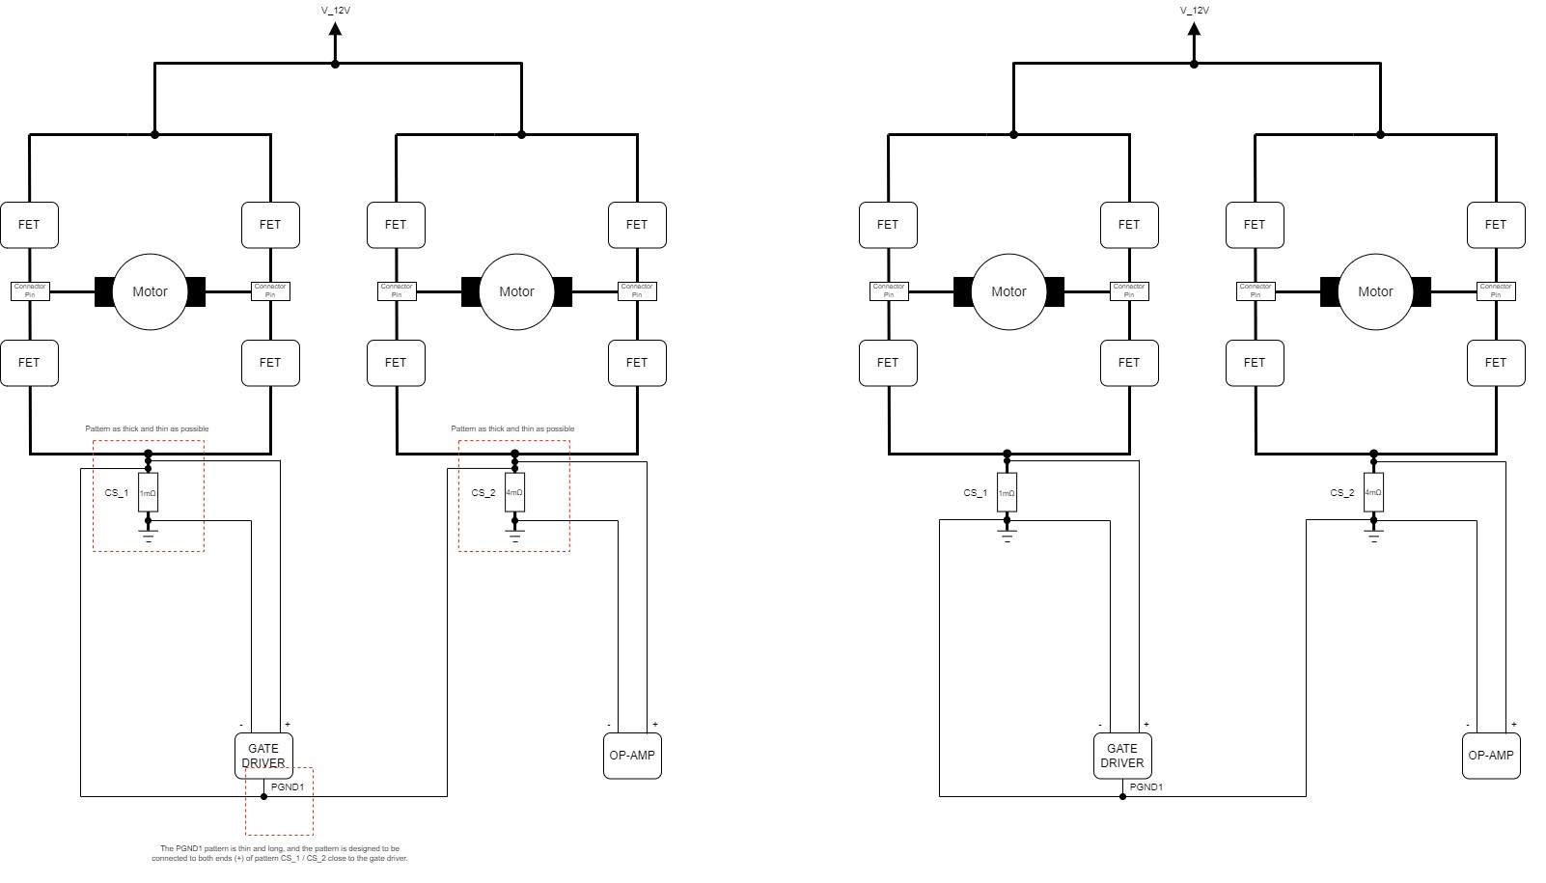
Current circuit structure considering PCB artwork
We confirmed that the circuit is connected by PGND1, but due to the impedance difference due to the pattern,
the two shunt resistors are not combined in parallel and the current is measured as each set.
However, there are two problems here and I would like to inquire.
1. When driving the CS_1 line load, an off-set occurs on the opposite (CS_2) line (increased according to the output current.)
2. An error of more than 30% occurs in the current sensing part of the GATE DRIVER through 1mΩ.
(The voltage across the shunt resistor is measured normally, but the VSO output has an error of about 30% in the calculated value - the error rate is maintained even when the load increases.)
Ex) At 16.8A load, the voltage across the shunt is calculated as 0.0168V / VSO output voltage is calculated as 2.034V (offset not included), but when actually measured, the voltage across the shunt is almost the same / VSO output voltage is measured as 2.48V.)
※ Current sensing register settings are as follows.
In the data sheet, there is only tolerance information for amplification and no information on output deviation, so please confirm whether there may be a 30% error.
For additional inquiries, please confirm whether your understanding of "Current Shunt Amplifier Configuration" is correct.
When VAREF = 5V, VSO_BI = 2.25V / VSO_UNI = 4.125V. Can I think of the voltage value calculated here as the range that can be sensed?
Example 1. When VSO_BI is set, the offset of VSO is approximately 2.5V. When inline sensing, current sensing can be used up to +2.25V when rising / -2.25V when falling based on 2.5V.
Example 2. When VSO_UNI is set, the offset of VSO is approximately 0.7V. When sensing high side or low side, current sensing can be used up to 4.125V when rising from 0.7V.
Is it correct to understand it as above?

Slide 10
In conclusion, I would like to change the circuit structure to the one on the left, but I would like to hear the opinion of a TI engineer.
When making an in-house judgment, there is an error equal to the shunt resistance value in the low side diagnosis, but it does not seem to mean that the diagnosis itself is impossible. (Planned to cover with tuning)
Please give your opinion on whether PGND must be connected to the FET Source.

