Slide 1
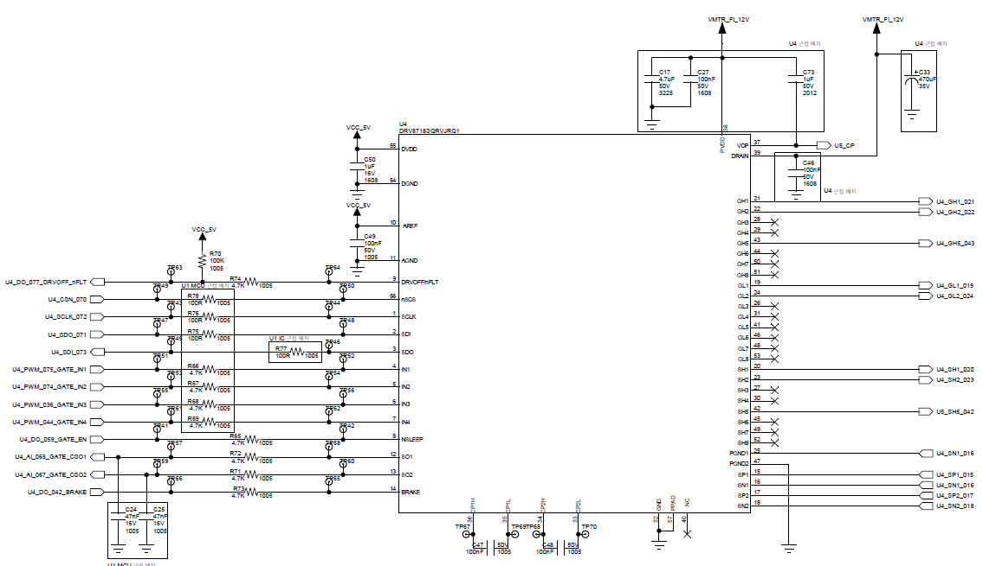
0ohm 0402(inch) resistor:
Optional: helpful debug for EMC or workaround.
0ohm
Connect to source of external LS FET.
Please refer page 5 for details.
4.7ohm
To MCU
SO1/SO2
DNP (100nF)
Holding cap for CSA_Blanking if customer use CSA Blanking function
47nF

Slide 2
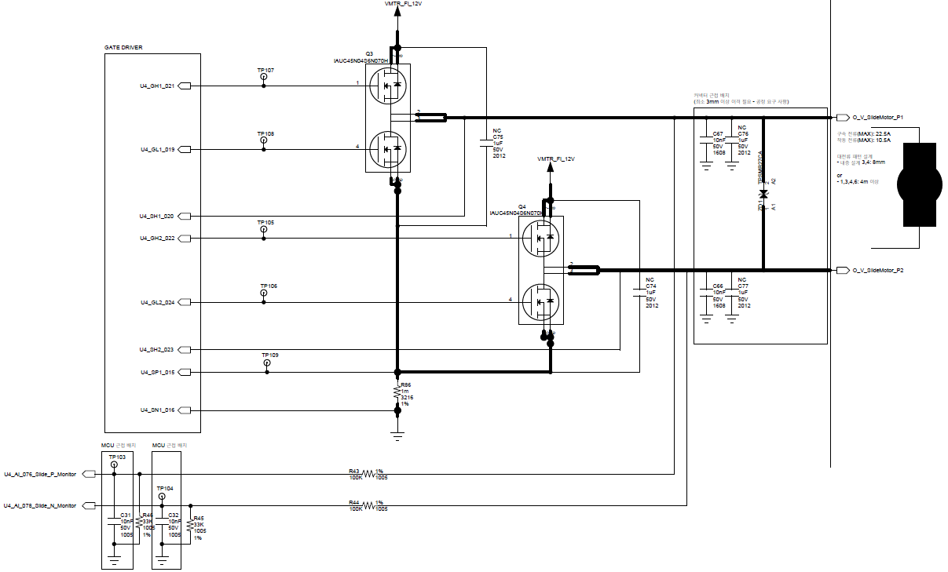
~1uF(DNP)
Close to FET is better for
EMI workaround as optional
0ohm on GHx and GLx.Optional. Can put some resister value if further slow down of tr/tf is needed.
100nF(DNP)
Close to motor terminal.
EMI workaround as optional
To PGND1 pin
Please refer page 5

Slide 3
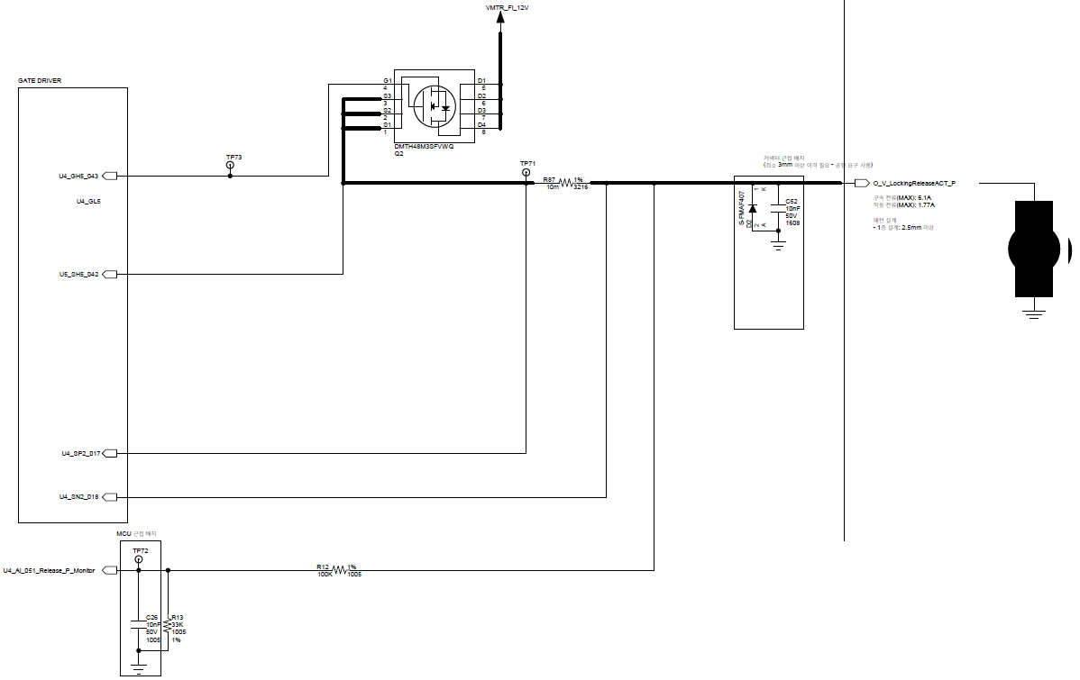
0ohm on GHx and GLx.Optional. Can put some resister value if further slow down of tr/tf is needed.

Slide 4
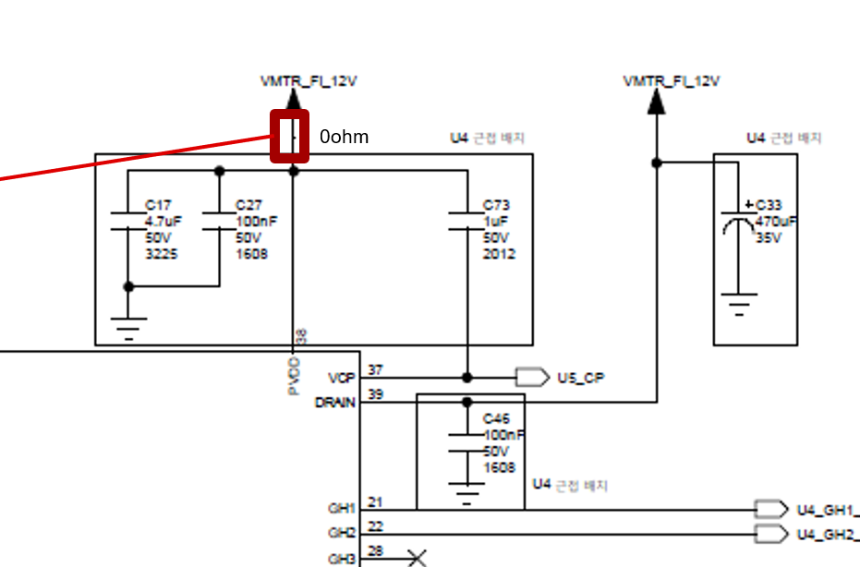
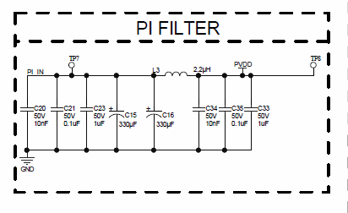
PI Filter ? This may be required for EMC. This is not TI DRV8718-Q1 requirement. PWM driving could need PI filter as EMC solution.
Just for your information.

Slide 5
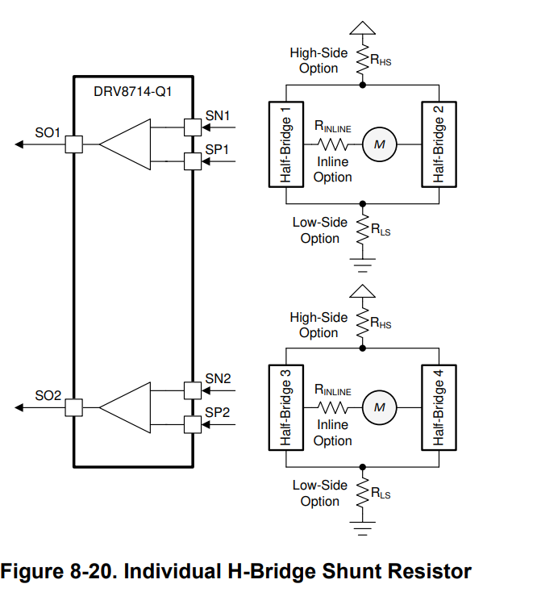
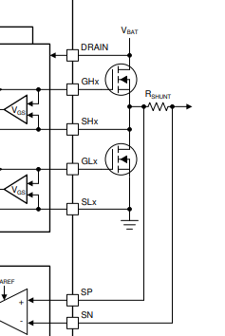
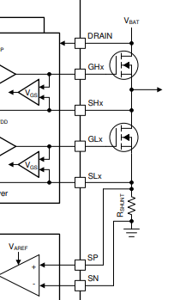
InLine
LowSide
DRV8718-Q1 can support Inline current sense. Could be preferable solution to measure the motor current waveform directly
PGNDx
PGNDx

Slide 6
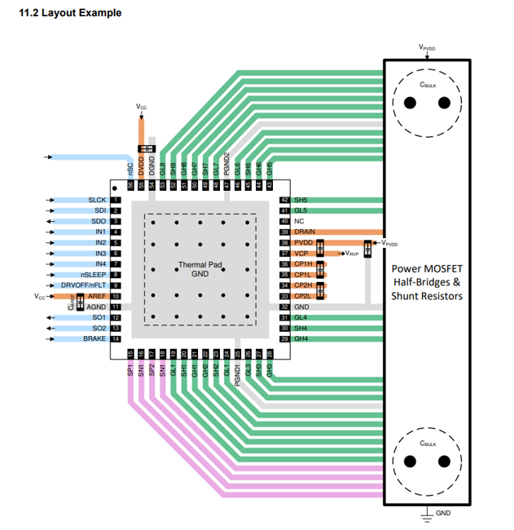
PGND1/PGND2/GND and decoupling in cap connection
1uF
PGND1 is source of low side gate drive for HB1/2.
PGND2 is for HB3/4.

